Slide 1
Temporal fossa
The temporal fossa is a shallow depression on the side of the skull bounded by the temporal lines and terminating below the level of the zygomatic arch.

Slide 2
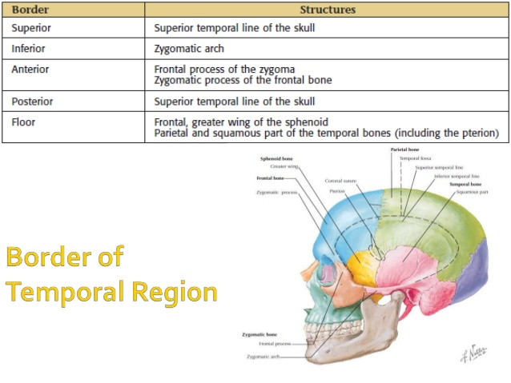

Slide 3
Contents:
Temporalis muscle
Deep temporal arteries
Superficial temporal artery (from external carotid)
Zygomaticotemporal nerve
Deep temporal nerves
Middle temporal artery

Slide 4
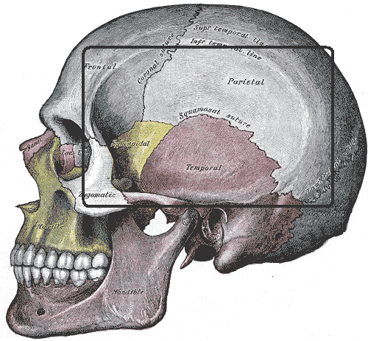

Slide 5
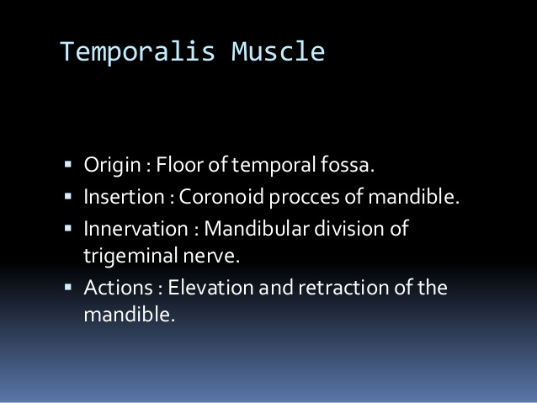
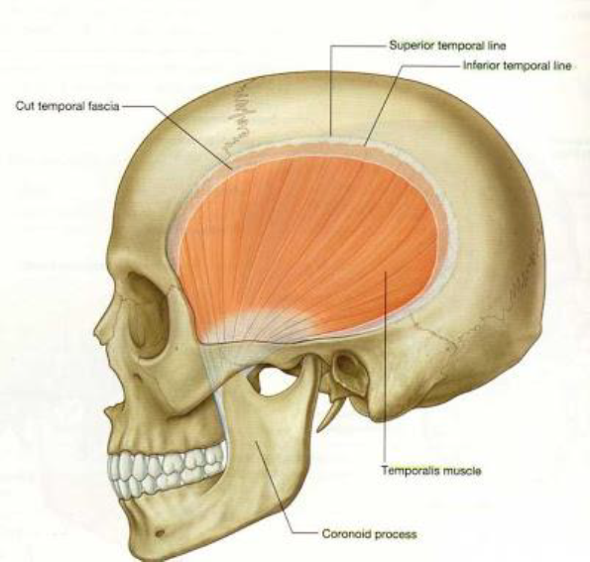

Slide 6
TEMPORAL FASCIA
•The temporal fascia covers the Temporal muscle.
• It is a strong, fibrous investment.
• Above: it is a single layer, attached to the entire extent of the superior temporal line.
• Below: it consists of two layers, one of which is attached to the lateral, and the other to the medial border of the zygomatic arch.

Slide 7
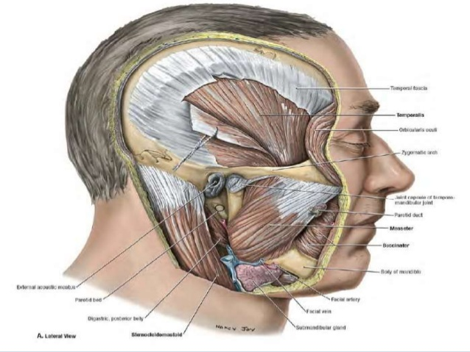

Slide 8
Contents:
Deep Temporal Nerves:
• Usually 2 in number; originates from the anterior branch of the mandibular nerve in the infratemporal fossa.
•Pass superiorly, around the infratemporal crest of the sphenoid bone, deep to the temporalis muscle to innervate it

Slide 9
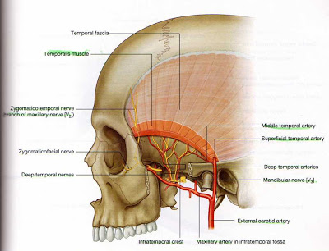
Zygomaticotemporal Nerve: Branch of the zygomatic nerve, a branch of the maxillary nerve.
Originates in the pterygopalatine fossa Penetrates temporal fascia to supply skin of the temple region.

Slide 10
Deep Temporal Arteries:
•Originate from the maxillary artery in the infratemporal fossa.
•Travel superiorly with the deep temporal nerves; Anastomoses with Middle temporal arteries.

Slide 11
Middle Temporal Artery:
•A branch of the superficial temporal artery.
• Penetrates under the temporal fascia and ascend deep to temporalis muscle; Supplies temporalis muscle and anastomoses with deep temporal arteries

Slide 12
INFRATEMPORAL FOSSA
The infratemporal fossa is wedge shaped cavity, situated inferior to the temporal fossa and between the ramus of mandible laterally and the wall of pharynx medially.

Slide 13
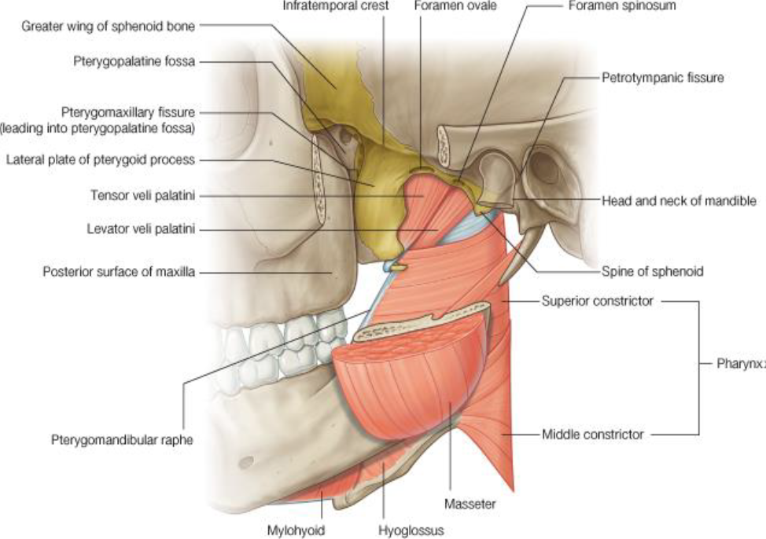
BOUNDRAIES
Anterior wall:
By part of the posterior surface of the maxilla.
Posteriorly:
By the articular tubercle of the temporal bone
and the spine of the sphenoid.
Superior wall:
By the greater wing of the sphenoid, below the infratemporal crest, and containing the foramen ovale and the foramen spinosum.
Medial wall:
Is formed anteriorly by the lateral plate of the pterygoid process and more posteriorly by the pharynx and two muscles of palate .

Slide 15
Lateral wall: By the ramus of mandible, which contains the mandibular foramen.
• Mandibular canal Through which the inferior alveolar nerve passes.
This also contains the lingula, which overlies the
mandibular foramen antero-medially.
• Mylohyoid groove descends obliquely
transmitting the mylohyoid nerve .

Slide 17
The following anatomical structures pass through the infratemporal fossa:
1.the temporalis muscle
2.the lateral pterygoid muscle
3.the medial pterygoid muscle
4.the maxillary artery
5.the pterygoid venous plexus
6.the mandibular nerve
7.the posterior superior alveolar nerve
8.the chorda tympani
9.the otic ganglion
10.the lesser petrosal nerve

Slide 18
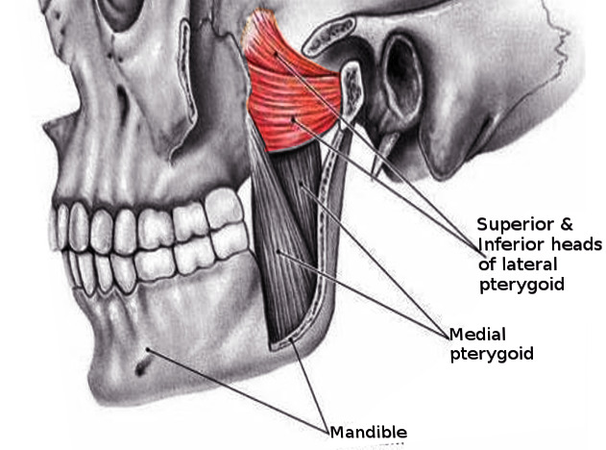
1-Muscles:
1) The lateral pterygoid or external pterygoid is a muscle of mastication with two heads. It lies superiorly to the medial pterygoid
Origin and insertion
The upper/superior head originates on the infratemporal surface and infratemporal crest of the greater wing of the sphenoid bone and inserts onto the articular disc and fibrous capsule of the temporomandibular joint.
The lower/inferior head originates on the lateral surface of the lateral pterygoid plate and inserts onto the neck of condyle process of the mandible;
innervation
The mandibular nerve, specifically the lateral pterygoid nerve, innervates the lateral pterygoid muscle.
Function
The primary function of the lateral pterygoid muscle is to pull the head of the condyle out of the mandibular fossa along the articular eminence to protrude the mandible. Opens the mouth

Slide 19
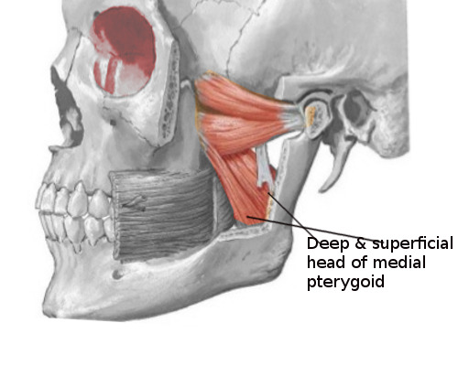
2) The medial pterygoid (or internal pterygoid muscle) is a thick, quadrilateral muscle of mastication.
It consists of two heads.
The bulk of the muscle arises as a deep head from the medial surface of the lateral pterygoid plate.
The smaller, superficial head originates from the maxillary tuberosity .
Its fibers pass downward, lateral, and posterior, and are inserted, into the lower and back part of the medial surface of the ramus and angle of the mandible.
Innervation
Medial pterygoid is innervated by nerve to medial pterygoid (a branch of the mandibular nerve).
Actions:
Elevation of the mandible (closes the jaw)
Minor contribution to protrusion of the mandible
Assistance in mastication

Slide 20
2- nerves
1) Mandibular nerve – a branch of the trigeminal nerve (CN V). It enters the fossa via the foramen ovale, giving rise to motor and sensory branches.
2) Chorda tympani – a branch of the facial nerve (CN VII). It follows the anatomical course of the lingual nerve and provides taste innervation to the anterior 2/3 of the tongue.
3) Otic ganglion – a parasympathetic fibres
leaving this gangolion to reach the parotid gland.

Slide 21
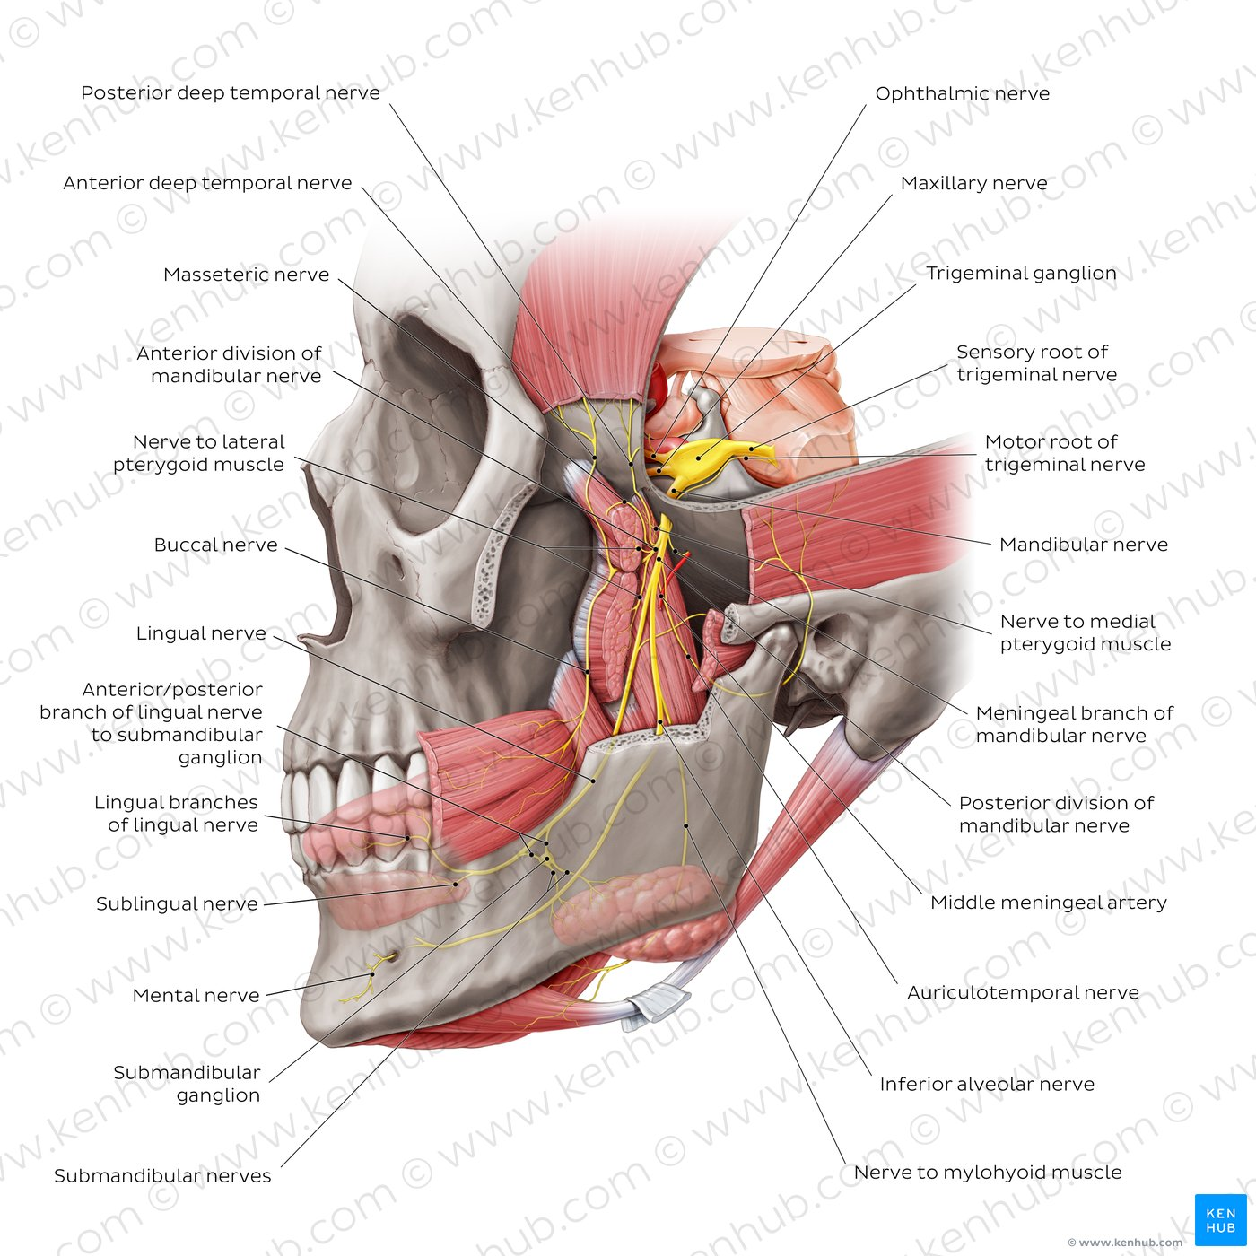

Slide 22
3-MAXILLARY ARTERY
The maxillary artery originates within the parotid gland and travels anteriorly toward where it is between the neck of the mandible and sphenomandibular ligament at which point the artery is now in the infratemporal fossa and usually lateral to the lateral pterygoid muscle and is divided into three parts based on its relation to the lateral pterygoid muscle.
•1st (mandibular) Deep to the condyle of mandible
•2nd (pterygoid) Neighborhood of lateral pterygoid muscle
•3rd (pterygopalatine)
Inside the infratemporal fossa
(extends into the pterygopalatine fossa)

Slide 23
BRANCHES OF MAXILLARY ARTERY within infratemporal fossa
•Internal maxillary branches found within the infratemporal fossa including the:
1. Middle meningeal artery
2. Inferior alveolar artery
3. Deep temporal artery
4. Buccal artery

Slide 24
4.PTERYGOID PLEXUS
•The pterygoid plexus is a network of veins between medial and lateral pterygoid muscles
•Tributaries are those veins which accompany branches of maxillary artery.
•Plexus is drain by maxillary vein.

Slide 25
5. CHORDA TAMPANI
• A branch of facial nerve carrying taste fibers from the anterior two thirds of the tongue.
•Joins the lingual nerve in the infratemporal fossa.

