Slide 1
Pterygopalatine fossa

Slide 2
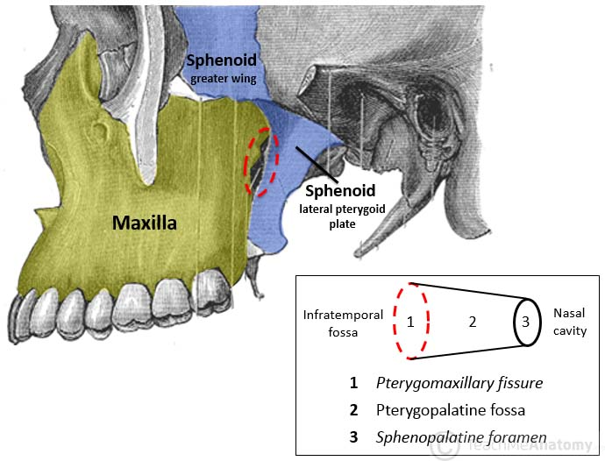
The pterygopalatine fossa is an inverted pyramidal-shaped, fat-filled space located on the lateral side of the skull, between the infratemporal fossa and the nasopharynx.
It is located between the maxilla, sphenoid and palatine bones, and communicates with other regions of the skull and facial skeleton via several canals and foramina

Slide 3
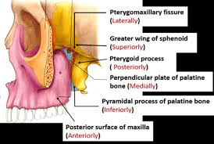
Borders
The borders of the pterygopalatine fossa are formed by the palatine, maxilla and sphenoid bones:
Anterior: Posterior wall of the maxillary sinus.
Posterior: Pterygoid process of the sphenoid bone.
Inferior: Palatine bone and palatine canals.
Superior: Inferior orbital fissure of the eye.
Medial: Perpendicular plate of the palatine bone
Lateral: Pterygomaxillary fissure

Slide 4
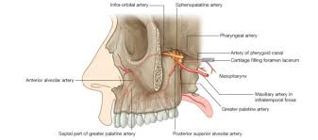
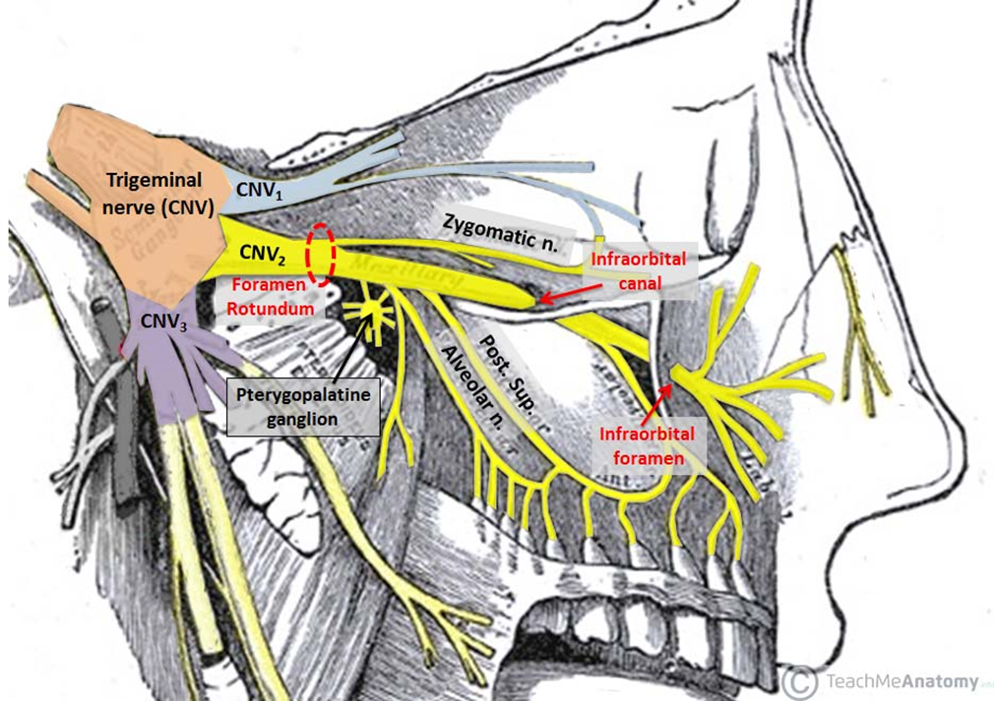
contents
The pterygopalatine fossa houses many important neurovascular structures. Among these are the:
maxillary nerve [V2]
pterygopalatine ganglion
terminal part of the maxillary artery
veins, as well as their associated branches.

Slide 5
Maxillary Nerve
The maxillary nerve is the second branch of the trigeminal nerve (CNV₂). It passes from the middle cranial fossa into the pterygopalatine fossa through the foramen rotundum.It is mainly sensory.
The main trunk of the maxillary nerve leaves the pterygopalatine fossa via the infraorbital fissure. Here, it enters the infraorbital canal of the maxilla and exits below the orbit in the infraorbital foramen to contribute to the sensory innervation of the face

Slide 6

Branches of maxillary n.in the pterygopalatine fossa
1. zygomatic nerve.
2. posterior superior alveolar nerve.
3. two ganglionic branches to pterygopalatine ganglion

Slide 7
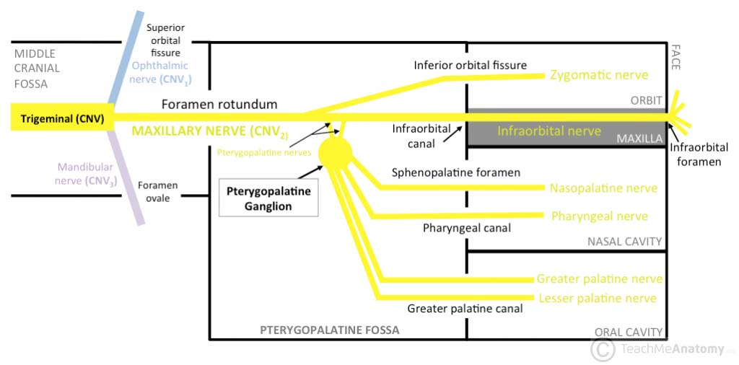

Slide 8
Pterygopalatine Ganglion
The pterygopalatine ganglion sits deep within the pterygopalatine fossa near the sphenopalatine foramen. It is the largest parasympathetic ganglion is predominantly innervated by the greater petrosal branch of the facial nerve (CNVII). Postsynaptic parasympathetic fibres leave the ganglion and distribute with branches of the maxillary nerve (CNV₂). These fibres are secretomotor in function, and provide parasympathetic innervation to the lacrimal gland, and muscosal glands of the oral cavity, nose and pharynx.

Slide 9
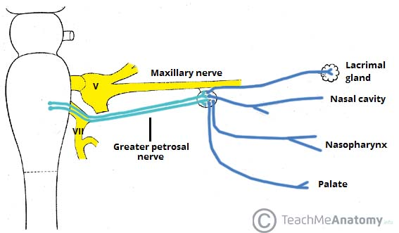
Pterygopalatine ganglion

Slide 10
Maxillary Artery
The maxillary artery is a terminal branch of the external carotid artery. The terminal portion of the maxillary artery lies within the pterygopalatine fossa. Here, it separates into several branches which travel through other openings within the fossa to reach the regions they supply.
These branches include:
1. Sphenopalatine artery (to the nasal cavity).
2. Descending palatine artery – branches into greater and lesser palatine arteries (hard and soft palates).
3. Infraorbital artery (lacrimal gland, and some muscles of the eye).
4. Posterior superior alveolar artery (to the teeth and gingiva).

Slide 11
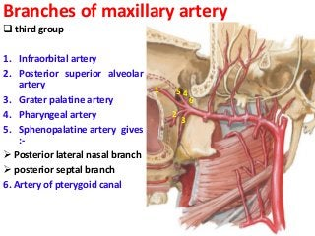

Slide 12
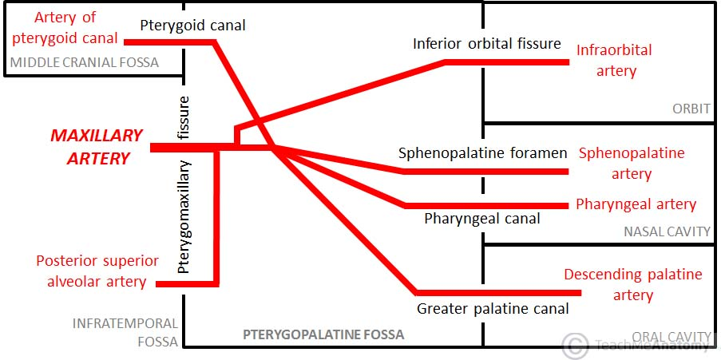

Slide 13
