Slide 1
orbit

Slide 2
Eyelids
The eyelids protect the eye from injury and excessive light by their closure
The upper eyelid is larger and more mobile than the lower, and they meet each other at the medial and lateral angles.
The palpebral fissure is the elliptical opening between the eyelids and is the entrance into the conjunctival sac.
The superficial surface of the eyelids is covered by skin, and the deep surface is covered by a mucous membrane called the conjunctiva.

Slide 3
Eyelashes
short, curved hairs on the free edges of the eyelids .
They are arranged in double or triple rows at the mucocutaneous junction.
The sebaceous glands (glands of Zeis) open directly into the eyelash follicles.
The ciliary glands (glands of Moll) are modified sweat glands that open separately between adjacent lashes.
The tarsal glands (Meibomian glands) are long, modified sebaceous glands that pour their oily secretion onto the margin of the lid; their openings lie behind the eyelashes.This oily material prevents the overflow of tears and helps make the closed eyelids airtight

Slide 4
Near the medial angle of the eye a small elevation, the papilla lacrimalis, which leads into the canaliculus lacrimalis .The punctum and canaliculus carry tears down into the nose.
Conjunctiva:
A thin mucous membrane that lines the eyelids and is reflected at the superior and inferior fornices onto the anterior surface of the eyeball. Thus forms a potential space, the conjunctival sac, which is open at the palpebral fissure.

Slide 5
the subtarsal sulcus, is a groove beneath the eyelid which tends to trap small foreign particles introduced into the conjunctival sac and is thus clinically important.
The framework of the eyelids is formed by a fibrous sheet, the orbital septum, which thickened at the margins of the lids to form the superior and inferior tarsal plates. The lateral ends of the plates are attached by the lateral palpebral ligament to a bony tubercle just within the orbital margin. The medial ends of the plates are attached by the medial palpebral ligament to the crest of the lacrimal bone.

Slide 6
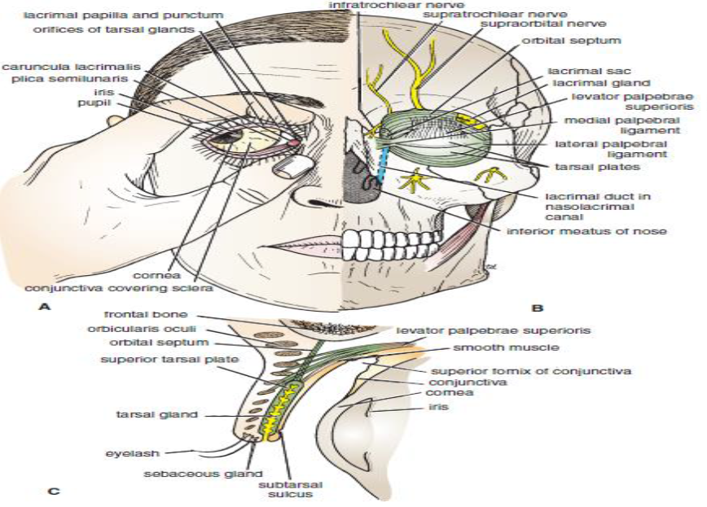

Slide 7
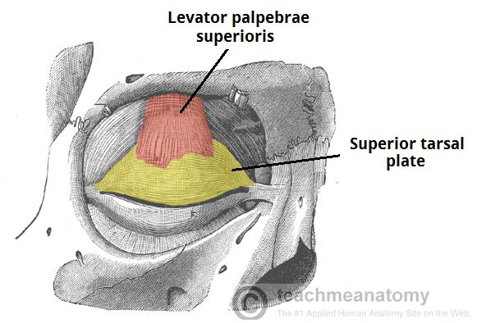
Movements of the Eyelids
The levator palpebrae superioris originates from inferior surface of the lesser wing of the sphenoid bone, just above the optic foramen, inserts on the skin of the upper eyelid, as well as the superior tarsal plate. Action : elevates the upper eyelid.
The eyelids are closed by the contraction of the orbicularis oculi and the relaxation of the levator palpebrae superioris muscles.
The eye is opened by the levator palpebrae superioris raising the upper lid.
On looking upward, the levator palpebrae superioris contracts, and the upper lid moves with the eyeball. On looking downward, both lids move, the upper lid continues to cover the upper part of the cornea, and the lower lid is pulled downward slightly by the conjunctiva, which is attached to the sclera and the lower lid.

Slide 8
TABLE 1: Muscles of the eyeball and eyelids.

Slide 9
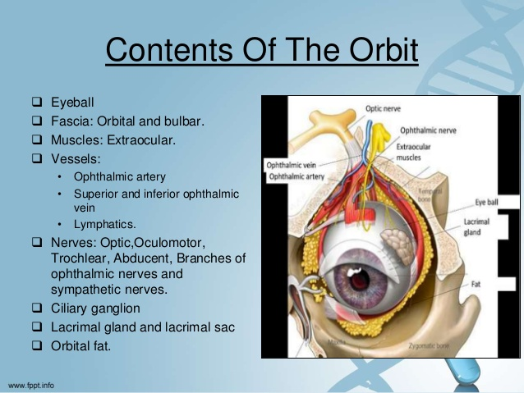

Slide 10
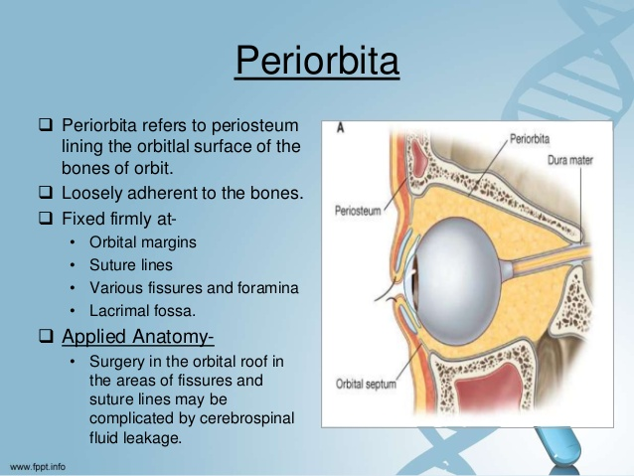

Slide 11
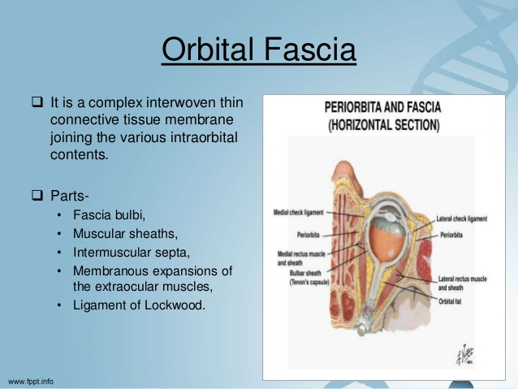
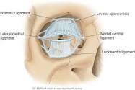

Slide 12
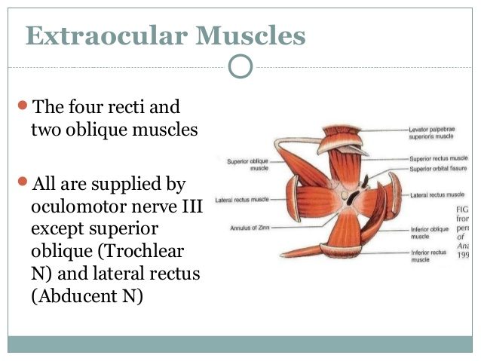
medial
LR6(SO4)3

Slide 13
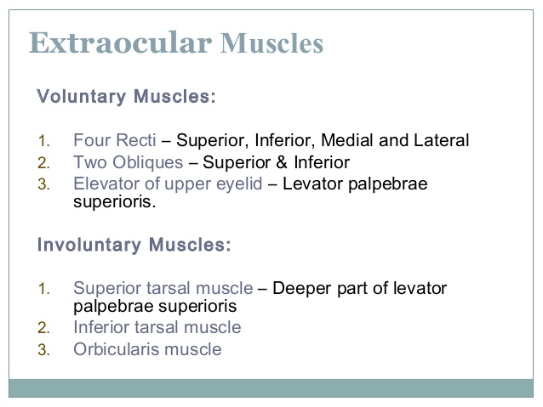

Slide 14
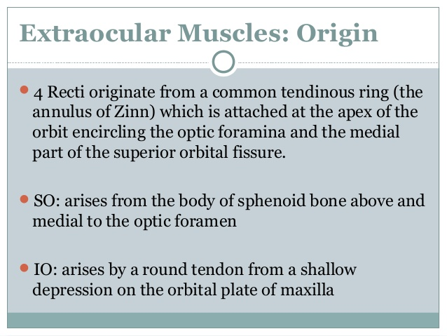
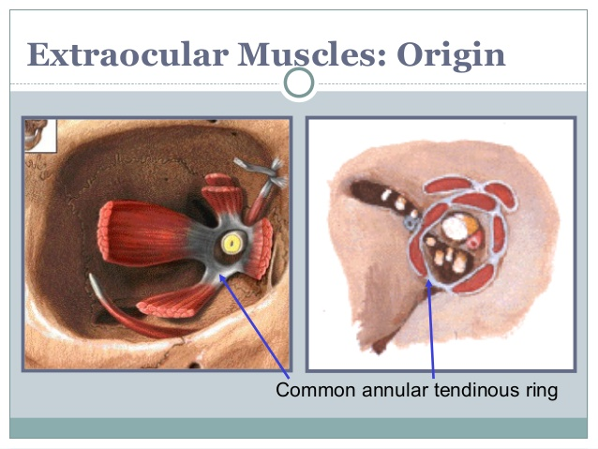

Slide 15
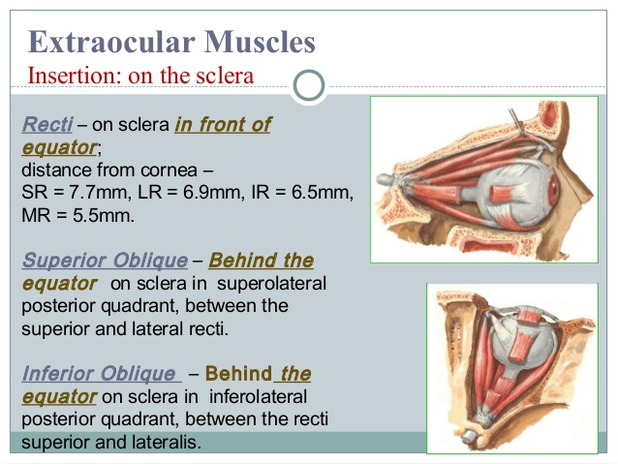
inferior

Slide 16
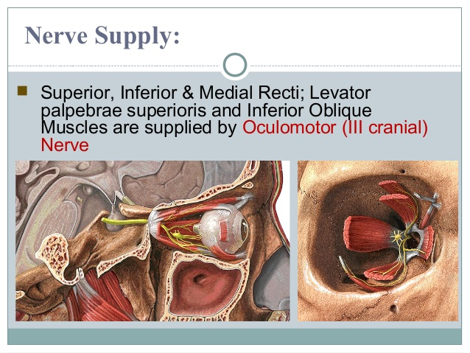

Slide 17
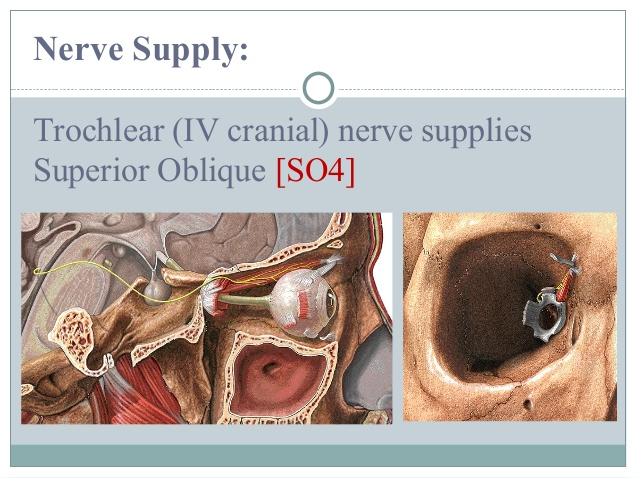
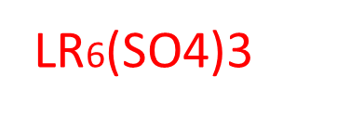

Slide 18
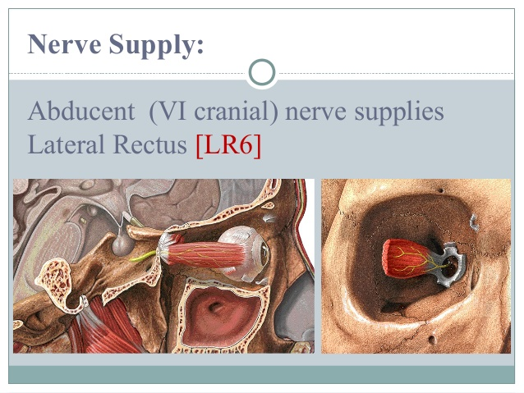

Slide 19
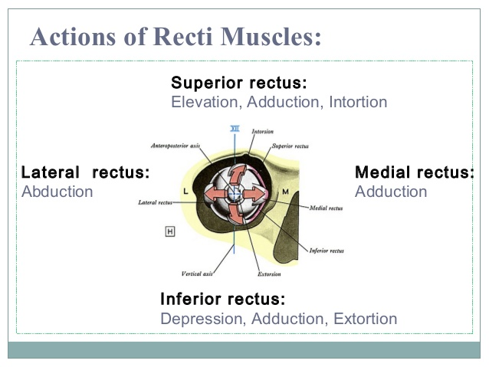

Slide 20
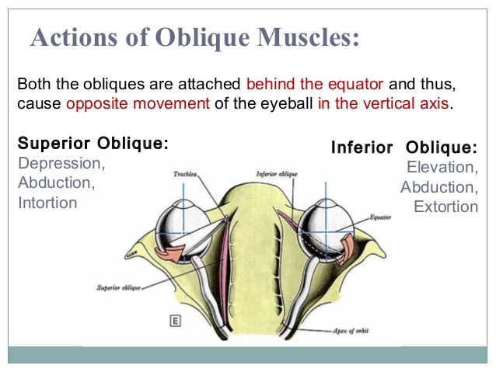
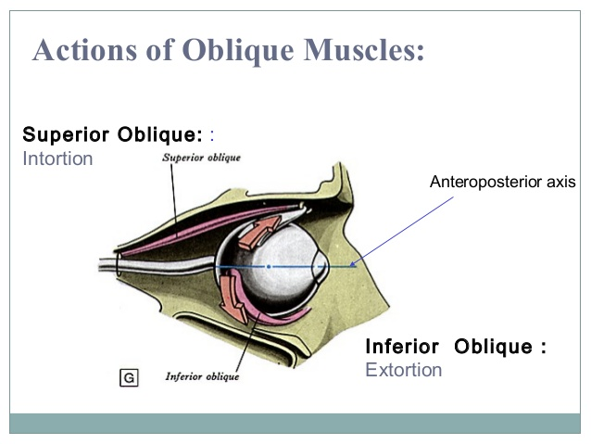

Slide 21
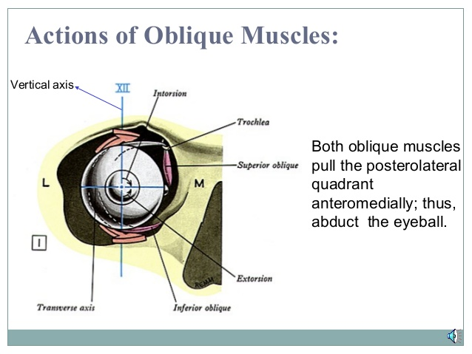

Slide 22
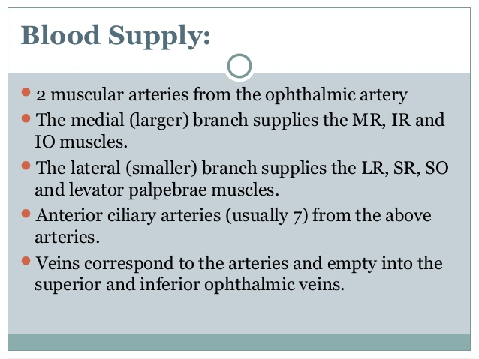

Slide 23
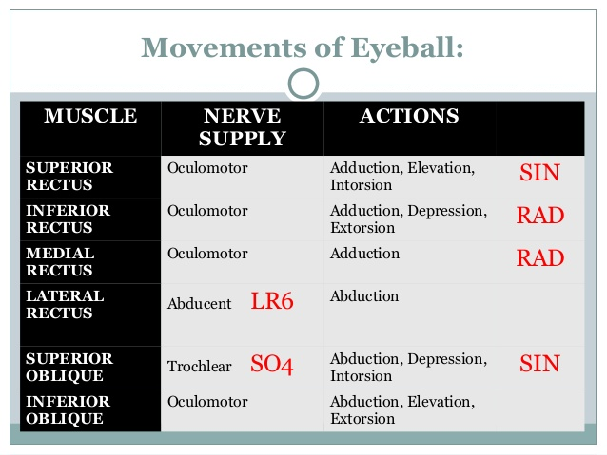

Slide 24
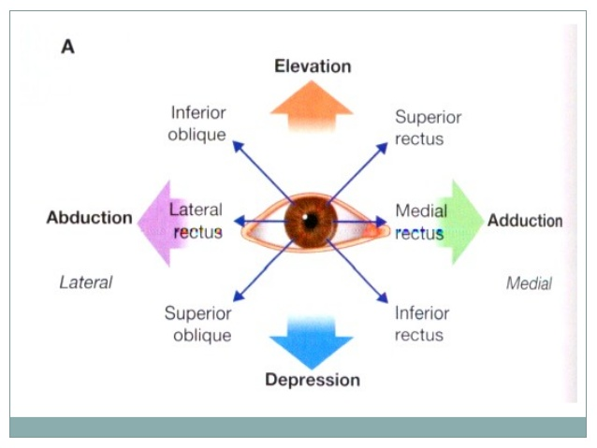

Slide 25
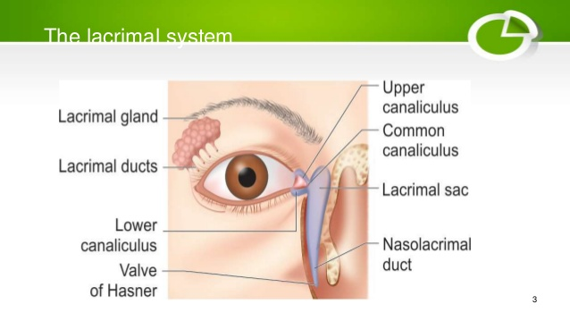

Slide 26
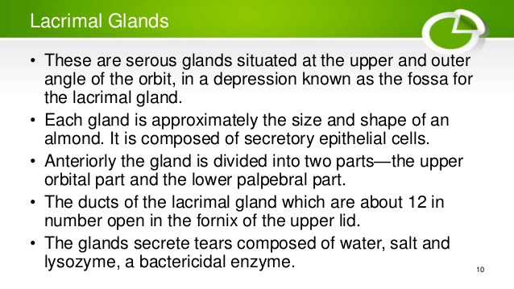

Slide 27
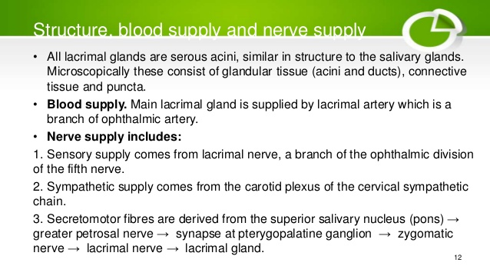

Slide 28


