Slide 1
Mandibular nerve
The mandibular nerve (V₃) is the largest of the three divisions of the trigeminal nerve, the fifth cranial nerve (CN V).

Slide 2
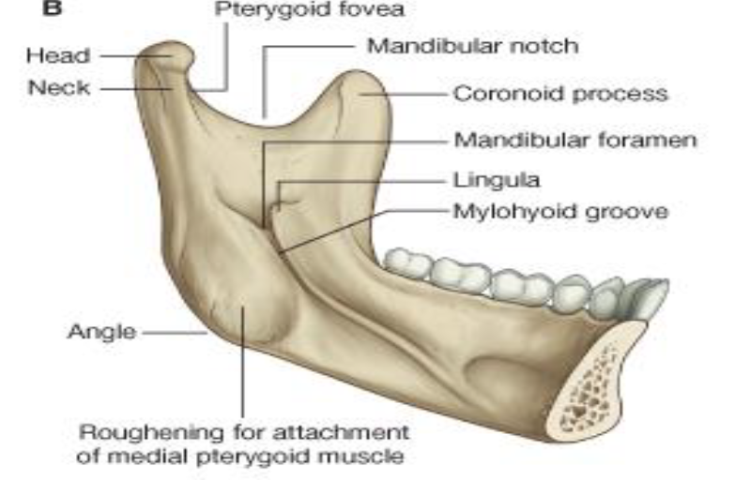

Slide 3
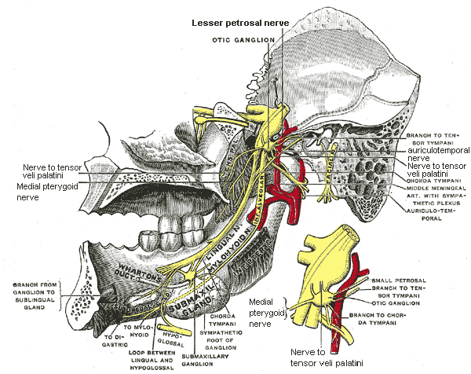
The large sensory root emerges from the lateral part of the trigeminal ganglion and exits the cranial cavity through the foramen ovale. The small motor root of the trigeminal nerve, passes under the trigeminal ganglion and through the foramen ovale to unite with the sensory root just outside the skull.
The mandibular nerve immediately passes between tensor veli palatini, which is medial, and lateral pterygoid, which is lateral, and gives off a meningeal branch (nervus spinosus) and the nerve to medial pterygoid from its medial side. The nerve then divides into a small anterior and large posterior trunk.

Slide 4
The anterior division gives off branches to three major muscles of mastication and a buccal branch which is sensory to the cheek.
The posterior division gives off three main sensory branches, the auriculotemporal, lingual and inferior alveolar nerves and two motor fibres to supply mylohyoid and the anterior belly of the digastric muscle.

Slide 5
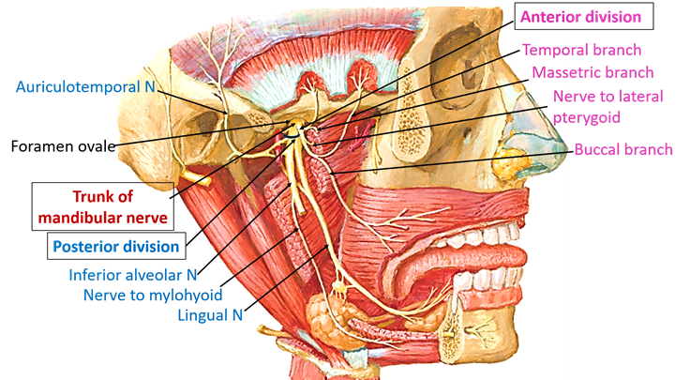
Branches
From the main trunk of the nerve (before the division)
muscular branches for the
1- medial pterygoid muscle (motor )
2- tensor tympani muscle (motor )
3- tensor veli palatini muscle (motor )
4- meningeal branch (a sensory nerve)
From the anterior division
masseteric nerve (motor)
deep temporal nerves, anterior and posterior (motor)
buccal nerve (a sensory nerve)
lateral pterygoid nerve (motor)
From the posterior division
auriculotemporal nerve (a sensory nerve)
lingual nerve (a sensory nerve)
inferior alveolar nerve (which gives off a motor nerve and a sensory nerve)
mental nerve (sensory branch) and the nerve to mylohyoid (motor branch) and anterior belly of digastric m

Slide 6
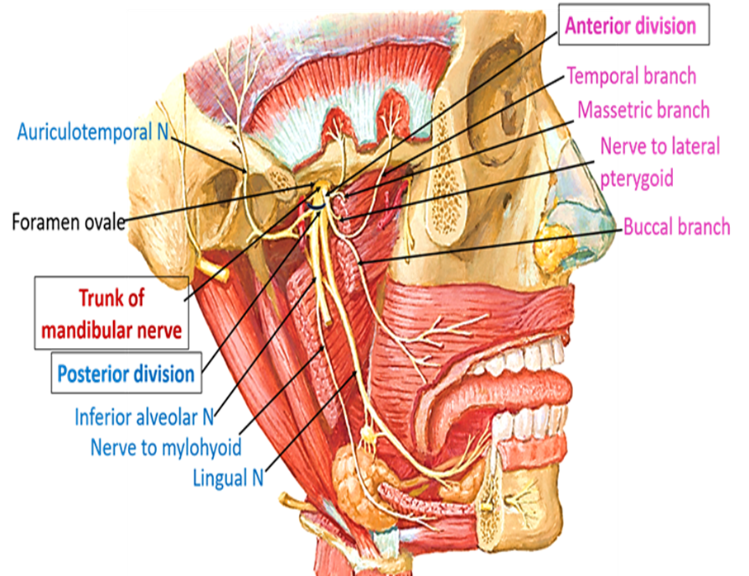
Supplies
Anterior Division:
(Motor Innervation - Muscles of mastication)
Masseteric nerve
Masseter
Lateral pterygoid nerve
Lateral pterygoid
Deep temporal nerve
Temporalis
(Sensory Innervation)
Buccal nerve
Inside of the Cheek (buccal mucosa)

Slide 7

Posterior Division
Lingual Split (Sensory Innervation - NOT Taste)
Anterior 2/3 of Tongue (mucous membrane)
Inferior Alveolar Split (Motor Innervation)
Mylohyoid
Digastric (Anterior Belly)
(Sensory Innervation)
Teeth and Mucoperiosteum of mandibular teeth
Chin and Lower Lip
Auriculotemporal Split
Scalp (auricula / temporal region)

Slide 8
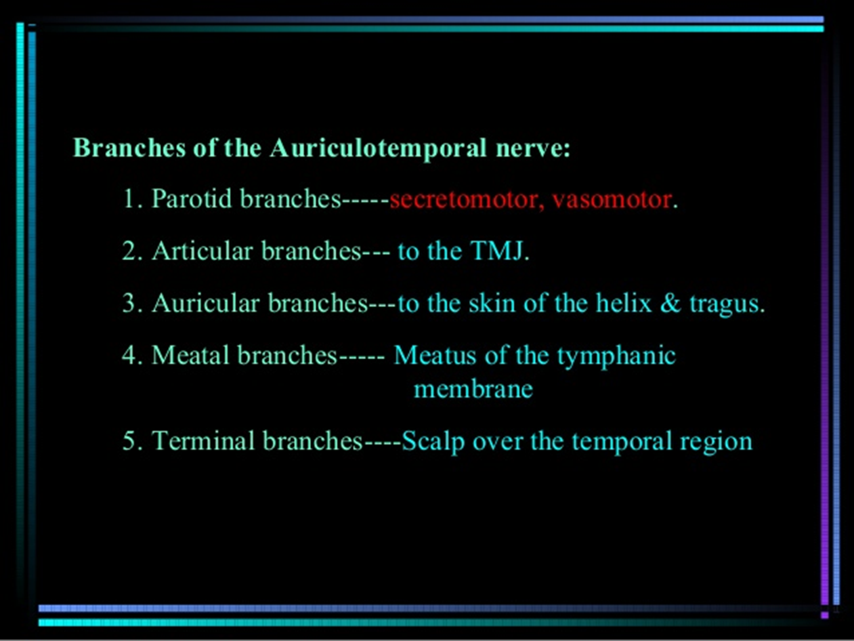
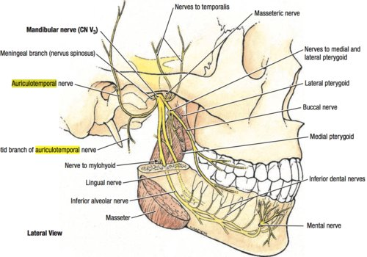

Slide 9
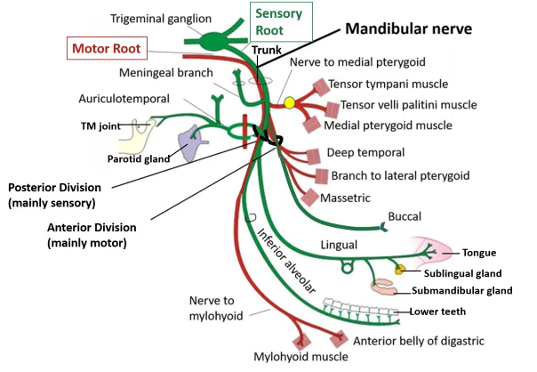

Slide 10
Lingual n.
The lingual nerve carries sensory innervation from the anterior two-thirds of the tongue.
It contains fibers from both the mandibular division of the trigeminal nerve (CN V₃ ) and from the facial nerve (CN VII). The fibers from the trigeminal nerve are for touch, pain and temperature (general sensation), and the ones from the facial nerve are for taste (special sensation).
The nerve then passes between the medial pterygoid muscle and the ramus of the mandible, and crosses obliquely to the side of the tongue lying immediately beneath the mucous membrane.
The most common cause of lingual nerve injuries is third molar (wisdom tooth) surgery, less commonly the lingual nerve can be injured by local anesthetic dental injections (particularly inferior dental block injections) and sublingual or submandibular surgery.

Slide 11
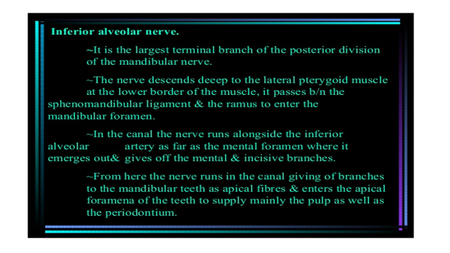

Slide 12
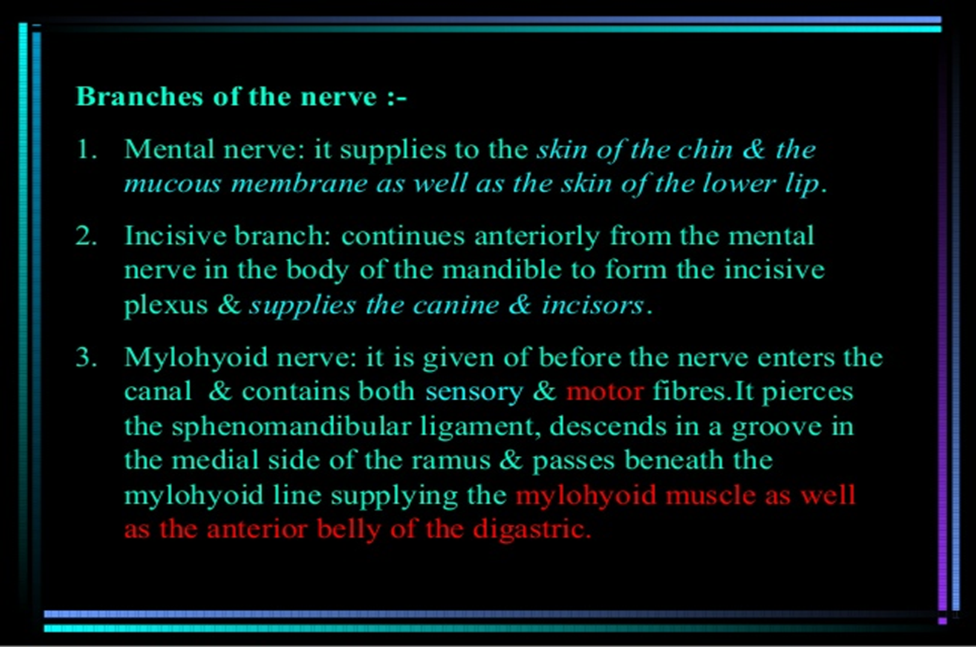

Slide 13
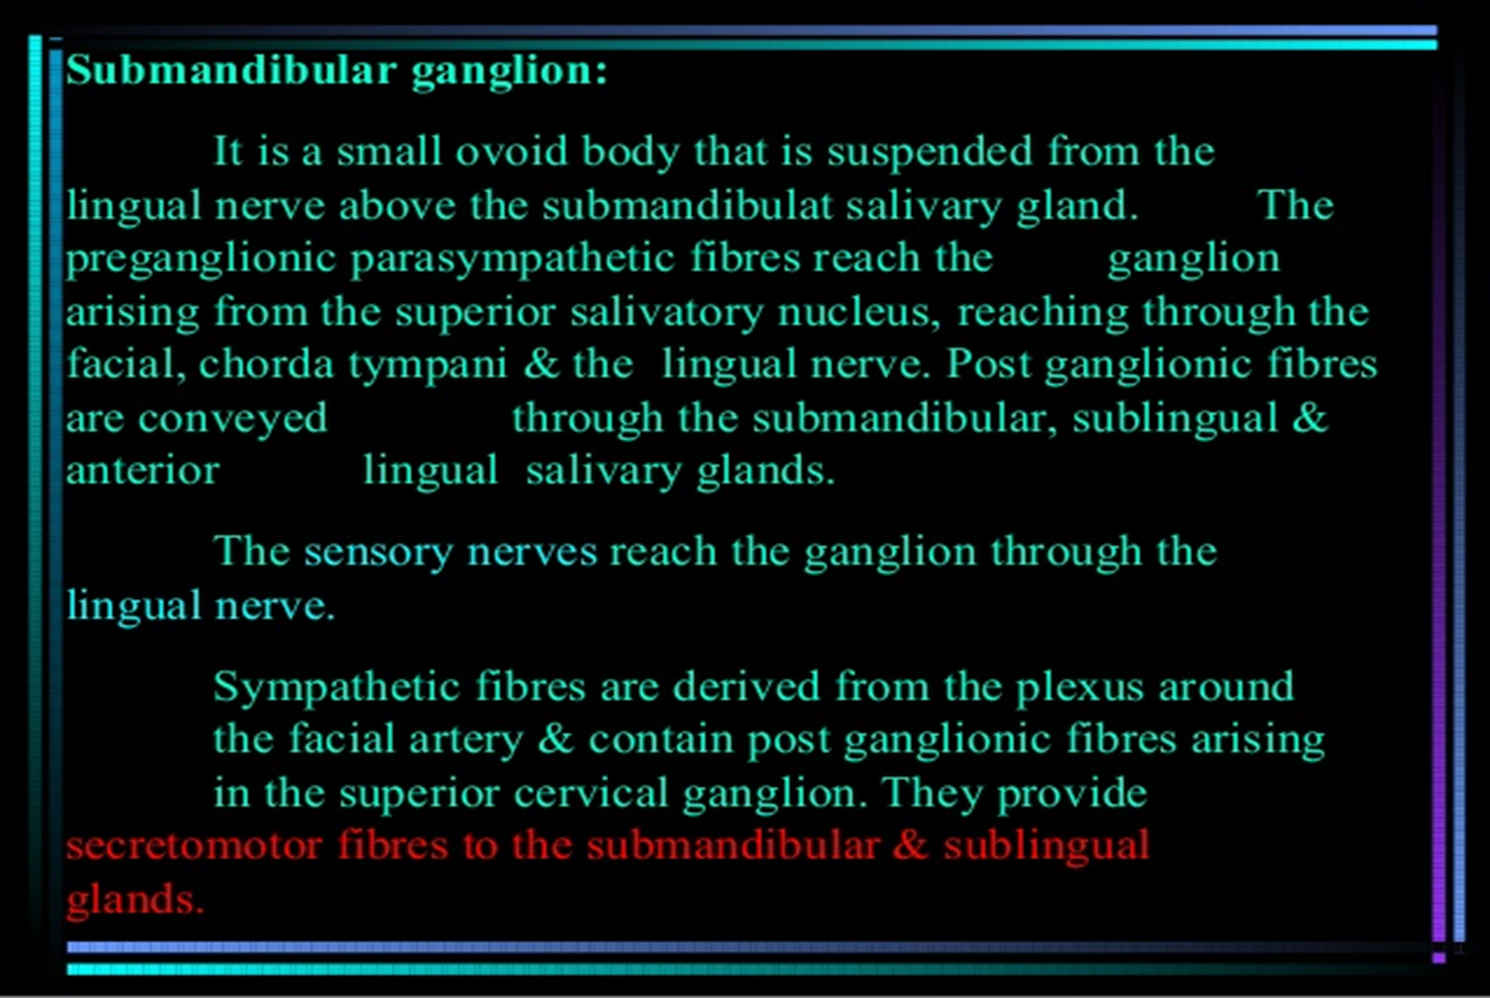

Slide 14
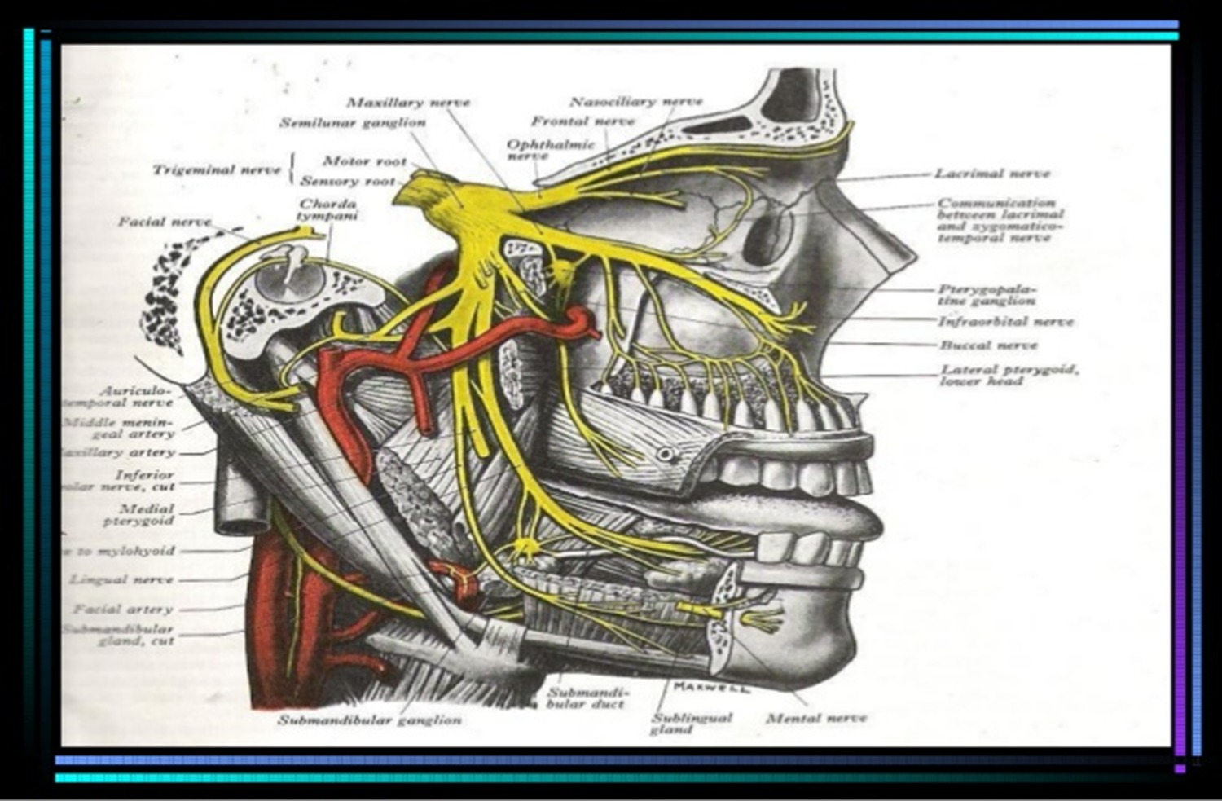

Slide 15
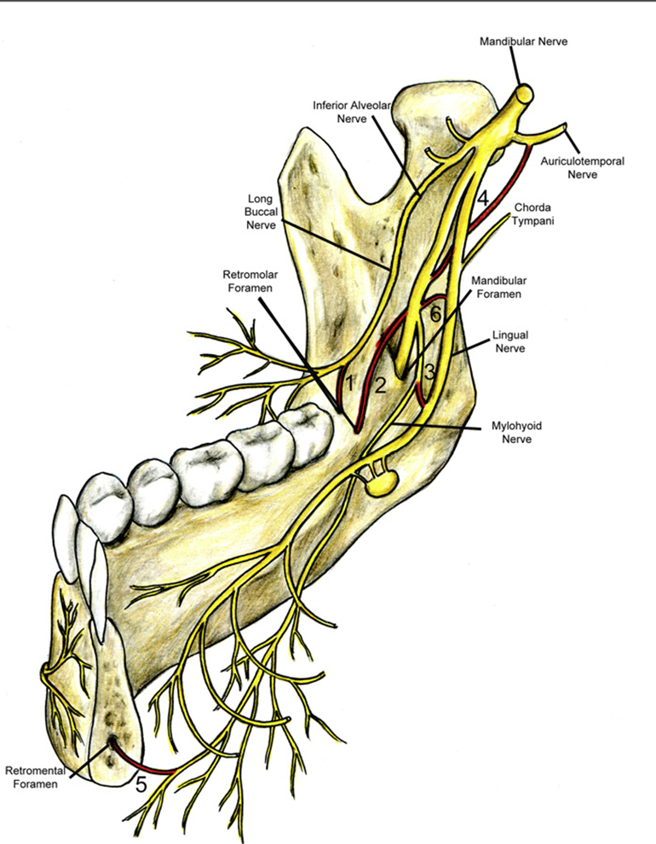

Slide 16
