Slide 1
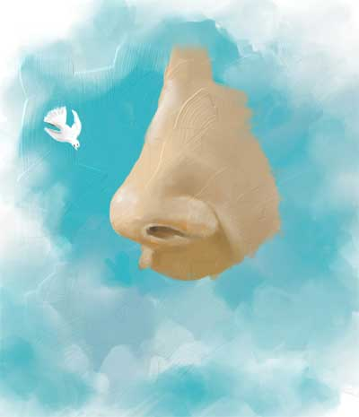
Anatomy of Nose and Paranasal Sinus

Slide 2
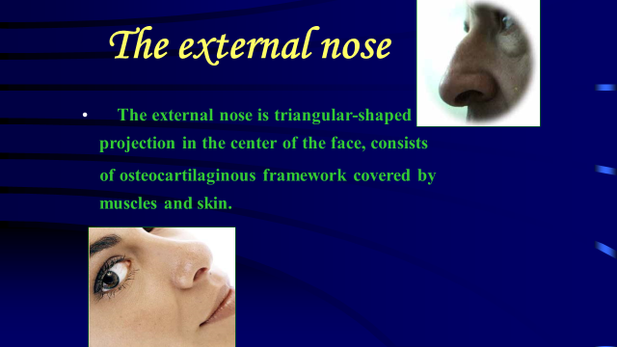

Slide 3
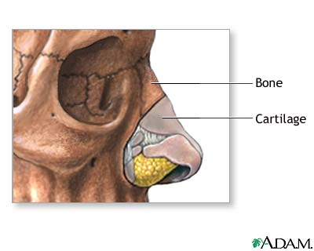
The Nose
The nose consists of the external nose and the nasal cavity,
Both are divided by a septum into right and left halves.

Slide 4
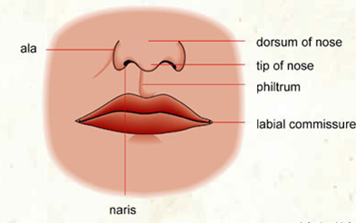
External Nose
The external nose has two elliptical orifices called the naris (nostrils), which are separated from each other by the nasal septum.
The lateral margin, the ala nasi, is rounded and mobile.

Slide 5
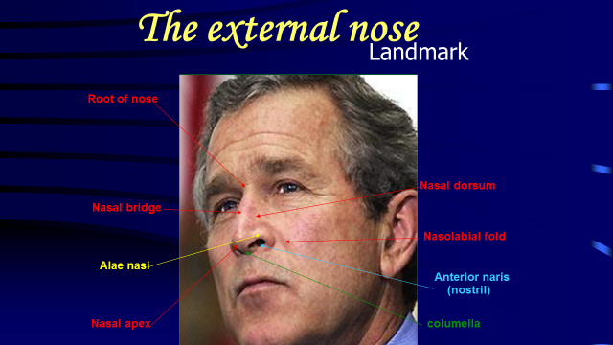

Slide 6
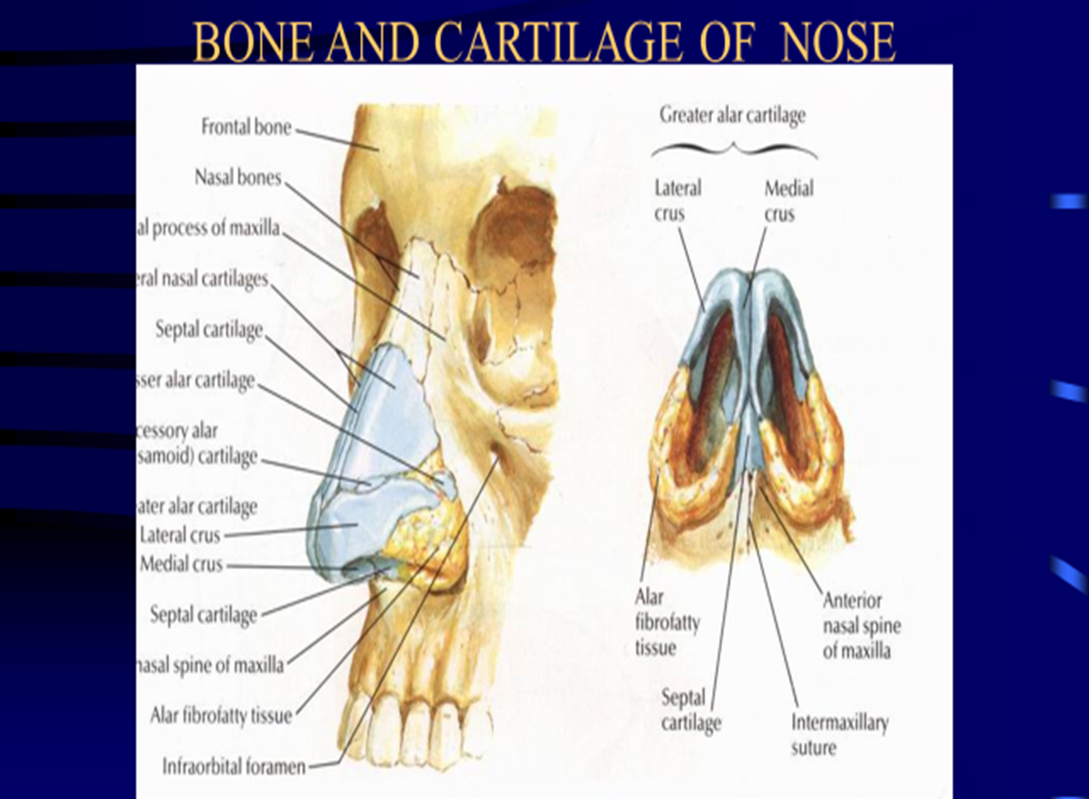
The framework of the external nose is made up above by the nasal bones, the frontal processes of the maxillae, and the nasal part of the frontal bone. Below, the framework is formed of plates of hyaline cartilage

Slide 7
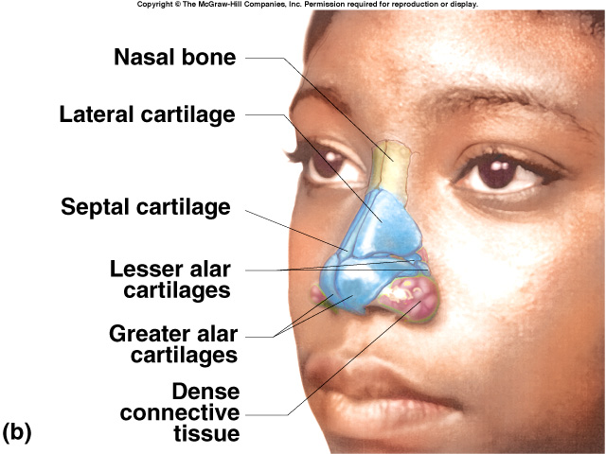
External Nose

Slide 8
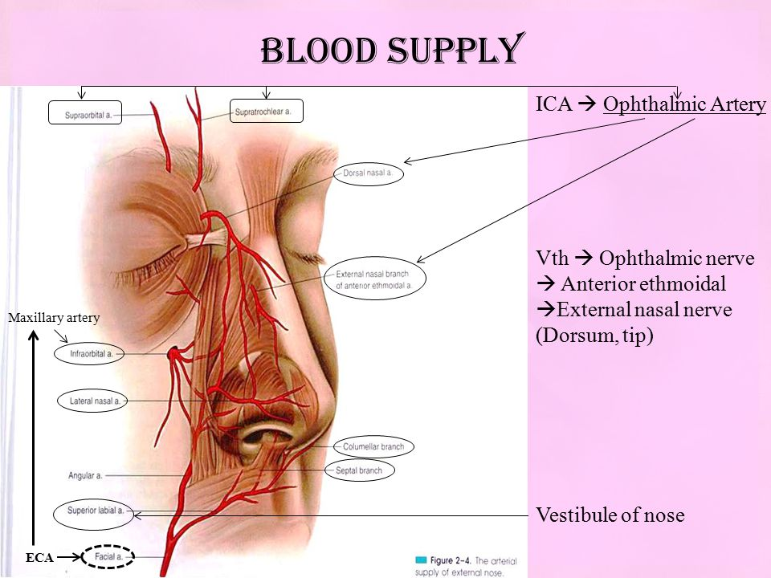
Blood Supply of the External Nose
The skin of the external nose is supplied by branches of the ophthalmic and the maxillary arteries.
The skin of the ala and the lower part of the septum are supplied by branches from the facial artery.

Slide 9
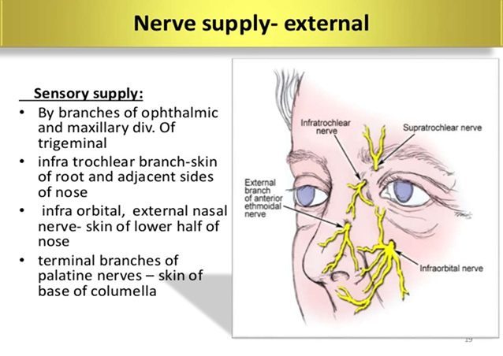

Slide 10
Nasal Cavity
The nasal cavity extends from the nostrils in front to the posterior nasal apertures or choanae behind, where the nose opens into the nasopharynx.
Mucous Membrane of the Nasal Cavity
The vestibule is lined with modified skin and has coarse hairs.
The area above the superior concha is lined with olfactory mucous membrane and contains nerve endings sensitive to the reception of smell.
The lower part of the nasal cavity is lined with respiratory mucous membrane.
The presence of warm blood in the venous plexuses serves to heat up the inspired air as it enters the respiratory system.

Slide 11
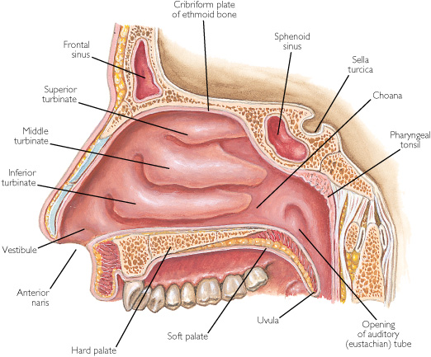
Nasal Cavity
The nasal cavity has
a floor,
a roof,
a lateral wall,
a medial or septal wall.

Slide 12
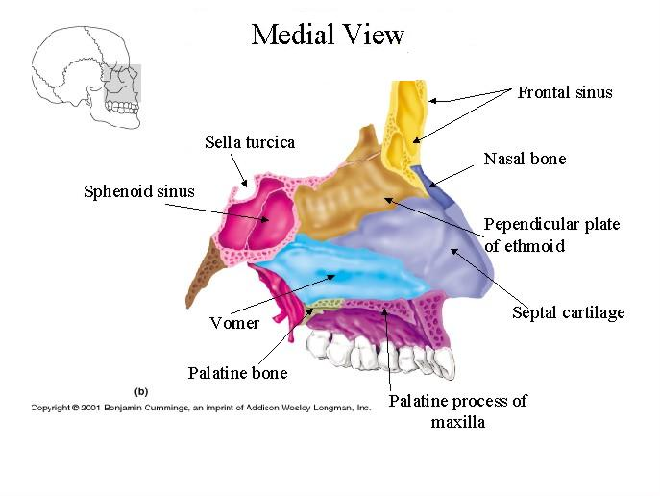
The Floor of Nasal Cavity
Palatine process maxilla
Horizontal plate palatine bone

Slide 13
The Roof of Nasal Cavity
Narrow
It is formed
anteriorly beneath the bridge of the nose by the nasal and frontal bones,
in the middle by the cribriform plate of the ethmoid,
posteriorly by the downward sloping body of the sphenoid

Slide 14
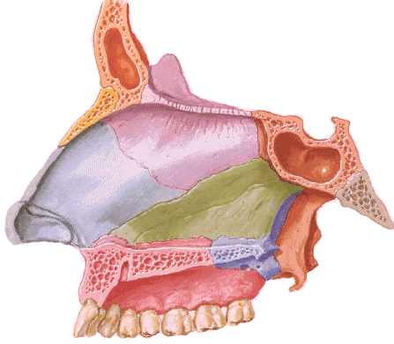
The Medial Wall of Nasal Cavity
The Nasal Septum
Divides the nasal cavity into right and left halves
Nasal septum consists of the perpendicular plate of the ethmoid bone (superior), the vomer (inferior) and septial cartilage (anterior)
Perpendicular Plate (ethmoid)
Septal Cartilage
Vomer

Slide 15
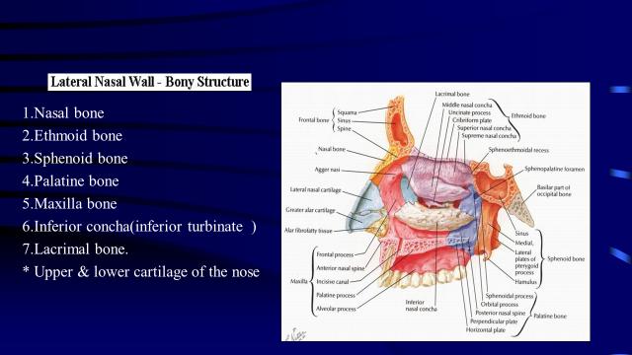

Slide 16
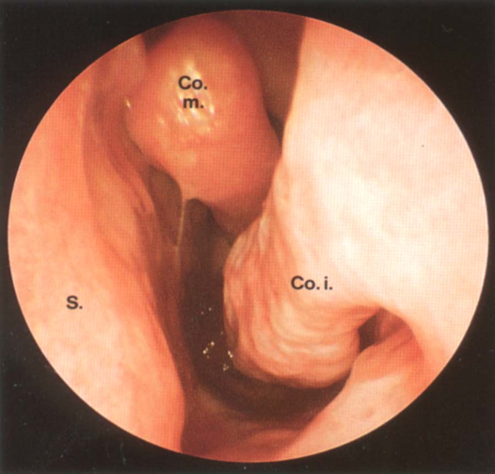
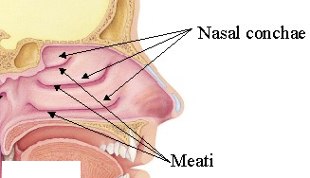
The Lateral Walls of Nasal Cavity
Marked by 3 projections:
Superior concha
Middle concha
Inferior concha
The space below each concha is called a meatus.

Slide 17
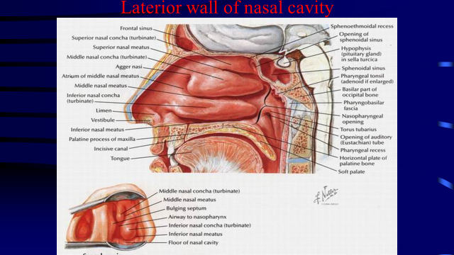

Slide 18
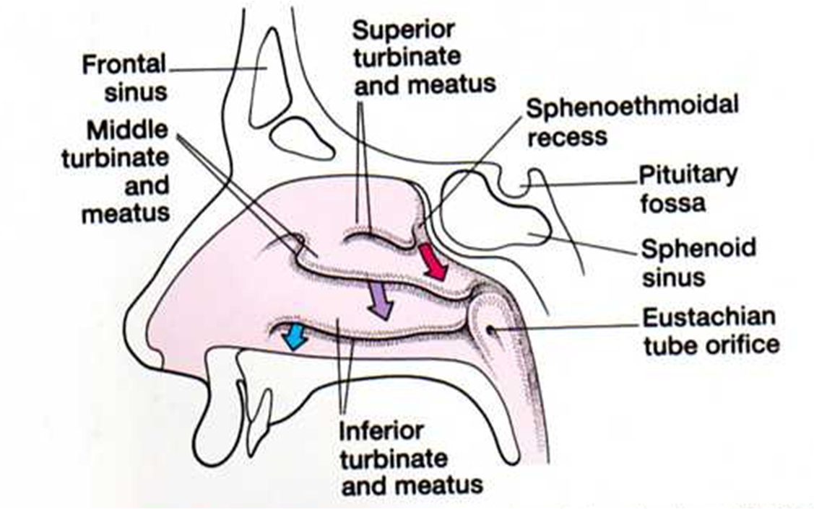
The Lateral Walls of Nasal Cavity
Inferior meatus: nasolacrimal duct
Middle meatus:
Maxillary sinus
Frontal sinus
Anterior ethmoid sinuses
Superior meatus: posterior ethmoid sinuses
Sphenoethmoidal recess: sphenoid sinus

Slide 19
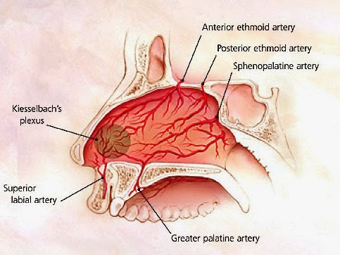
Blood supply of the septum

Slide 20
Blood supply of nasal cavity
The arterial supply of the medial and lateral walls of the nasal cavity can be summarized as follow
1. Anterior ethmoidal artery (a branch from the ophthalmic artery).
2. Posterior ethmoidal artery (a branch from the ophthalmic artery).
3. Sphenopalatine artery (a branch from the maxillary artery).
4. Greater palatine artery (a branch from the maxillary artery).
5. Septal branch of the superior labial artery (a branch from the facial artery).
The anterior part of the nasal septum is the site (Kiesselbach area) of an anastomotic arterial plexus involving all five arteries supplying the septum

Slide 21
Venous Drainage of the Nasal Cavity
A rich submucosal venous plexus, deep to the nasal mucosa, provides venous drainage of the nose via the sphenopalatine, facial, and ophthalmic veins. The plexus is an important part of the body’s thermoregulatory system, exchanging heat and warming air before it enters the lungs.

Slide 22
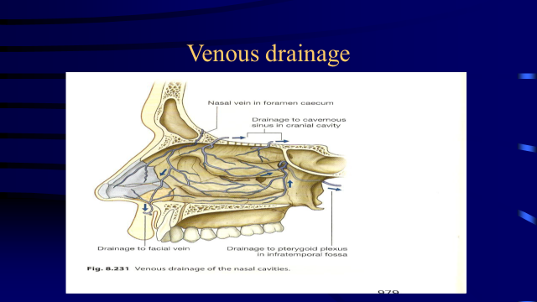

Slide 23
Nerve Supply of the Nasal Cavity
The olfactory nerves from the olfactory mucous membrane ascend through the cribriform plate of the ethmoid bone to the olfactory bulbs (olfaction)
The nerves of ordinary sensation are branches of the ophthalmic division (V1) and the maxillary division (V2) of the trigeminal nerve.

Slide 24
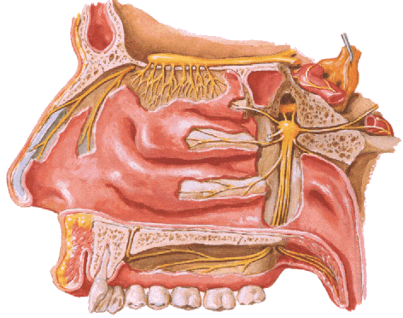
Nerve Supply of the Nasal Cavity
CN I – Olfactory Nerves (SVA)
Anterior ethmoidal branch of V₁
Posterior nasal branches of V₂
Cut nasopalatine branch of V₂ to septum

Slide 25
Lymph Drainage of the Nasal Cavity
The lymph vessels draining the vestibule end in the submandibular nodes.
The remainder of the nasal cavity is drained by vessels that pass to the upper deep cervical nodes.

Slide 26
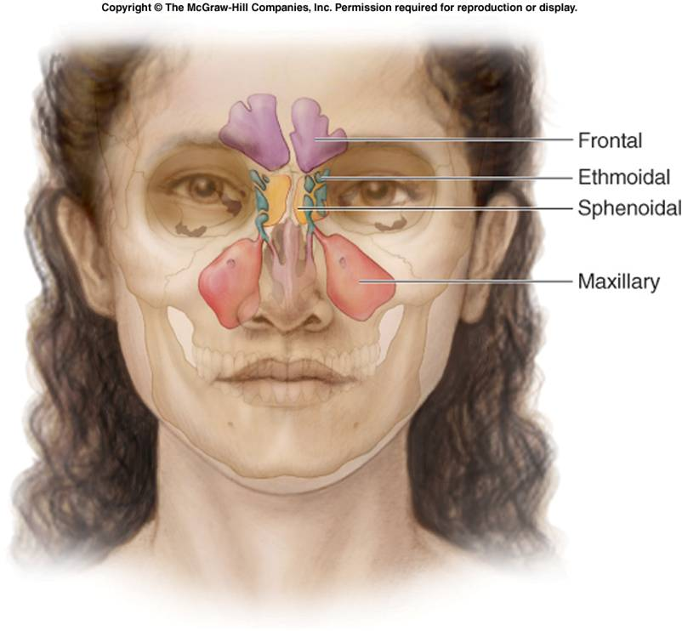
The Paranasal Sinuses

Slide 27
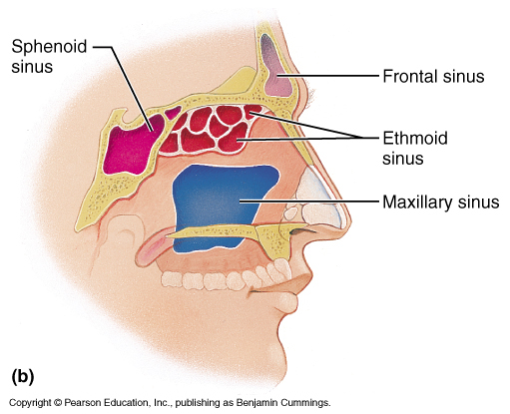
The Paranasal Sinuses
The paranasal sinuses are cavities found in the interior of the maxilla, frontal, sphenoid, and ethmoid bones .
They are lined with mucoperiosteum and filled with air.
They communicate with the nasal cavity through relatively small apertures.

Slide 28
Drainage of Mucus and Function of Paranasal Sinuses
The mucus produced by the mucous membrane is moved into the nose by cilliary action of the columnar cells.
Drainage of the mucus is also achieved by the siphon action created during the blowing of the nose.
Functions:
Resonators of the voice
They also reduce the skulls weight
Help warm and moisten inhaled air
Act as shock absorbers in trauma

Slide 29
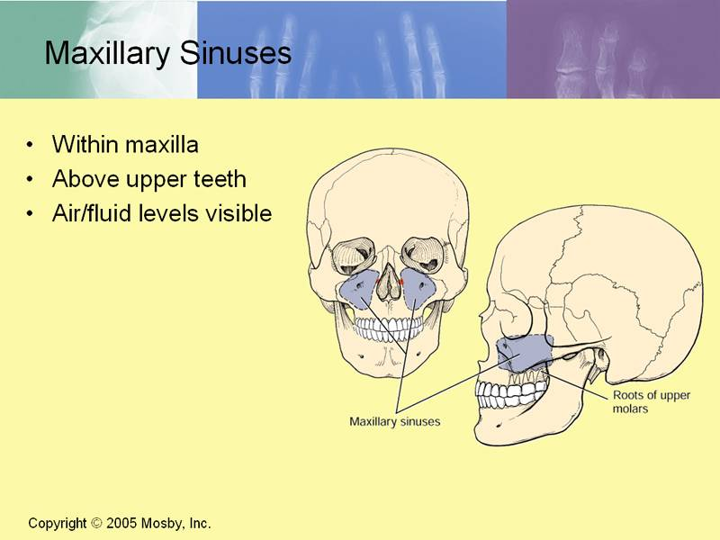
Maxillary Sinus
Pyramidal in shape
Paired & symmetric
Located within the body of the maxilla behind the skin of the cheek.
The roof is formed by the floor of the orbit, and the floor is related to the roots of the 2nd premolars and 1st molar teeth.
The maxillary sinus opens into the middle meatus of the nose

Slide 30
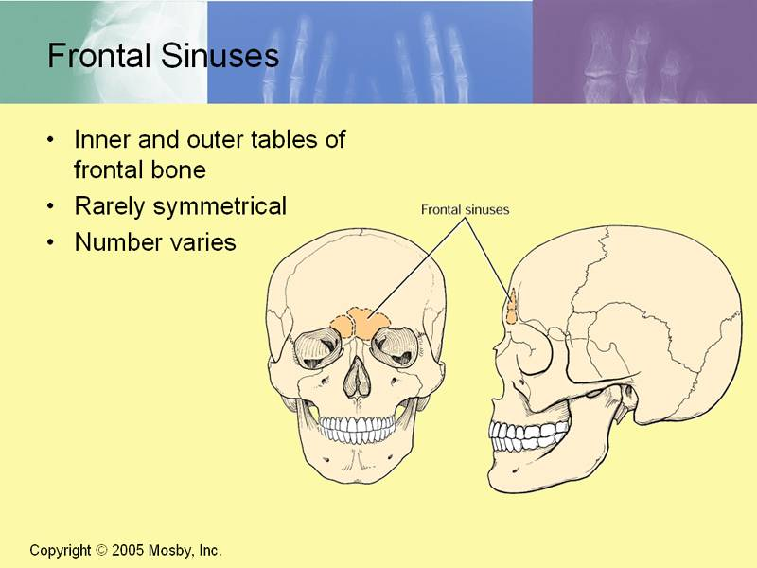
Frontal Sinuses
Rarely symmetrical
Contained within the frontal bone .
Separated from each other by a bony septum.
Each sinus is roughly triangular
Extending upward above the medial end of the eyebrow and backward into the medial part of the roof of the orbit.
Opens into the middle meatus

Slide 31
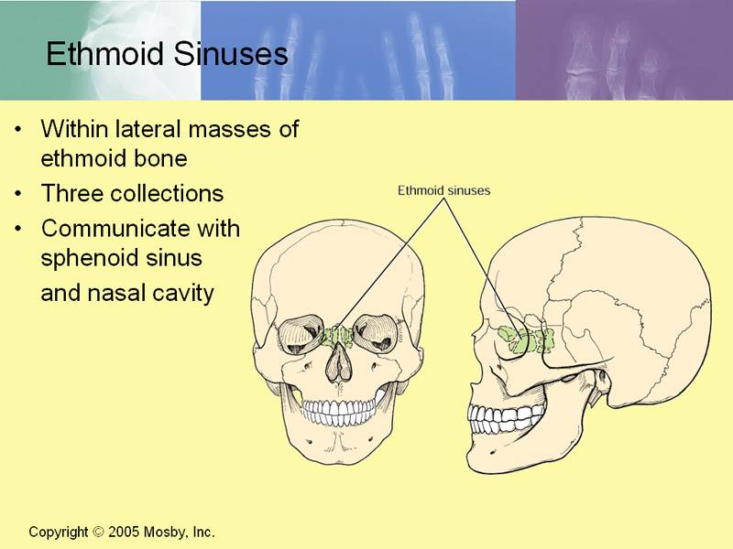
Ethmoid Sinuses
They are anterior, middle, and posterior
They are contained within the ethmoid bone, between the nose and the orbit
Anterior & middle
Drains into middle nasal meatus
Posterior
Drain into superior nasal meatus
Separated from the orbit by a thin plate of bone so that infection can readily spread from the sinuses into the orbit

Slide 32
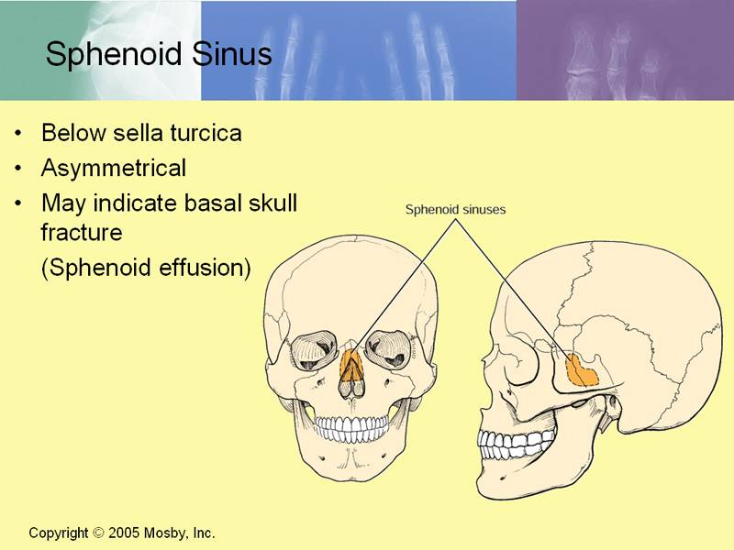
Sphenoidal Sinuses
Lie within the body of the sphenoid bone
Below sella turcica
Opens into the sphenoethmoidal recess above the superior concha

Slide 33
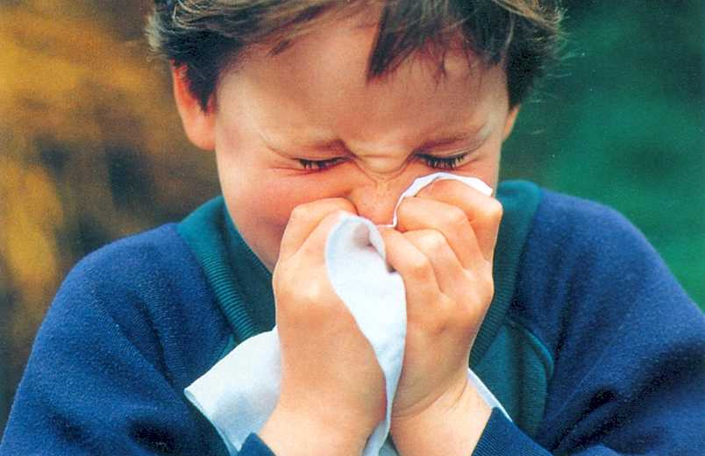
Thank you

