Slide 1
Anatomy of the mouth

Slide 2
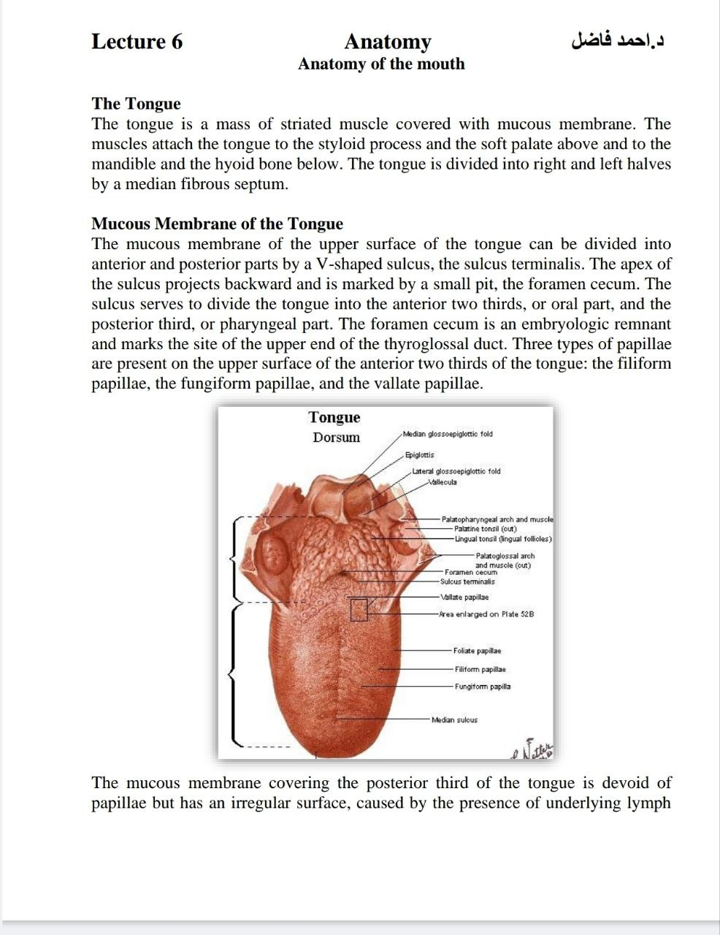

Slide 3
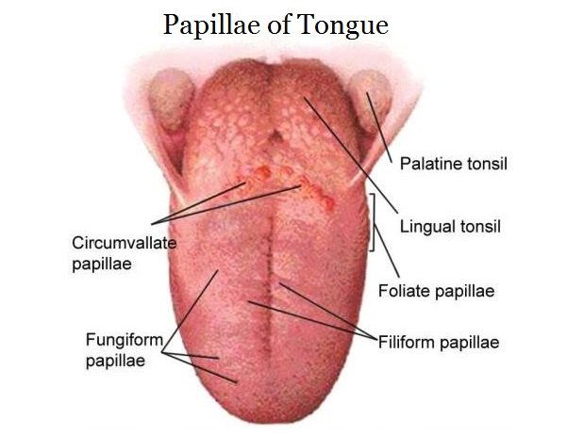

Slide 4
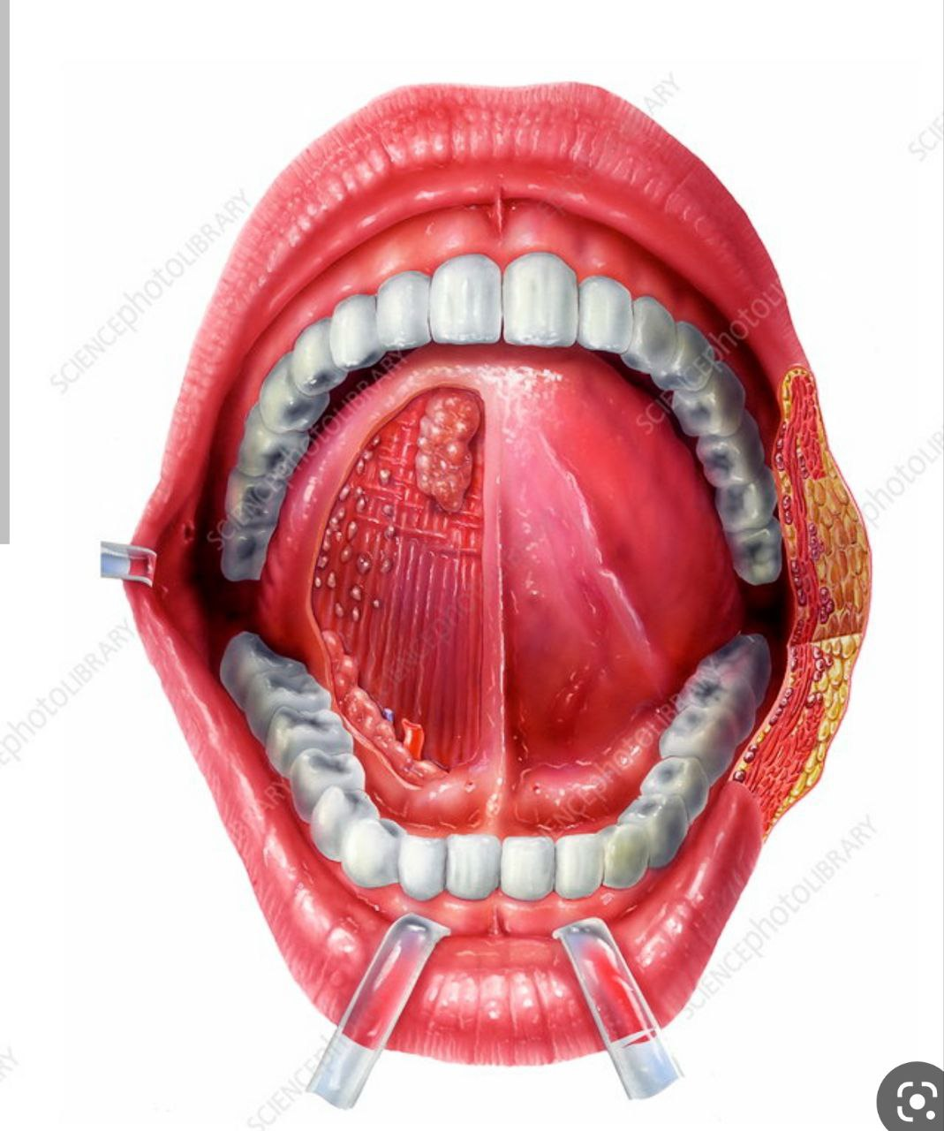

Slide 5
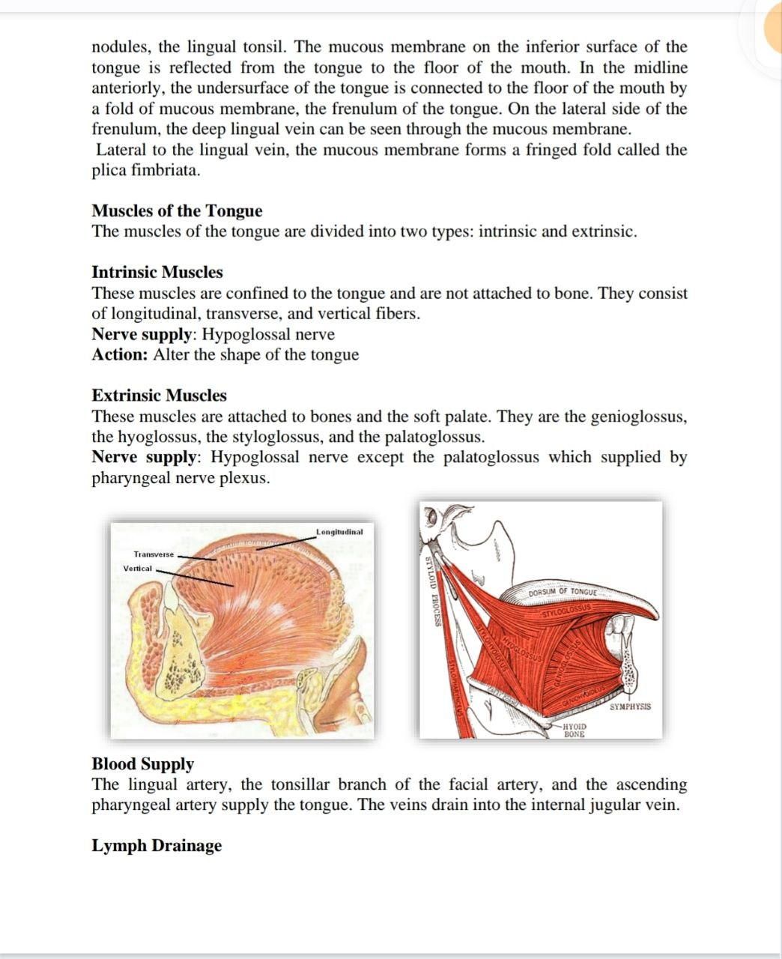

Slide 6
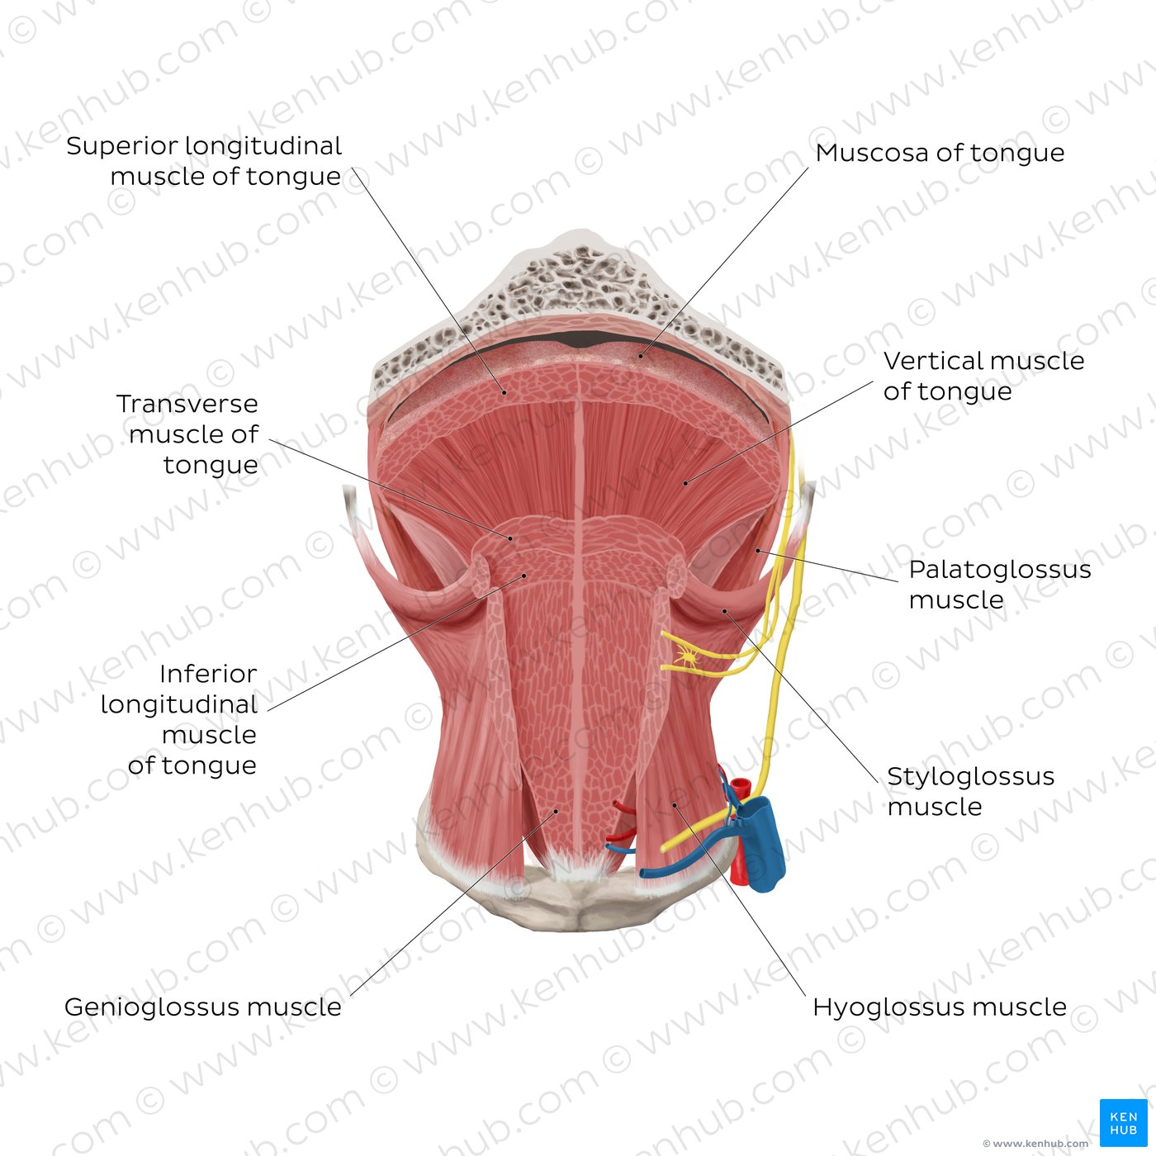
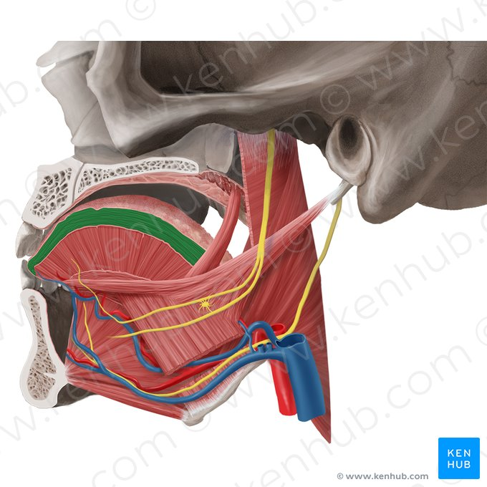

Slide 7
Intrinsic muscles
Superior longitudinal | Origin - submucosa of posterior tongue, lingual septum Insertion - apex/anterolateral margins of tongue Innervation - hypoglossal nerve (CN XII) Blood supply - lingual branch of external carotid artery Action - retracts and broadens tongue, elevates apex of tongue
Inferior longitudinal | Origin - root of tongue, body of hyoid bone Insertion - apex of tongue Innervation - hypoglossal nerve (CN XII) Blood supply - lingual branch of external carotid artery Action - retracts and broadens tongue, lowers apex of tongue
Transverse muscle | Origin - lingual septum Insertion - lateral margin of tongue Innervation - hypoglossal nerve (CN XII) Blood supply - lingual branch of external carotid artery Action - narrows and elongates tongue
Vertical muscle | Origin - root of tongue, genioglossus muscle Insertion - lingual aponeurosis Innervation - hypoglossal nerve (CN XII) Blood supply - lingual branch of external carotid artery Action - broadens and elongates tongue

Slide 8
Extrinsic muscles
Genioglossus | Origin - Superior mental spine of mandible Insertion - entire length of dorsum of tongue, lingual aponeurosis, body of hyoid bone Innervation - hypoglossal nerve (CN XII) Blood supply - sublingual branch of lingual artery, submental branch of facial artery Action - depresses and protrudes tongue (bilateral contraction); deviates tongue contralaterally (unilateral contraction)
Hyoglossus | Origin - body and greater horn of hyoid bone Insertion - inferior/ventral parts of lateral tongue Innervation - hypoglossal nerve (CN XII) Blood supply - sublingual branch of lingual artery, submental branch of facial artery Action - depresses and retracts tongue
Styloglossus | Origin - anterolateral aspect of styloid process (of temporal bone), stylomandibular ligament Insertion - blends with inferior longitudinal muscle (longitudinal part); blends with hyoglossus muscle (oblique part) Innervation - hypoglossal nerve (CN XII) Blood supply - sublingual branch of lingual artery Action - retracts and elevates lateral aspects of tongue
Palatoglossus | Origin - palatine aponeurosis of soft palate Insertion - lateral margins of tongue, blends with intrinsic muscles of tongue Innervation - vagus nerve (CN X) (via branches of pharyngeal plexus) Blood supply - ascending palatine branch of facial artery, ascending pharyngeal artery Action - elevates root of tongue, constricts isthmus of fauces

Slide 9
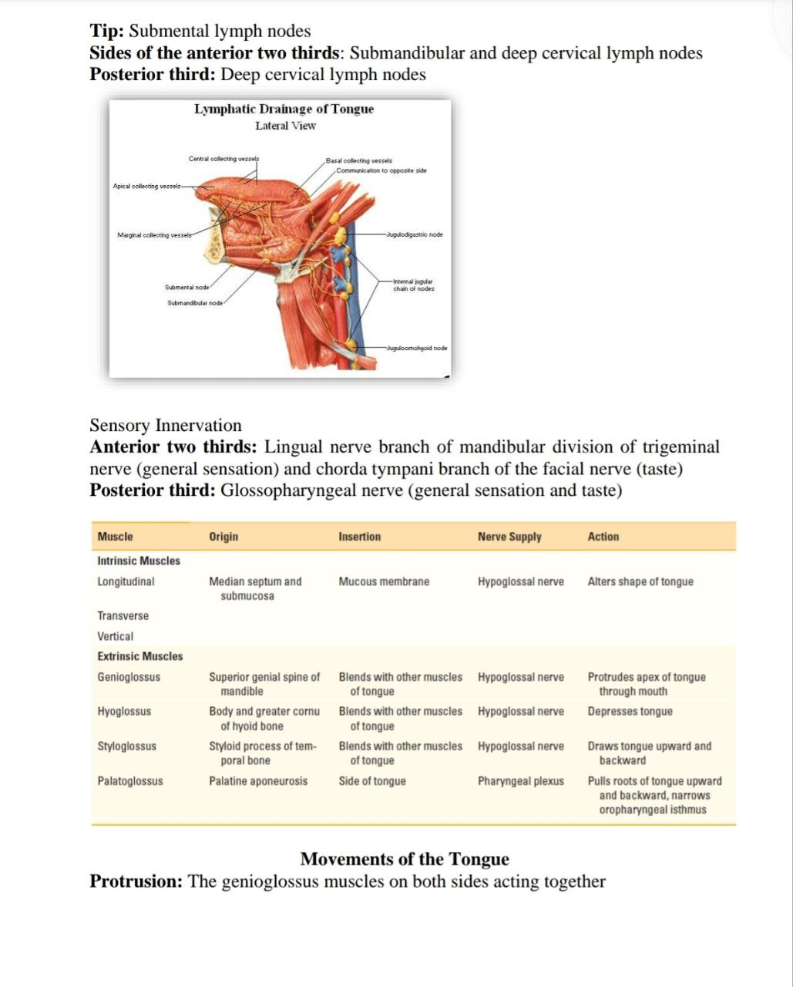

Slide 10
