Slide 1
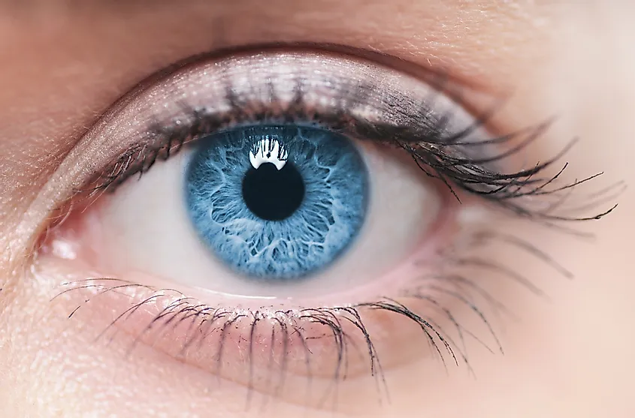
Anatomy of orbit

Slide 2
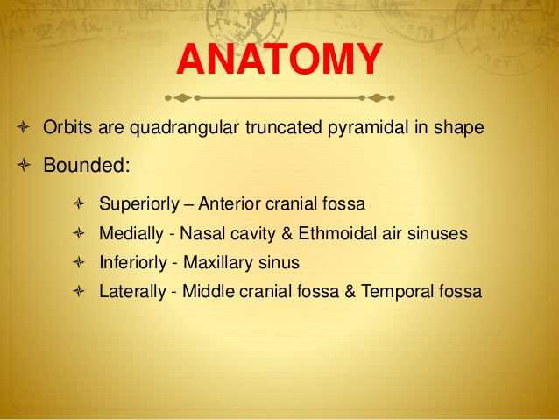

Slide 3
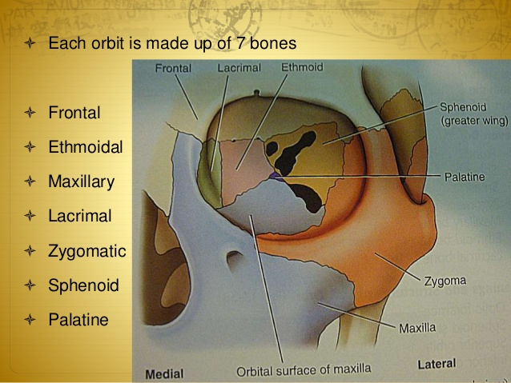

Slide 4
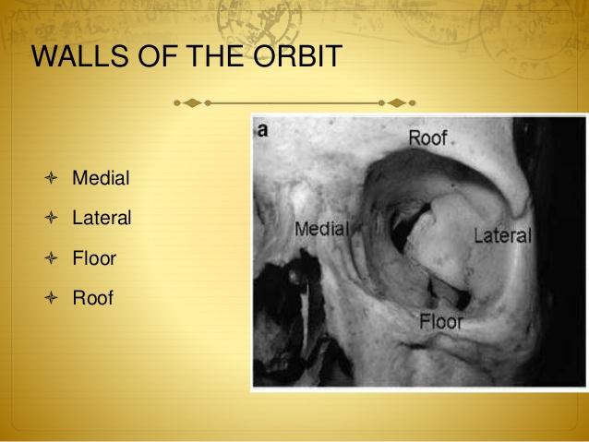

Slide 5
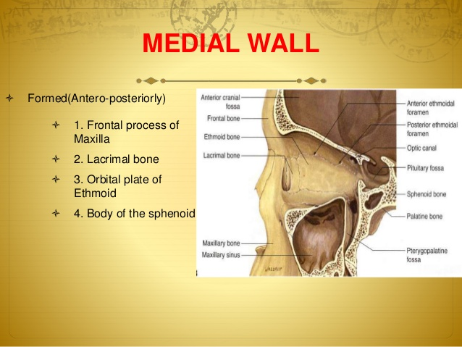

Slide 6
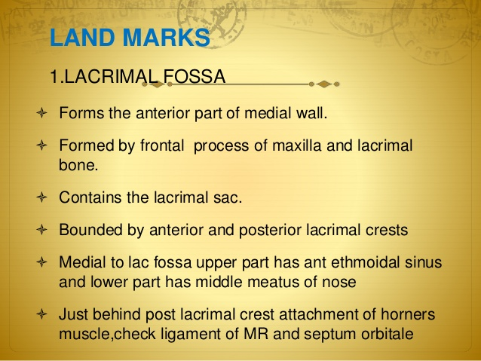
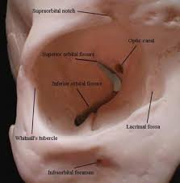

Slide 7
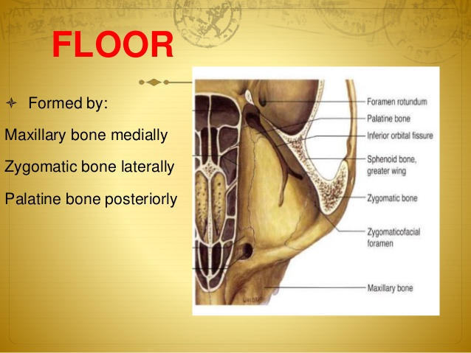
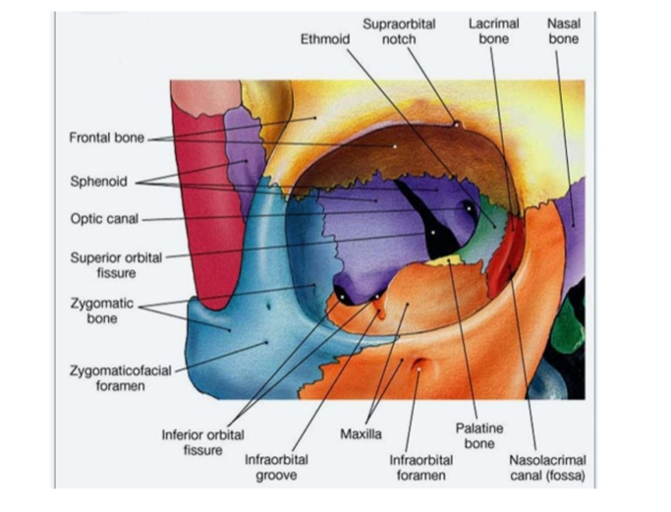

Slide 8
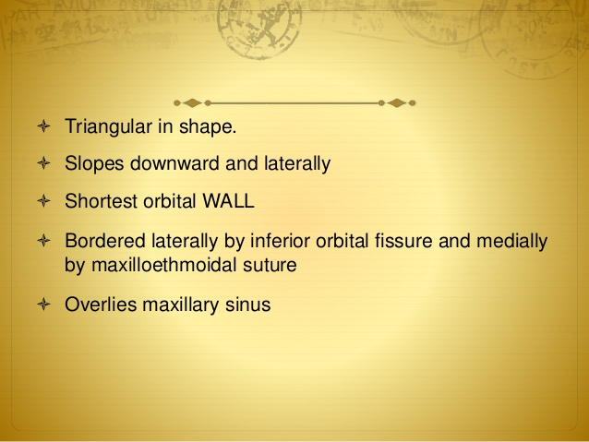


Slide 9
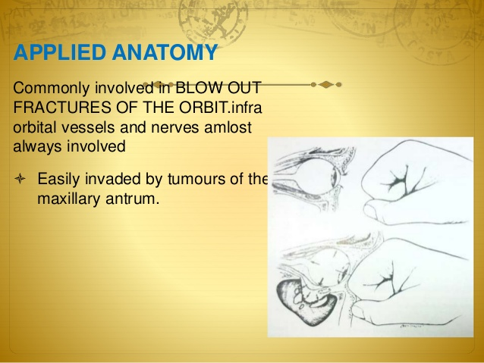

Slide 10
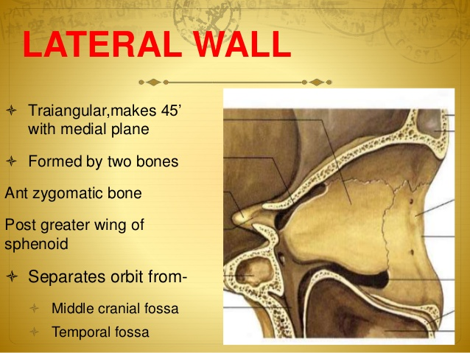
Sphenoid bone
Zygomatic bone

Slide 11
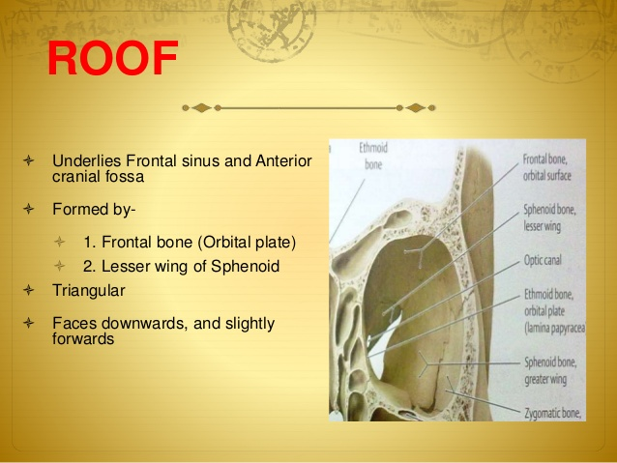
Frontal bone

Slide 12
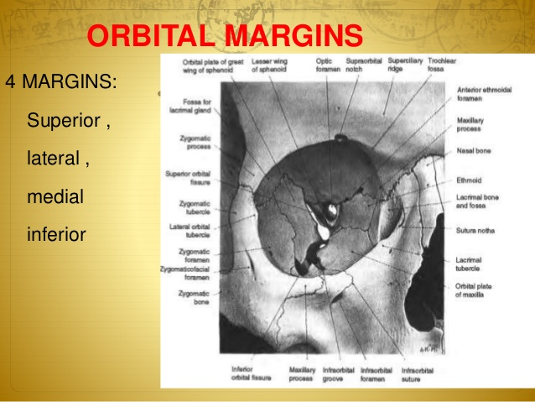

Slide 13
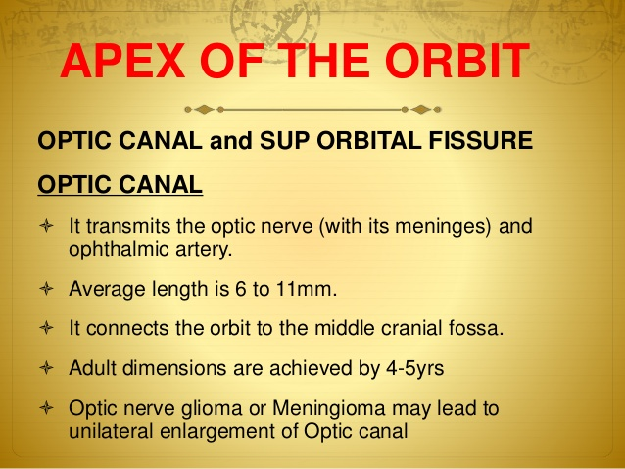

Slide 14
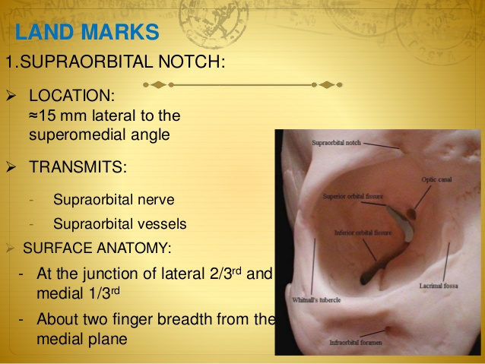

Slide 15

Openings into the Orbital Cavity
Orbital opening: Lies anteriorly. About one sixth of the eye is exposed; the remainder is protected by the walls of the orbit.
Supraorbital notch (Foramen): It is situated on the superior orbital margin and transmits the supraorbital nerve and blood vessels.
Infraorbital groove and canal: Situated on the floor of the orbit in the orbital plate of the maxilla ,they transmit the infraorbital nerve and blood vessels.
Nasolacrimal canal: Located anteriorly on the medial wall; it communicates with the inferior meatus of the nose .It transmits the nasolacrimal duct.

Slide 16

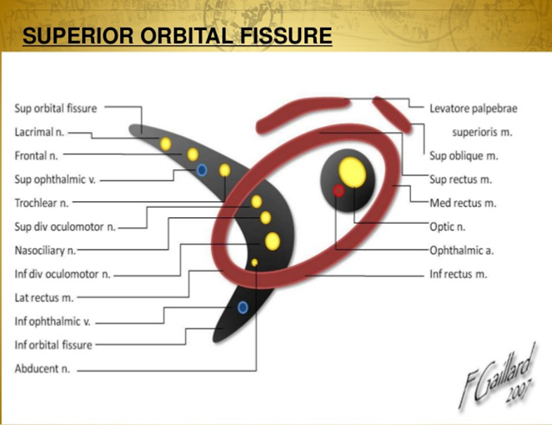
Superior orbital fissure: Located posteriorly between the greater and lesser wings of the sphenoid ,it communicates with the middle cranial fossa. It transmits the lacrimal nerve, the frontal nerve, the trochlear nerve, the oculomotor nerve (upper and lower divisions), the abducent nerve, the nasociliary nerve, and the superior ophthalmic vein.
Inferior orbital fissure: Located posteriorly between the maxilla and the greater wing of the sphenoid ,it communicates with the pterygopalatine fossa. It transmits the maxillary nerve and its zygomatic branch, the inferior ophthalmic vein, and sympathetic nerves.
Optic canal: Located posteriorly in the lesser wing of the sphenoid, it communicates with the middle cranial fossa. It transmits the optic nerve and the ophthalmic artery.

Slide 17
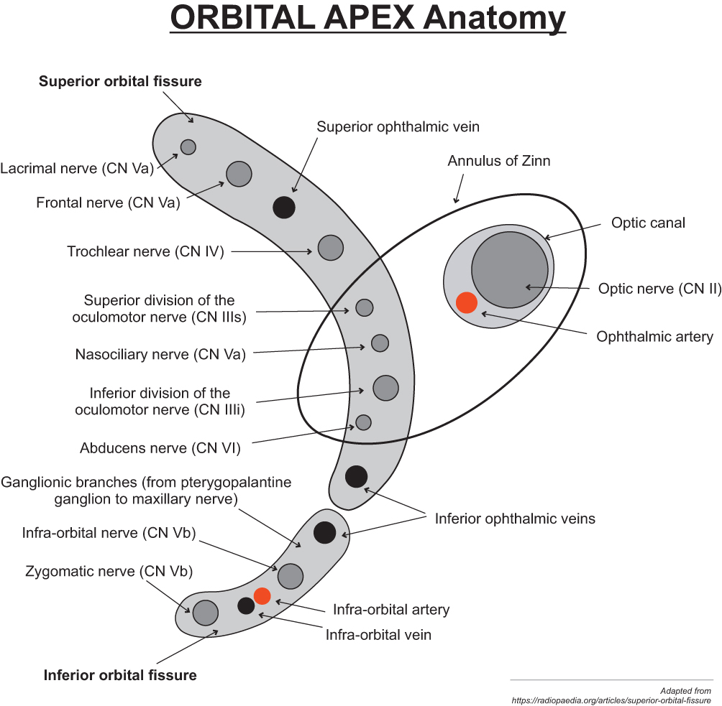

Slide 18

Thank you

