Slide 1
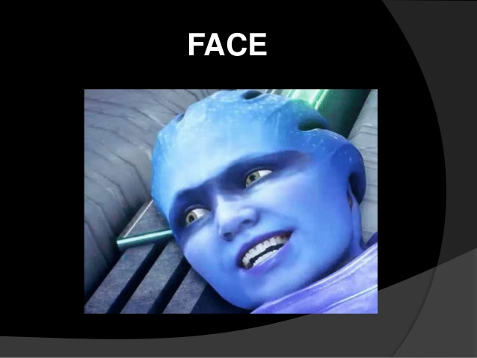

Slide 2
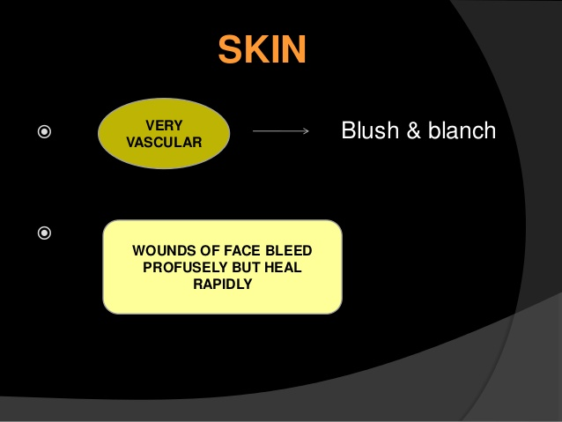
The skin is the largest organ of the body, with a total area of about 20 square feet.

Slide 3
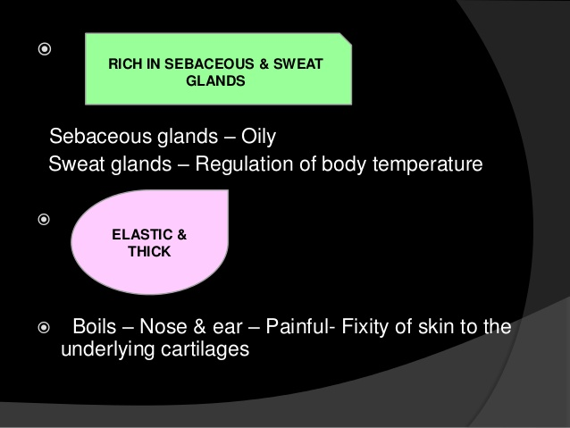
The skin protects us from microbes and the elements, helps regulate body temperature, and permits the sensations of touch, heat, and cold.

Slide 4
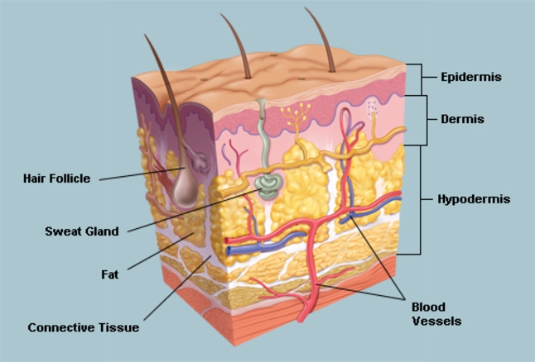
Skin has three layers:
The epidermis, the outermost layer of skin, provides a waterproof barrier and creates our skin tone.
The dermis, beneath the epidermis, contains tough connective tissue, hair follicles, and sweat glands.
The deeper subcutaneous tissue (hypodermis) is made of fat and connective tissue.

Slide 5
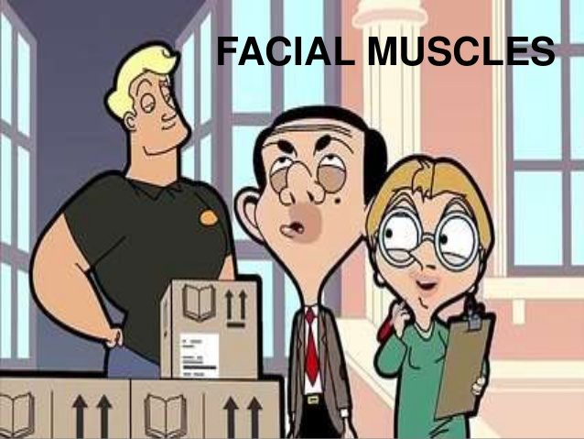

Slide 6
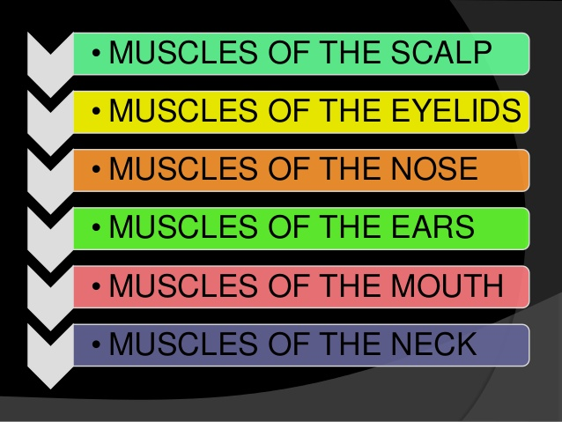

Slide 7
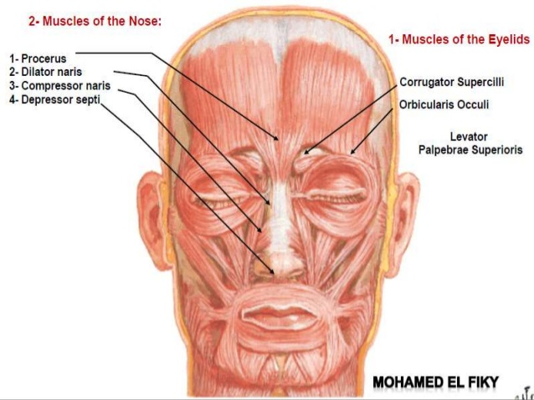

Slide 8
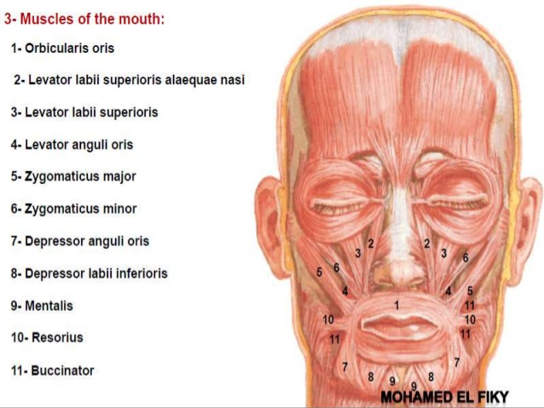

Slide 9
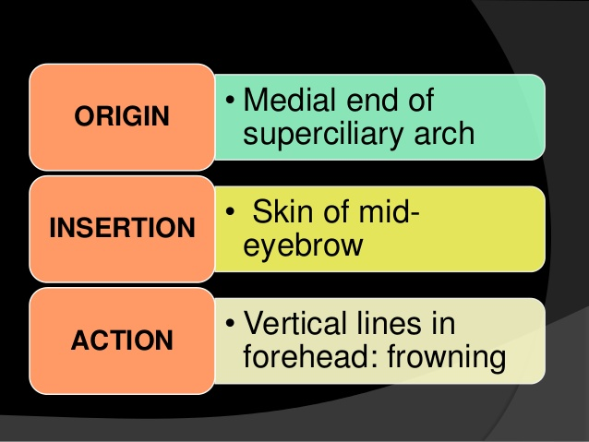
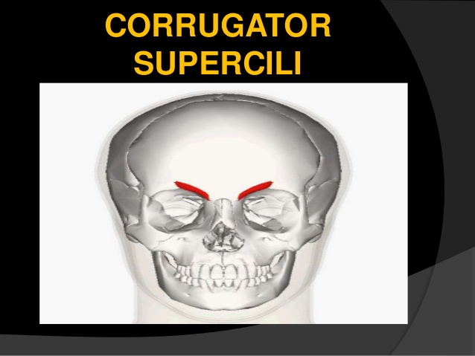
blood >>supratrochlear &supraorbital nerve supply >>temporal &zygomatic branches of facial n.

Slide 10
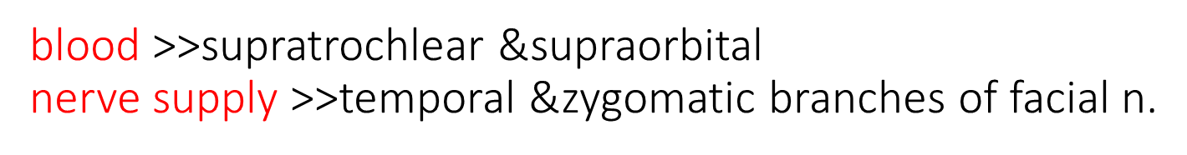
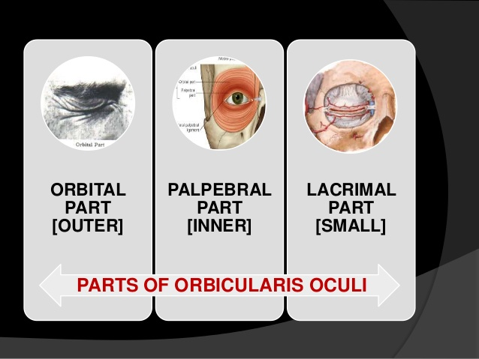
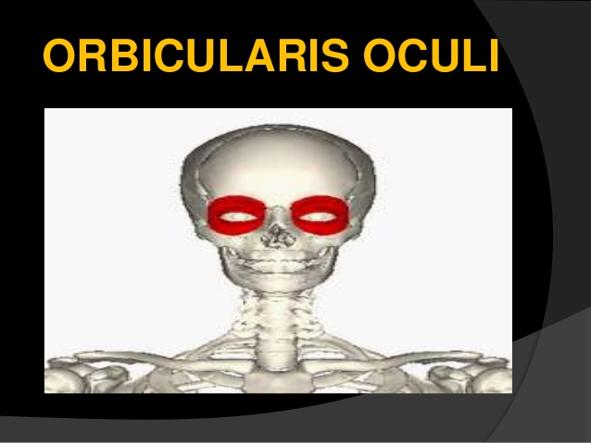

Slide 11
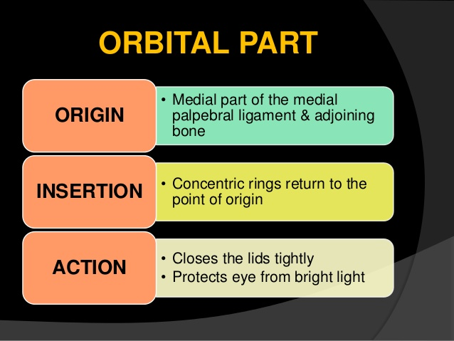
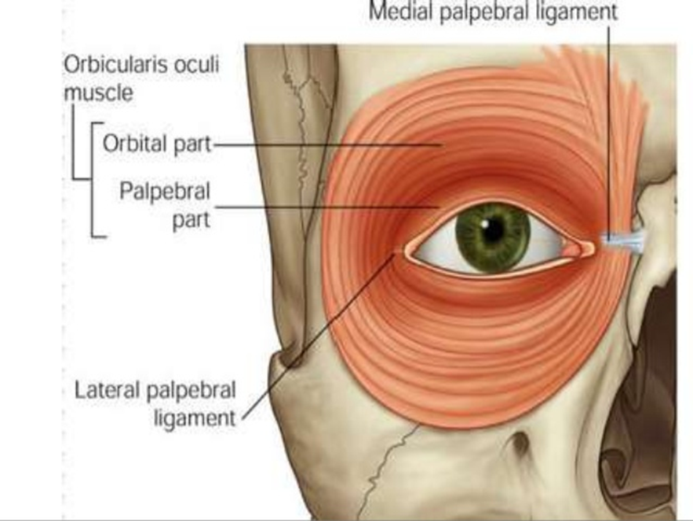

Slide 12
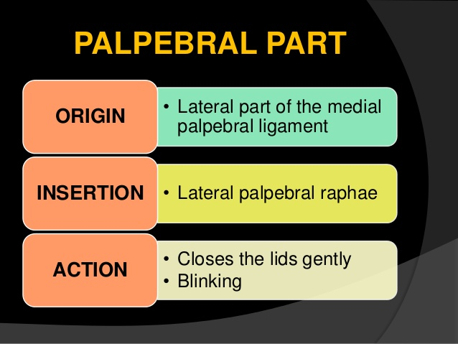
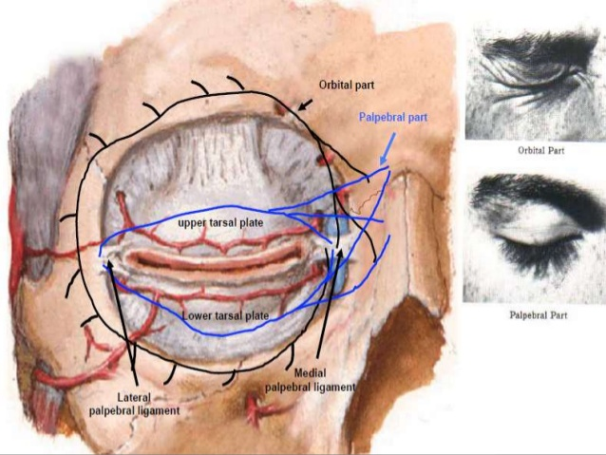

Slide 13
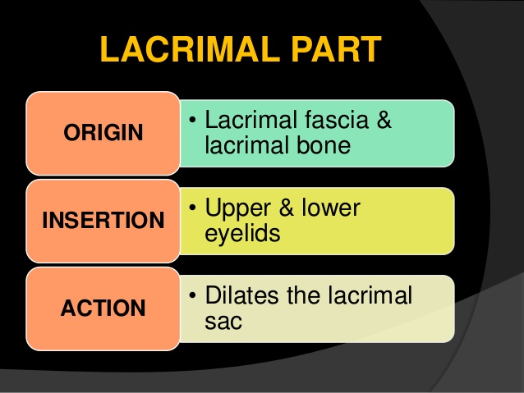
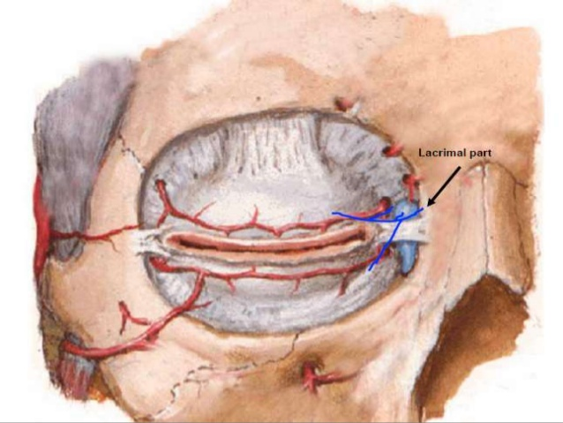

Slide 14
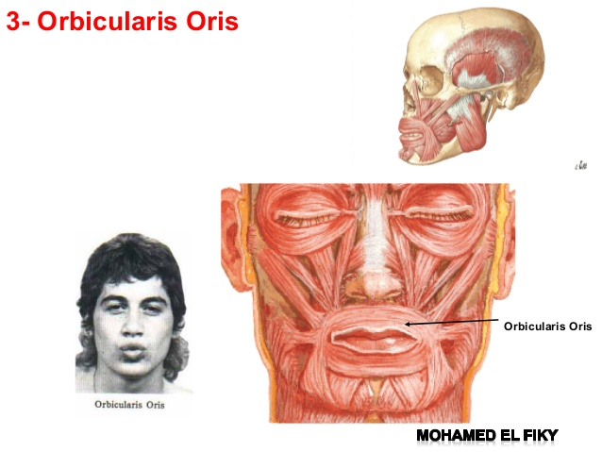

Slide 15

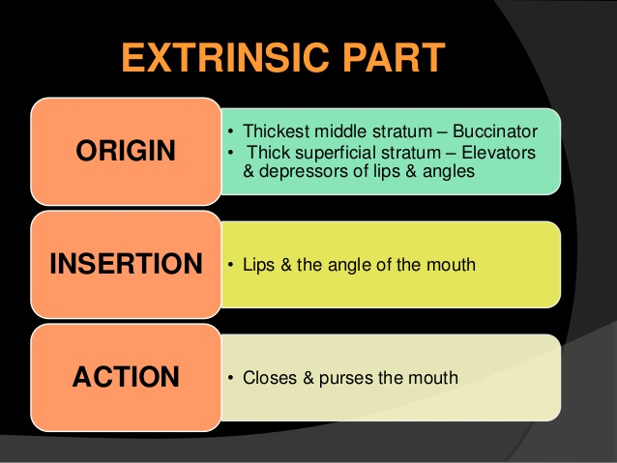

Slide 16
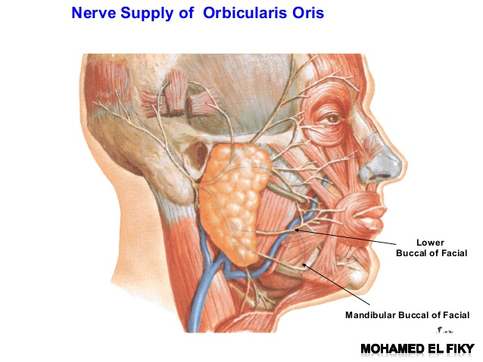
Blood>>sup&inf.labial br.from facial a. nerve>> buccal br. Of facial n

Slide 17
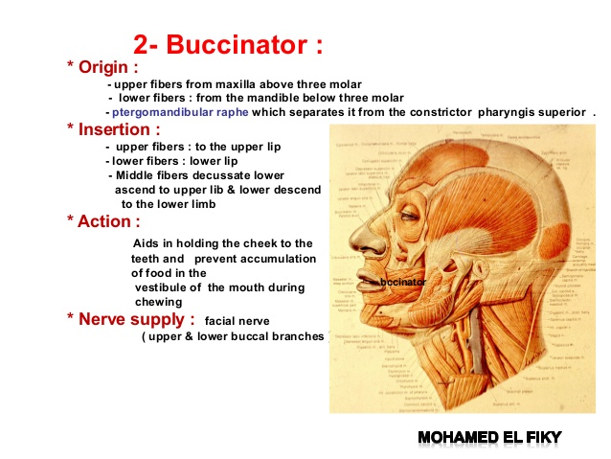
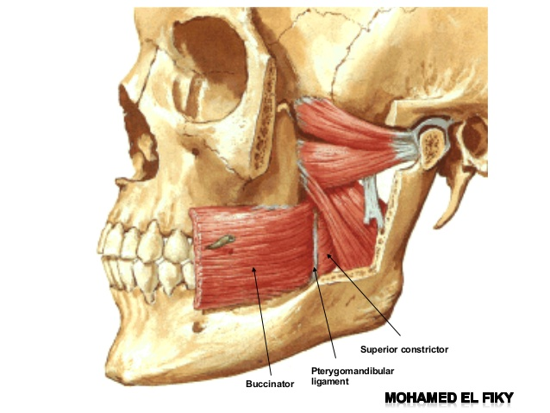
l
lip
lip

Slide 18
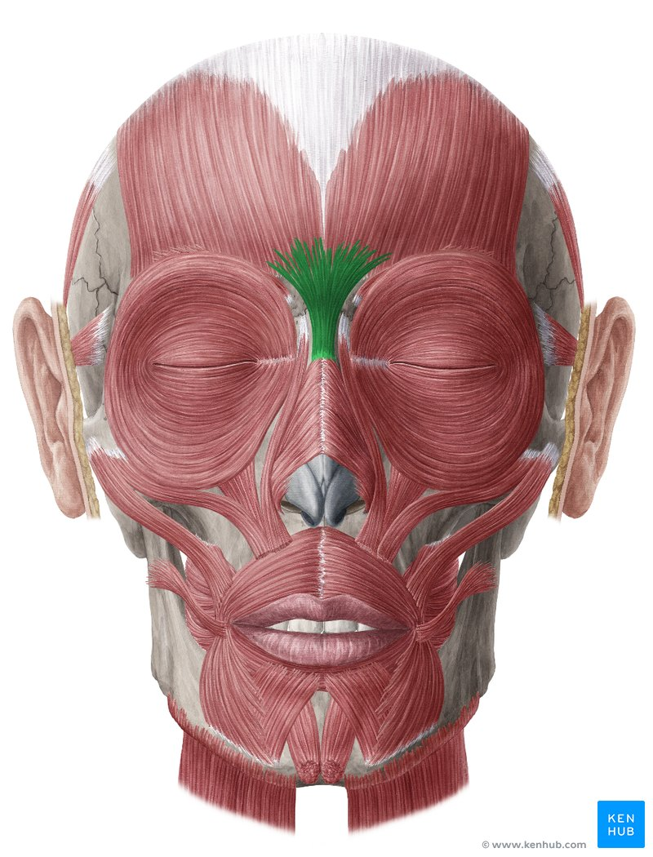
procerus muscle
The procerus muscle is the pyramid-shaped muscle extending from the lower part of the nasal bone to the middle area in the forehead between the eyebrows, where it is attached to the frontalis muscle. Its location allows it to pull the skin between the eyebrows down.
Procerus is supplied by temporal and lower zygomatic branches from the facial nerve

Slide 19
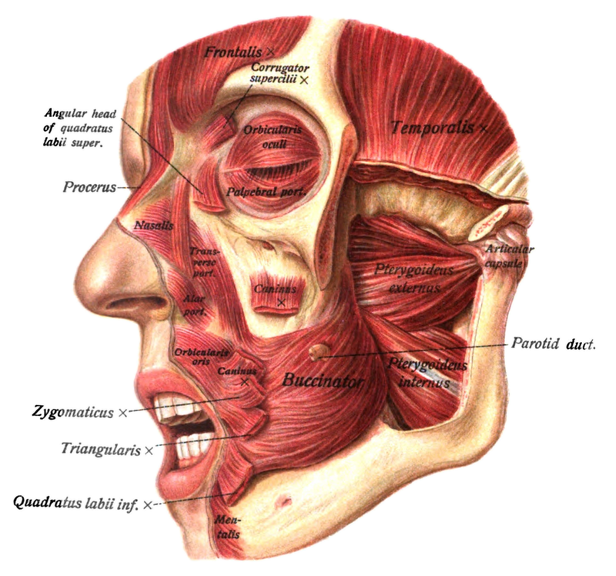
Nasalis m.
The nasalis is a sphincter-like muscle of the nose whose function is to compress the nasal cartilages. It is the muscle responsible for "flaring" of the nostrils. It consists of two parts, transverse and alar:
The transverse part (compressor naris) arises from the maxilla, above and lateral to the incisive fossa; It compresses the nostrils and may completely close them.
The alar part (dilator naris) arises from the maxilla over the lateral incisor and inserts into the greater alar cartilage.
innervated by the seventh cranial nerve: the facial nerve.

Slide 20
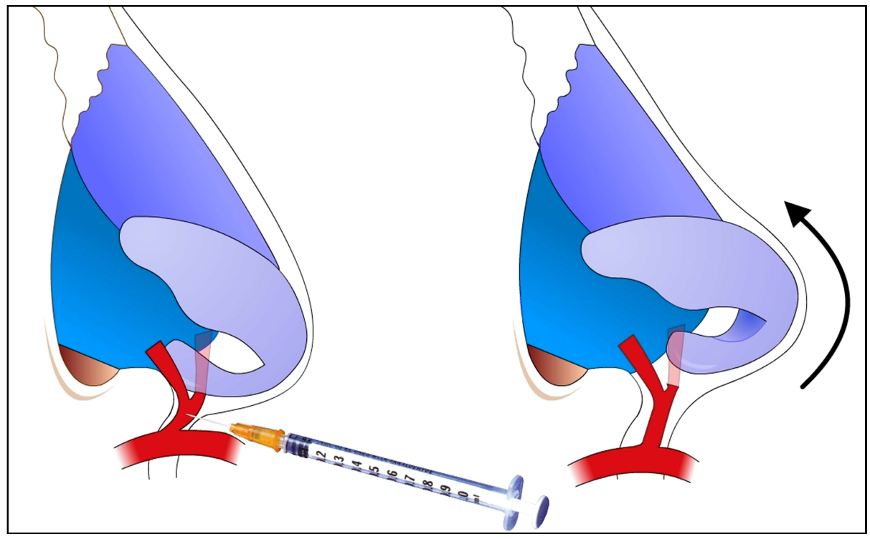
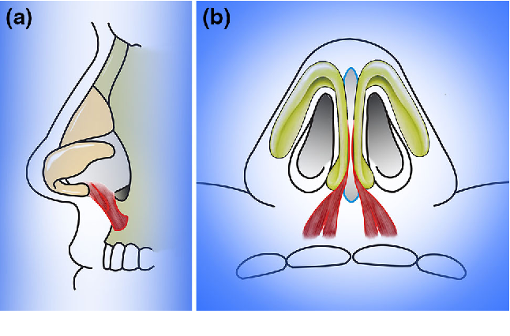
Depressor septi m.
The depressor septi (depressor alae nasi) arises from the incisive fossa of the maxilla.
Its fibers ascend to be inserted into the nasal septum and back part of the alar part of nasalis muscle.
constricting the aperture of the nares.

Slide 21
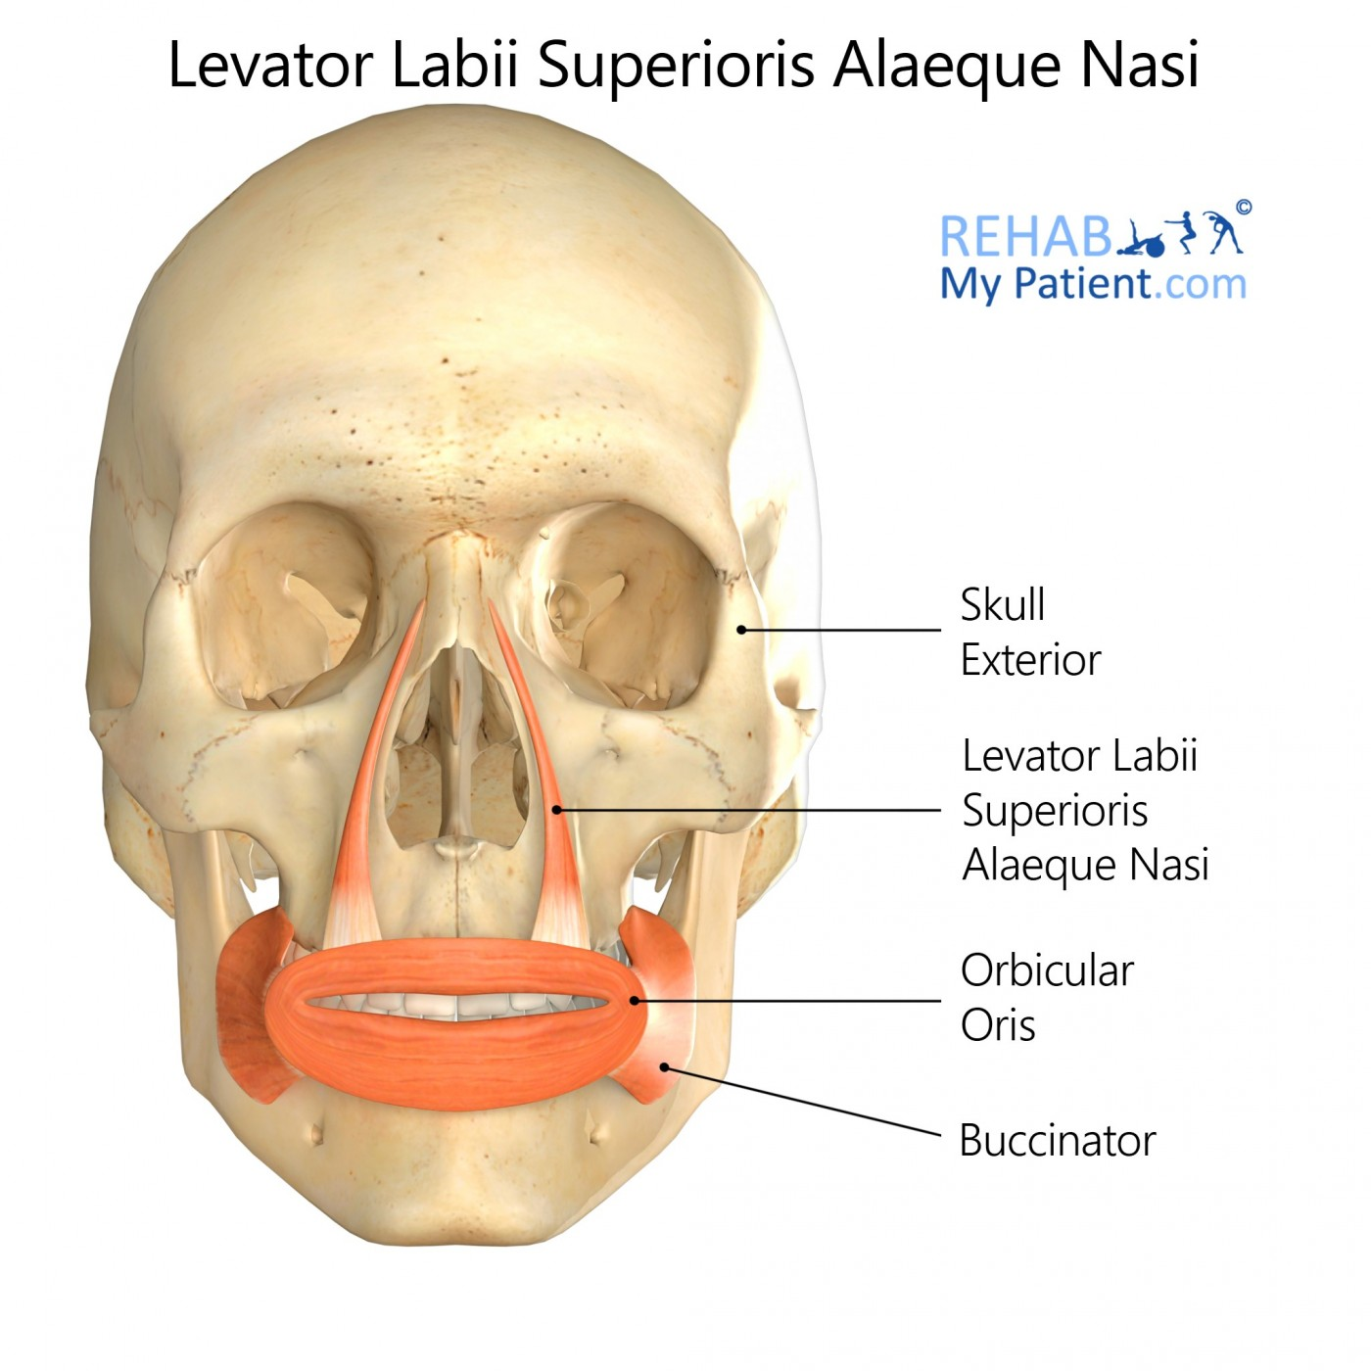
levator labii superioris alaeque nasi muscle
The muscle is attached to the upper frontal process of the maxilla and inserts into the skin of the lateral part of the nostril and upper lip.
primary purpose is to dilate the nostrils and elevate the upper lip.

Slide 22
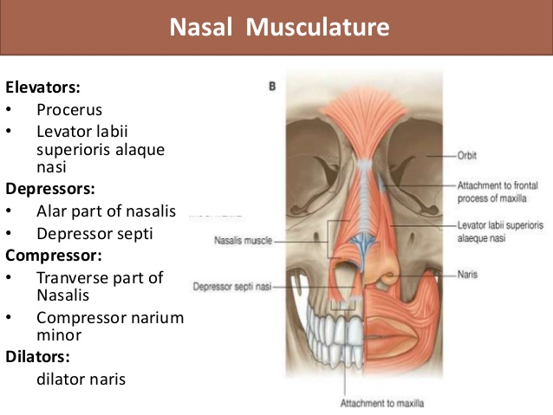

Slide 23
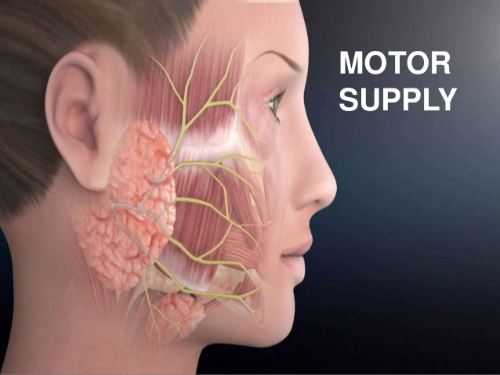
Facial nerve

Slide 24
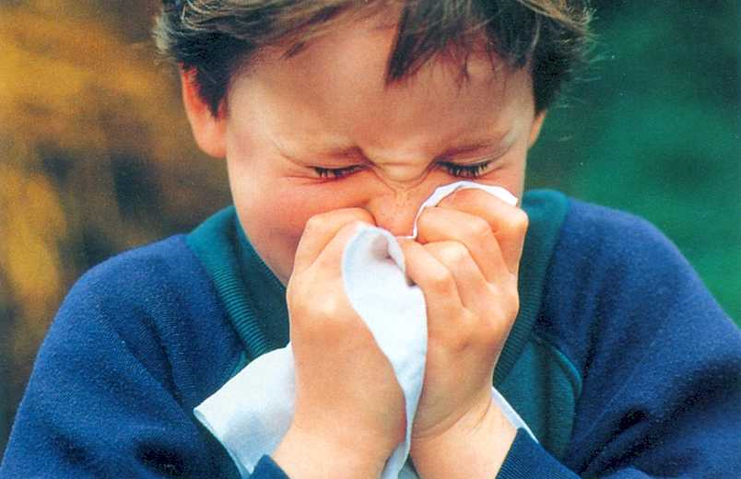
Thank you

