Slide 1
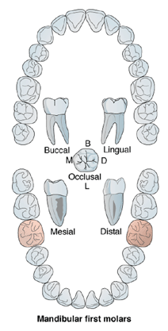
Mandibular
1st molar

Slide 2
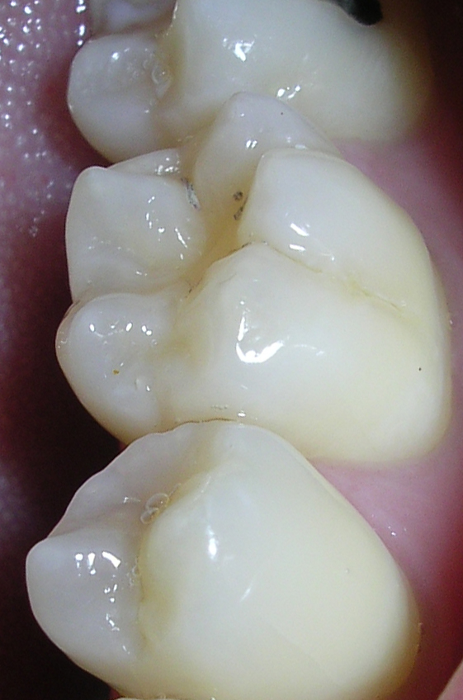
Principal Identifying Features:
❤- Has the largest mesio-distal dimension of any tooth. The crown is wider mesio-distally than bucco-lingually.
❤- It most often has five cusps: two buccal, two lingual and the smallest distal cusp may be absent about a fifth of the time . When there are five cusps, their heights in order from longest to shortest ,ML ,DL ,MB ,DB , then the smallest distal cusp.
❤-The buccal surface is inclined lingually , with the presence of two buccal developmental grooves.
❤-The occlusal surface is rectangular in shape.
❤-There are two well developed roots; one mesial and one distal.

Slide 3
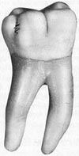
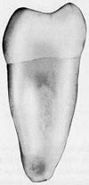


The general features that differentiate the Mandibular and maxillary molars are:
1- The crowns of the lower molars are wider mesiodistally than buccolingually.
2- The crowns are tilted lingually and show rhomboid outline proximally.
3- The occlusal surface is hexagonal or rectangular.
4- Presence of four or five cusps, the two lingual cusps approximately of the same size.
5- The presence of two roots in most cases one mesially and the other one distally.

Slide 4
Type and function
🍀-Play a major role in the mastication of food(chewing and grinding).
🍀-Most important in maintaining the vertical dimension of the face.
🍀-Important in maintaining continuity within the dental arches , thus keeping other teeth in proper alignment.
🍀-At least a minor role in esthetics or keeping the cheeks normally full or supported.
No. of lobes
It has five lobes: two buccal, one distal and two lingual.

Slide 5
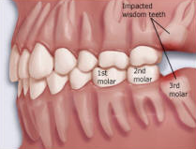
Relation
The lower 1st molar makes contact mesially with the distal surface of the lower 2nd premolar and distally with the mesial surface of the 2nd permanent molar.
6
7
5

Slide 6
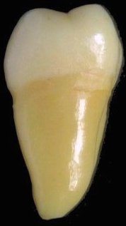
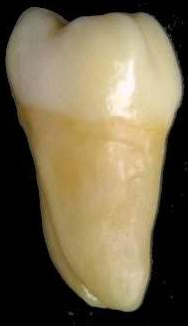
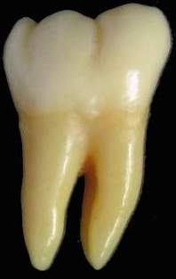
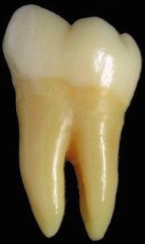
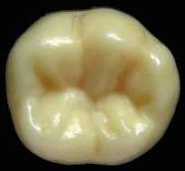
No. of surfaces
It has four surfaces and Occlusal aspect.
Mesial
Distal
Buccal
Lingual
No. of roots
It has two roots (one mesial and one distal).
Occlusal

Slide 7
The buccal aspect
Geometrical outline
Trapezoid in shape.
-The short side cervically.
-The long side occlusally.
The outline
💎- Mesial outline is straight till the contact area (at the junction of occ. and middle 1/3s).
💎- Then become convex for the mesial slope of the mesio-buccal cusp.
💎- The distal outline is convex till the contact area at the middle third.
💎- The distal slope of the distal cusp is convex.

Slide 8
- The cervical line is straight or slightly convex apically.
- The occlusal outline is divided into three unequal cusps.
- The widest of them is the mesiobuccal
then distobuccal (80%),and the smallest one is the distal cusp(20%).
- The mesiobuccal and distobuccal cusp tips are blunt while the distal cusp tip is rounded.
Surface anatomy
- Cervical ridge.
-The mesiobuccal developmental groove
- The distobuccal developmental groove
- The two developmental grooves may fade out near the middle of crown or end in a pit.

Slide 9
The Root
🌟- It has two roots one mesial and one distal. The mesial root is wider and longer than the distal root.
🌟- There is a deep developmental depression at the center of the root trunk.
🌟 The root trunk bifurcates at the junction of cervical and middle thirds 3mm below the cervical line.
🌟-The mesial root curves mesially from the root trunk to the middle portion of the root length and then curves distally to the tapered apex.
🌟-The distal root is straight with distal curvature at the apical third.

Slide 10
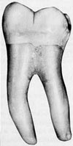
Lingual aspect
❤- The lingual surface has the same crown
outline like buccal surface but,
with lingual convergence.
❤- The mesiolingual, distolingual cusps (obtuse)
and small part of the distal cusp could
be seen from this aspect.
❤-The lingual developmental groove
separates the two lingual cusps.
❤- The lingual developmental groove fades out near the middle of the crown.
❤-The cervical line is located at more occlusal level than that on the buccal surface so, the roots appear to be longer lingually than buccally .

Slide 11
The mesial aspect
❤-It is rhomboidal in shape (constricted occlusally) and inclined lingually.
❤- The buccal outline is convex at the cervical third for the presence of cervical ridge.
❤- then becomes slightly concave or straight at the middle third and becomes slightly convex or straight to the mesiobuccal cusp tip.
❤- The lingual outline is less convex from the cervical line to the mesiolingual cusp tip with the maximum convexity at the middle of the crown.

Slide 12
❤- The cervical line is usually irregular,and.
- It inclined from the lingual side to the buccal as it always located at a more occlusal level on the lingual side.
❤-The mesial marginal ridge is continuous with the cusp ridges but in a slightly lower level (1mm below the level of the cusps tips.
❤-The contact area is located at the junction of the middle and occlusal thirds slightly buccal to the midline.
❤-The mesial root has straight buccal and lingual outline till the middle of the root length and then tapers to a blunt apex.
❤- It has a deep groove on its middle portion.

Slide 13




❤-The buccal cusp is flat and the lingual cusp is sharp with greater cusp height.

Slide 14
The distal aspect
❤-The distal aspect is similar to the mesial surface, but narrower.
❤-The distal cusp is seen in the foreground and is located more to the buccal side.
❤- The distal contact area appears on the distal cusp contour just below the distal cusp tip.
❤-The distal marginal ridge is short and made by the union of both the distal cusp ridge and the distolingual cusps.
❤-A developmental groove is usually found crossing the distal marginal ridge.
❤-The distal root is narrower than the mesial root and has more tapered apex.

Slide 15
The occlusal aspect
❤- The occlusal surface is hexagonal
❤- Larger mesiodistally than buccolingually.
❤- The buccal surface is larger than lingual and mesial is larger than distal.
1
4
❤- It has five cusps.
5
❤- The five cusps according to
their sizes are 1) mesiobuccal
2) mesiolingual 3) distolingual
4) distobuccal 5) distal cusp.
2
3
❤- Mesial marginal ridge is longer and broader
than the distal marginal ridge.

Slide 16
❤- The occlusal surface has three fossae:
1- the central fossa
Mesiobuccal developmental groove
Distobuccal developmental groove
2- mesial triangular fossa
3- distal triangular fossa
The lingual developmental groove
central developmental groove

Slide 17
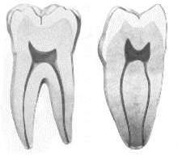
The pulp cavity
Mesio-distal section
- The pulp chamber is rectangular in shape
- The mesial root canal is curved while the distal root canal is straight and larger than the mesial

Slide 18
Bucco-lingual section
- The mesial pulp chamber is large and may extend to a small part into the root.
- The mesial root usually has two root canals that usually open in separate apical foramina or may unite in the apical region to open in a single foramen.

Slide 19
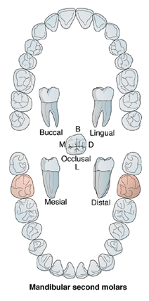
Mandibular
2nd molar

Slide 20
Principal Identifying Features:
1-It is smaller than the first molar.
2-Four well developed cusps 2B.and 2L. Of nearly equal size.
3-No distal cusp but larger DB. Cusp than 1st
molar.
4-It has 2 roots 1M.and 1D.broad buccolingually but less than 1st molar.
No. of lobes
It has four lobes: two buccal and two lingual.

Slide 21
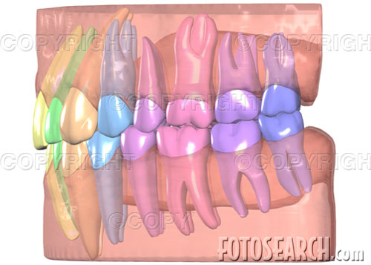
Relation
The lower 2nd molar makes contact mesially with the distal surface of the lower 1st molar and distally with the mesial surface of the 3rd molar.
8
6
7

Slide 22
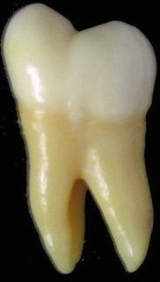
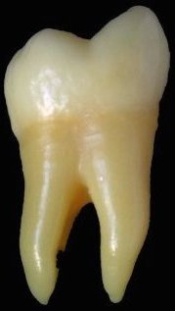
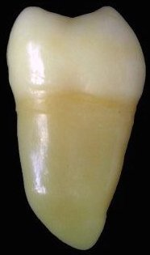
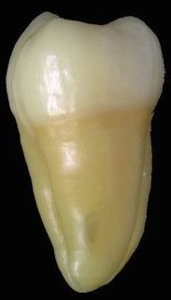
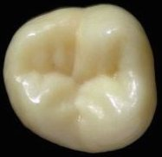
No. of surfaces
It has four surfaces and Occlusal aspect.
Buccal
Lingual
Mesial
Distal
No. of roots
It has two roots (one mesial and one distal).
Occlusal

Slide 23
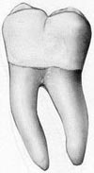
It is similar to the Mandibular first molar except in the following:
1- The crown measurements are generally smaller than that of first permanent molar in all dimensions (smaller mesiodistally and occlusocervically).

Slide 24
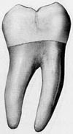
2- The crown is usually composed of four developmental lobes. The buccal groove divides the mesiobuccal and distobuccal cusps equally and the lingual groove divides the mesiolingual and distolingual cusps equally.
3- The two roots are smaller, shorter and less divergent

Slide 25
4- The contact areas mesially and distally are located at the same level in the middle third.

Slide 26


Buccal Aspect
1-The crown is shorter cervico-occlusally and narrower mesio-distally than the 1st molar.
2-There is one buccal developmental groove , separates between MB and DB cusps.
3-MB and DB cusps are nearly equal in their mesio-distal measurements.
4- The cervical line in many instances points sharply to the root bifurcation.
5-The roots are shorter than those of the 1st molar usually closer together (parallel ) ,inclined distally.

Slide 27

Lingual Aspect
1-The crown and the roots converge lingually but to a slight degree, therefore:
A-Little of the mesial and distal surfaces may be seen from this aspect.
B-The mesiodistal dimension cervically is greater than that of the 1st molar.
2-The contact areas are more noticeable from this aspect, and they are more cervically positioned than the 1st molar.

Slide 28

Mesial Aspect
1-Buccal cervical ridge is less pronounced compared to the first molar.
2-The mesial root has somewhat pointed apex.

Slide 29

Distal Aspect
1-It is similar to the 1st mandibular molar except for the absence of a distal cusp and a distobuccal groove.
2-The contact area is centered bucco-lingually and cervico-occlusally.

Slide 30
5- The occlusal surface outline is rectangular. There is a cross-shaped groove pattern (cruciform grooves) .
6- The occlusal surface has more supplemental grooves than the mandibular first permanent molar.

Slide 31
7- There are three fossae with three developmental pits in their bottom as seen in the Mandibular first molar.

Slide 32
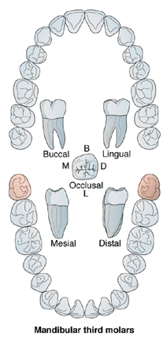
Mandibular
3rd molar

Slide 33
Relation
The lower 3rd molar makes contact mesially with the distal surface of the lower 2nd molar and distally has no contact cause it is the last tooth in the dental arch.
8
7

Slide 34
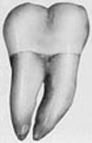
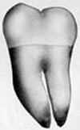
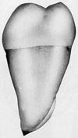
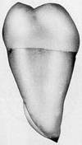

No. of surfaces
It has four surfaces and Occlusal aspect.
Buccal
Lingual
Mesial
Distal
No. of roots
It has two roots (one mesial and one distal).
Occlusal

Slide 35
Principal Identifying Features
-This tooth varies considerably in different individuals and present many anomalies both in form and position.
-The tooth could be congenitally missing.
-Usually there are two short roots, one M and one D .These are usually shorter than the roots of the 1st or 2nd molars. Sometime there are more than 2 roots or the roots may be fused.

Slide 36
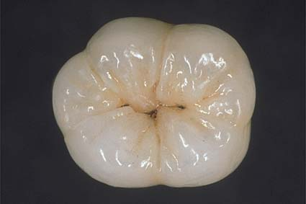
- It is usually smaller in all dimensions than any mandibular molars but, sometimes it may reach the size of the first permanent mandibular molar.
- Its crown is variable but two basic types are usually seen:
1- The crown resembles the permanent mandibular first molar with five cusps and similar occlusal pattern with increase number of supplemental grooves.

Slide 37
2- The crown resembles the permanent mandibular second molar, it has 4 cusps and the same occlusal pattern with increase number of supplemental groove. It has tendency for a more rounded occlusal outline

Slide 38
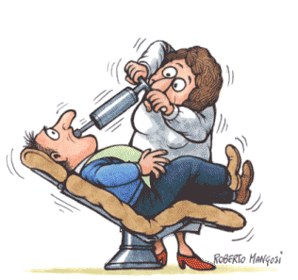
The world without Dentists

Slide 39
Arch Traits to distinguish Maxillary from Mandibular Molars
Two buccal cusps: Mesiobuccal and distobuccal Mesiolingual cusp tip visible from buccal One buccal groove Three roots (two buccal and one lingual) Root trunk longer Crown centered over root | Two or three buccal cusps: Mesiobuccal, distobuccal, and distal( on firsts) Both lingual cusp tips visible from buccal Two buccal grooves on most first molars Two roots (one mesial and one distal) Root trunk shorter Crown tipped distally on root
Lingual groove off center (toward distal) Mesiolingual cusp larger than distolingual cusp, more than on mandibular molars Cervix of crown tapers more to lingual Cusp of Carabelli (or groove) common on first molars | Lingual groove nearly centered Mesiolingual and distolingual cusps size and height more equal Cervix of crown tapers less to lingual No Carabelli cusp

Slide 40
Crown more centered over root Smaller distolingual cusp on most second molars or no distolingual cusp Crowns wider faciolingually than mesiodistal Oblique ridge present from mesiolingual to distobuccal One transverse ridge mesiobuccal to mesiolingual | Crown tipped more lingually over root Smallest distal cusp seen from distal on most first molars Crowns wider mesiodistally than fasiolingual No oblique ridge Two transverse ridges mesiobuccal to mesiolingual and distobuccal to distolingual
Parallel ( or square ) shape crown for four-cusp type Three-cusp seconds are heart shaped Four fossae: including large central and cigar-shaped distal Central groove in mesial half does not cross oblique ridge First molars have four cusps plus Carabilli cusp/ groove First molars wider on lingual than buccal Second molars have four cusps or three cusps (heart shaped) ML Cusp much larger than DL | Pentagon shape crown on first Rectangular shape crown on second Three fossae: central fossa is larger Central fossa with zigzag or+ groove pattern Five cusps on firsts (distal cusp is fifth cusp) First molars wider on buccal than lingual Second molars have four cusps Mesiolingual cusp slightly larger Than DL

Slide 41
Permanent Teeth
By: Samira Jameel Tarfa
References:
Notes of Dental anatomy, Physiology And Occlusion. by Prof. Dr. Nahed E.Abo-Azma.
Ash,Major M and stanley j.Nelson,2003.
Wheeler dental anatomy,physiology and occlusion.8th edition.

