Slide 1
Irreversible cell injury 1- Necrosis 2- Apoptosis 3-Gangreen 4-Pathological calcification

Slide 2
Necrosis is irreversible cell death characterized by loss of membrane integrity and leakage of cellular contents culminating in dissolution of cells. - necrosis resulting from the degradative action of enzymes liberated from injured cells. -The leaked cellular contents elicit a local host reaction, called inflammation, that attempts to eliminate the dead cells and start the subsequent repair process. -The enzymes responsible for digestion of the cell are derived either from the lysosomes of the dying cells themselves or from the lysosomes of leukocytes that are recruited as part of the inflammatory reaction to the dead cells.

Slide 3
Causes 1-Poisons A- Chemical poisons such as insecticides , fungicides. B- Bacterial toxins. C- Plant poisons. D-Enterotoxins. 2- loss of blood supply. 3- physical agents as trauma ,burn ,radiation , UV. 4- Immunologic reaction as AG-AB reactions

Slide 4
Morphology
-Cytoplasmic changes 1-The necrotic cells show increased eosinophilia (i.e., pink staining from the eosin dye, the "E" in "H&E"). This is attributable in part to increased binding of eosin to denatured cytoplasmic proteins and in part to loss of the basophilia that is normally imparted by the ribonucleic acid (RNA) in the cytoplasm (basophilia is the blue staining from the hematoxylin dye, the "H" in "H&E"). 2- The cell may have a more glassy homogeneous appearance than viable cells . 3- When enzymes have digested the cytoplasmic organelles, the cytoplasm becomes vacuolated and appears moth eaten

Slide 5
Nuclear changes occur due to breakdown of DNA and chromatin which include :- A- pyknosis , characterized by nuclear shrinkage and increased basophilia; the DNA condenses into a solid shrunken mass. B- karyorrhexis , the pyknotic nucleus undergoes fragmentation. C- karyolysis:- The basophilia of the chromatin may fade, presumably secondary to deoxyribonuclease (DNase) activity . In 1 to 2 days, the nucleus in a dead cell may completely disappear. .

Slide 6
Fates of necrotic cells 1-Necrotic cells may persist for some time or may be digested by enzymes and disappear. 2-Dead cells may be replaced by myelin figures, which then either phagocytosed by other cells or further degraded into fatty acids . 3-These fatty acids bind calcium salts, which may result in the dead cells ultimately becoming calcified.

Slide 7
Patterns of Tissue Necrosis 1- Coagulative necrosis is a form of tissue necrosis in which the component cells are dead but the basic tissue architecture is preserved for at least several days. The affected tissues take on a firm texture . the injury denatures not only structural proteins but also enzymes by blocking the proteolysis of the dead cells; as a result, eosinophilic , anucleate cells may persist for days or weeks.

Slide 8
Leukocytes are recruited to the site of necrosis, and the dead cells are digested by the action of lysosomal enzymes of the leukocytes. The cellular debris is then removed by phagocytosis. Coagulative necrosis is characteristic of infarcts (areas of ischemic necrosis) in all solid organs except the brain.

Slide 9
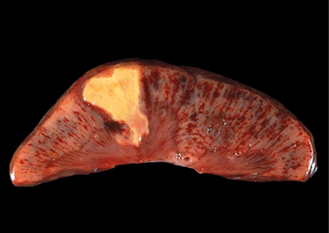
Coagulative necrosis. Show kidney infarct (yellow)

Slide 10
2- Liquefactive necrosis is seen in focal bacterial or, occasionally, fungal infections, because microbes stimulate the accumulation of inflammatory cells and the enzymes of leukocytes digest ("liquefy") the tissue.
For obscure reasons, hypoxic death of cells within the central nervous system evokes liquefactive necrosis . The dead cells are completely digested , transforming the tissue into a liquid viscous mass . Eventually, the digested tissue is removed by phagocytes . If the process was initiated by acute inflammation, the material is frequently creamy yellow and is called pus.

Slide 11
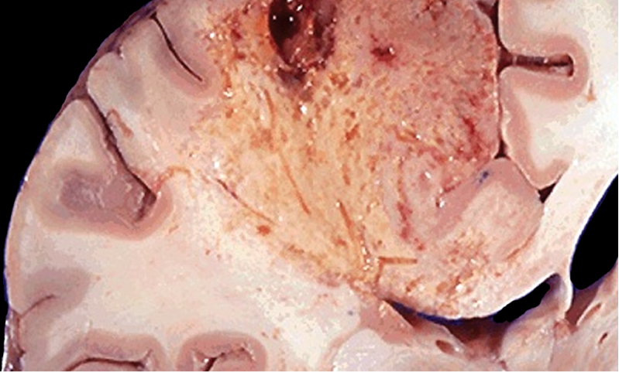
Liquefactive necrosis of the brain

Slide 12
3- Gangrenous necrosis is not a distinctive pattern of cell death, the term is still commonly used in clinical practice. It is usually applied to a limb, generally the lower leg, that has lost its blood supply and has undergone coagulative necrosis involving multiple tissue layers . When bacterial infection is superimposed , coagulative necrosis is modified by the liquefactive action of the bacteria and the attracted leukocytes to (so-called wet gangrene).

Slide 13
4- Caseous necrosis is encountered most often in foci of tuberculous infection. The term "caseous" (cheese-like) is derived from the friable yellow-white appearance of the area of necrosis .On microscopic examination, the necrotic focus appears as a collection of fragmented or lysed cells with an amorphous granular pink appearance.
Unlike coagulative necrosis, the tissue architecture is completely obliterated and cellular outlines cannot be discerned. Caseous necrosis is often enclosed within a distinctive inflammatory border; this appearance is characteristic of a focus of inflammation known as a granuloma.

Slide 14
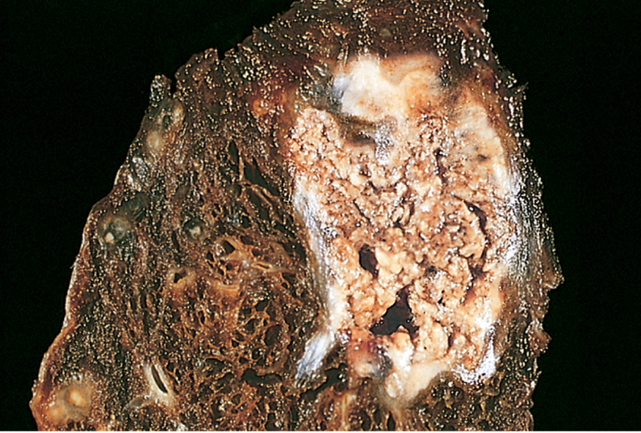
Caseous necrosis. A tuberculous lung with a large area of caseous necrosis containing yellow-white and cheesy debris.

Slide 15
5- Fat necrosis, refers to focal areas of fat destruction, resulting from release of activated pancreatic lipases into the substance of the pancreas and the peritoneal cavity. This occurs in acute pancreatitis .In this disorder , pancreatic enzymes (lipases) that have leaked out of acinar cells and ducts liquefy the membranes of fat cells in the peritoneum, and lipases split the triglyceride esters contained within fat cells. The released fatty acids combine with calcium to produce grossly visible chalky white areas (fat saponification) , which enable the surgeon and the pathologist to identify the lesions . On histologic examination, the foci of necrosis contain shadowy outlines of necrotic fat cells with basophilic calcium deposits, surrounded by an inflammatory reaction.

Slide 16
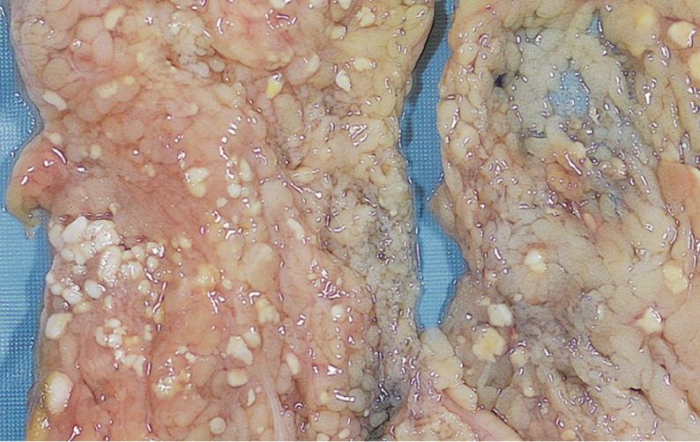
The areas of white chalky deposits represent foci of fat necrosis with calcium soap formation (saponification) in the mesentery.

Slide 17
6- Fibrinoid necrosis is a special form of necrosis usually seen in immune reactions in which complexes of antigens and antibodies are deposited in the walls of arteries. Deposits of these "immune complexes," together with plasma protein (fibrin) that has leaked out of vessels, result in a bright pink and amorphous appearance in H&E stains, called "fibrinoid" (fibrin-like).
this type of necrosis is found in the immunologically mediated diseases (e.g., polyarteritis nodosa) .

Slide 18
2- Apoptosis ( Programmed cell death )
Apoptosis is a pathway of cell death in which cells activate
enzymes that degrade the cells’ own nuclear DNA and nuclear
and cytoplasmic proteins . Fragments of the apoptotic cells then break off, giving the appearance that is responsible for the name (apoptosis, "falling off") . The plasma membrane of the apoptotic cell remains intact, but the membrane is altered in such a way that the cell and its fragments become avid targets for phagocytes. The dead cell is rapidly cleared before its contents have leaked out , for this reason the apoptotic cell death does not elicit an inflammatory reaction in the host. Thus, apoptosis differs from necrosis, which is characterized by loss of membrane integrity, enzymatic digestion of cells, leakage of cellular contents, and frequently a host reaction.

Slide 19
CAUSE OF APOPTOSIS
1- Apoptosis in Physiologic Situations
Apoptosis occurs normally in many situations, and serves to eliminate potentially harmful cells and cells that have outlived their usefulness.
1-The programmed destruction of cells during embryogenesis, Normal development is associated with the death of
some cells and the appearance of new cells and tissues.
2-Involution of hormone-dependent tissues upon hormone deprivation, such as endometrial cell breakdown during the menstrual cycle , and regression of the lactating breast after weaning.
3-Cell loss in proliferating cell populations, such as intestinal crypt epithelia, so as to maintain a constant number.
4-Death of cells that served their useful purpose, such as neutrophils in an acute inflammatory response, and lymphocytes at the end of an immune response.
5-Elimination of potentially harmful self-reactive lymphocytes, either before or after they have completed their maturation, in order to prevent reactions against one's own tissues.
6-Cell death induced by cytotoxic T lymphocytes, a defense mechanism against viruses and tumors these cell s kill and eliminate virus-infected and neoplastic cells.

Slide 20
2-Apoptosis in Pathologic Conditions
when cells are damaged beyond repair, especially when the damage affects the cell's DNA or proteins; in these situations, the irreparably damaged cell is eliminated
1-DNA damage. Radiation, cytotoxic anticancer drugs, extremes of temperature, and even hypoxia can damage DNA, either directly or via production of free radicals. If repair mechanisms cannot cope with the injury, the cell triggers intrinsic mechanisms that induce apoptosis.
2-Accumulation of misfolded proteins lead to apoptotic cell death .
3-Cell injury in certain infections, particularly viral infections, in which loss of infected cells is largely due to apoptotic death that may be induced by the virus.
4-Pathologic atrophy in parenchymal organs after duct obstruction, such as occurs in the pancreas, parotid gland, and kidney.

Slide 21
Mechanisms of Apoptosis
There are two pathways for Apoptosis
1- Mitochondrial pathway: (intrinsic pathway).
2-Death receptor pathway: (extrinsic pathway) .
Both results in activation of caspase which lead to nuclear fragmentation and formation of apoptotic bodies.
Morphology of apoptosis
In H&E-stained tissue sections, apoptotic cells may appear as round or oval masses with intensely eosinophilic cytoplasm . Nuclei show various stages of chromatin condensation and aggregation and, ultimately, karyorrhexis.

Slide 22
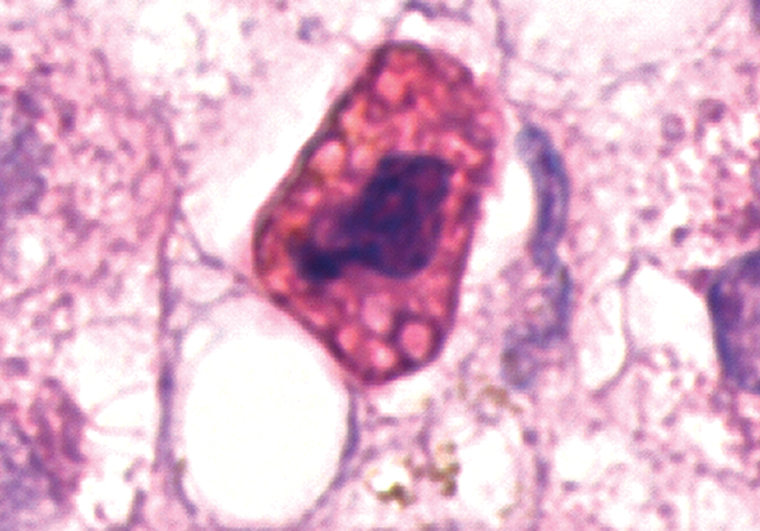

Slide 23
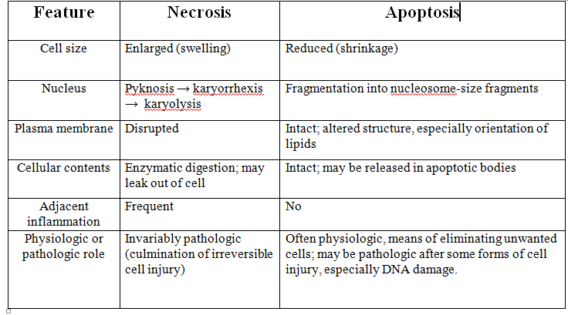

Slide 24
3-Gangrene
Is a form of tissue necrosis superadded with putrefaction . Characterized by liquefaction due to action of putrefactive bacteria.
It may be caused either by ischemia as
A- Gangrene of bowel
B-Gangrene of limb
Or by inflammation which caused by virulent bacteria resulting in massive tissue necrosis as
A-gangrenous appendicitis
B-gangrenous stomatitis

Slide 25
Types of gangrene
1-Dry gangrene
2-Wet gangrene
A-Gas gangrene
1-Dry gangrene
This type of gangrene is begins in the distal part of the limbs and spreads slowly upwards until it reaches a point where the blood supply is adequate to keep the tissue viable.
A line of separation is formed at the point between gangrenous part and viable part.

Slide 26
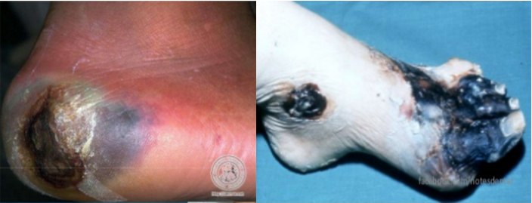

Slide 27
Morphology
- Grossly
The affected part is dry ; shrunken ; and dark black . its black color is due to liberation of hemoglobin from haemolysed red blood cells which combined hydrogen disulfide produced by bacteria result in formation of black iron sulfide .
- Microscopic
-The necrosis with smudging of the tissue.
- the line of separation consist of inflammatory granulation tissue.

Slide 28
2-Wet gangrene
Occur in naturally wet tissues such as mouth ; bowel; cervix; and vulva. Its develop rapidly due to blockage of venous and less commonly arterial blood flow by thrombosis and embolism. The affected part is stuffed with blood which favours the rapid growth of putrefactive bacteria. The toxic products formed by bacteria are absorbed causing systemic manifestation of septicemia and finally death.

Slide 29
Morphology
- Grossly
The affected part is soft ; swollen ; putrid;rotten; and dark such as gangrene of bowel due to strangulated hernia , volvulus , and intussuscepion. The part is dark due to the same mechanism in dry gangrene.

Slide 31
Microscopically
- coagulative necrosis with stuffing of affected part with blood.
- there is ulceration of the mucosa and inflammatory infiltration.
- the lumen of bowel contains mucus and blood.
-the line between gangrenous segment and viable bowel is generally not clear .

Slide 32
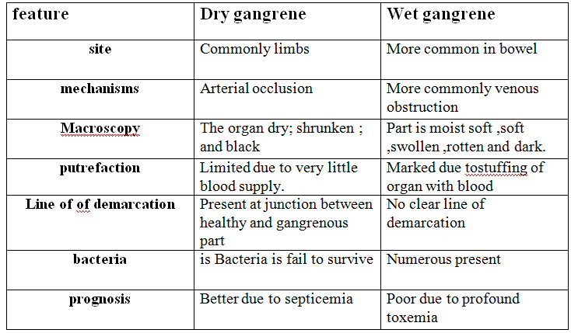

Slide 33
A- Gas gangrene
Is special form of wet gangrene caused by gas forming gram positive anaeropic bacteria such as clostridia which enter in to the tissue through contaminated wounds as in muscles or complications after operation .
Morphology
-Grossly
-The affected area is swollen ,edematous, painful ,and crepitate due to accumulation of gas bubbles within the tissue.
- subsequently, the affected tissue becomes dark black and foul smelling.
Microscopic
- muscle fibers undergo coagulative necrosis and liquefaction.
- large number of gram positive bacilli can be identified .
- a zone of leuckocytes infiltration , edema , congestion are found.

Slide 34
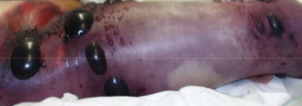

Slide 35
Pathological Calcification
It is abnormal deposition of calcium salts, together with smaller amounts of iron, magnesium, and other minerals in any tissue except bones and teeth.
There are two distinct types of Pathological calcification:-
1- Dystrophic calcification
Characterized by deposition of calcium salts in dead or degenerated tissues with normal calcium metabolism and normal serum calcium levels.
Dystrophic calcification is encountered in areas of necrosis of any type . It is visible in advanced atherosclerosis, associated with intimal injury in the aorta and large arteries and characterized by accumulation of lipids. Although dystrophic calcification may be an incidental finding indicating past cell injury, it may also be a cause of organ dysfunction. For example, calcification can develop in aging or damaged heart valves, resulting in severely compromised valve motion. Dystrophic calcification of the aortic valves is an important cause of aortic stenosis in the elderly persons.

Slide 36
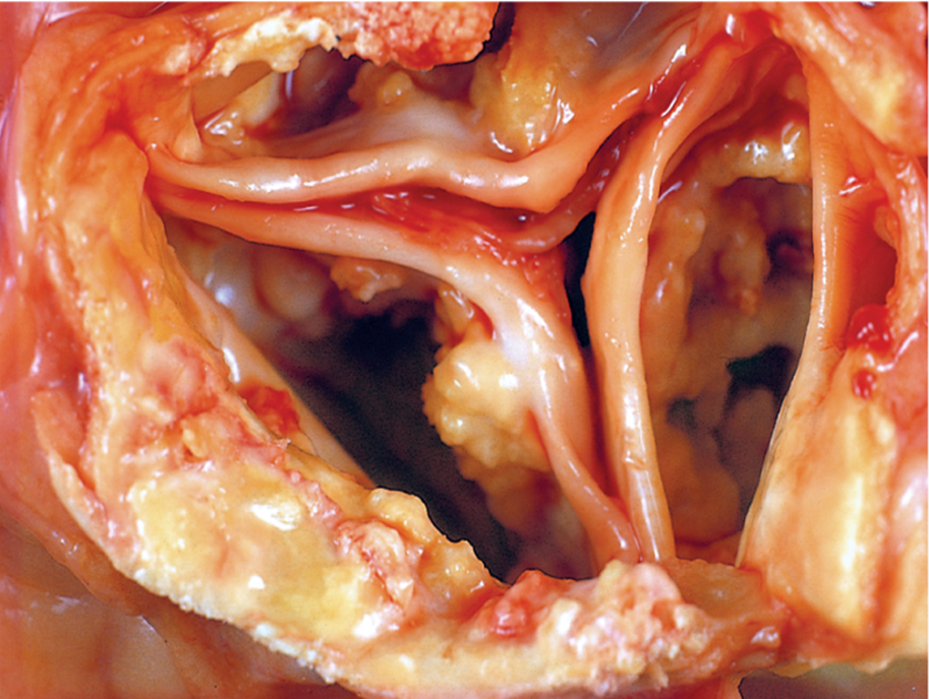
Calcification of the aortic valve. the unopened aortic valve in a heart with calcific aortic stenosis. The semilunar cusps are thickened and fibrotic. Behind each cusp are large, irregular masses of dystrophic calcification that will prevent normal opening of the cusps

Slide 37
pathogenesis of dystrophic calcification
The pathogenesis of dystrophic calcification involves initiation and propagation, both of which may be either intracellular or extracellular . The end product is the formation of crystalline calcium phosphate which formed by reaction of phosphate ions with calcium ions.
Its involves two steps:-
1- Initiation
- Initiation in extracellular sites occurs in membrane-bound vesicles. calcium is initially concentrated in these vesicles by its affinity for membrane phospholipids, while phosphates accumulate as a result of the action of membrane-bound phosphatases .
- Initiation of intracellular calcification occurs in the mitochondria of dead cells that have lost their ability to regulate intracellular calcium.
2- Propagation
After initiation in either location, propagation of crystal formation occurs.

Slide 38
2- Metastatic calcification
Characterized by deposition of calcium salts in normal tissues due to defect in calcium metabolism (hypercalcemia)
The four major causes of hypercalcemia are
(1) increased secretion of parathyroid hormone, due to either primary parathyroid tumors or production of parathyroid hormone-related protein by other malignant tumors.
(2) destruction of bone due to the effects of accelerated turnover (e.g., Paget disease), immobilization, or tumors (increased bone catabolism associated with multiple myeloma, leukemia).
(3) Vitamin D-related disorders including vitamin D intoxication and sarcoidosis.
(4) renal failure, in which phosphate retention leads to secondary hyperparathyroidism

