Slide 1
Cholesterol and Cholesteryl Esters Cellular cholesterol metabolism is tightly regulated to synthesis of normal cell membrane without significant intracellular accumulation. phagocytic cells (macrophages ) may become overloaded with lipid (cholesterol,and cholesteryl esters) in several different pathologic processes. Atherosclerosis is the most important example for this change .

Slide 2
Hyaline change
Is histological or cytological alterations characterized by glassy homogeneous material appear as eosinophilic in H&E staining section . It may be intracellular or extracellular .
Intracellular hyaline change
- mainly seen in epithelial cells e.g
1- Hyaline droplets in proximal convoluted epithelial cells in case of excessive re absorption of plasma protein.
2- Hyaline degeneration of rectus abdomenalis muscle called Zenker s degeneration , occurring in typhoid fever

Slide 3
3-Mallory s hyaline is aggregates of intermediate filaments in the hepatocytes in case of alcoholic liver
4- Russell s bodies excessive accumulation of immunoglobulin's in plasma cells.

Slide 4
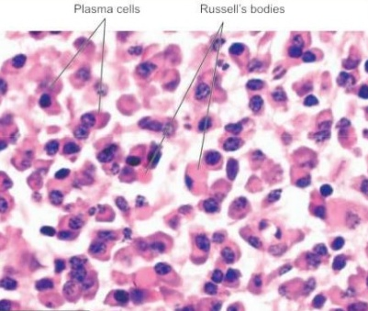
Intracellular hyaline as Russell s bodies in cytoplasm of plasma cells

Slide 5
Extracellular hyaline is seen in connective tissues.
Examples of extracellular hyaline change as :-
1- Hyaline degeneration in leiomyomas of the uterus.
2- Hyalinised old scar of fibro- collagenous tissues.
3- Hyalinised glomeruli in chronic glomerulonephritis.
4- Hyaline arteriosclerosis in renal vessels in hypertension and diabetes mellitus.

Slide 6
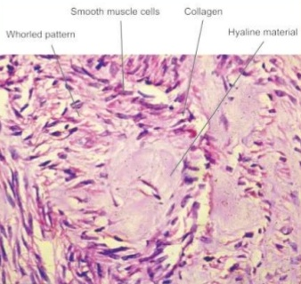
Extracellular hyaline deposit in leiomyoma uterus

Slide 7
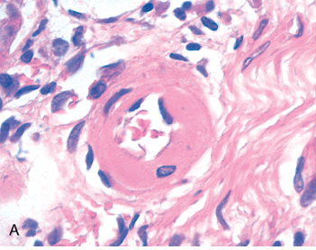
Hyaline arteriolosclerosis. The arteriolar wall is hyalinized and the lumen is markedly narrowed

Slide 8
Mucoid degeneration
There is a change characterized by accumulation of mucin in intracellular and extracellular loci.
Mucin is a glycoprotein secreted by mucous glands .
Epithelial mucin examples
1- Catarrhal inflammation of mucous membrane of respiratory tract ;alimentary tract ;and uterus .
2- Obsruction of duct leading to mucocele in the oral cavity .
of ovary ; stomach ;and large bowel. tumor Secreting 3- mucin
4- fibrosis of the pancreas .

Slide 9
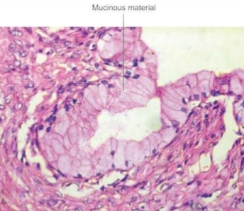
intra cytoplasmic Mucinous material in epithelial cell of ovary

Slide 10
Connective tissue mucin
Examples of disturbance of connective tissue
mucine :-
1- mucoid degeneration in some tumours e.g. myxomas ; neurofibroma; fibroadenoma; and soft tissue sarcoma.
2- dissecting aneurysm of the aorta.
3- myxomatous change in the dermis.

Slide 11
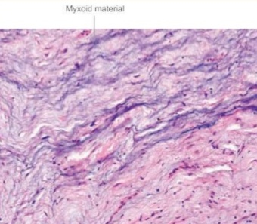
Myxoid change in neurofibroma

Slide 12
Amyloid degeneration
Amyloidosis results from abnormal folding of proteins , which are deposited as fibrils in extracellular tissues and disrupt normal function due to inherited and inflammatory disorders .
Pathogenesis Normally, misfolded proteins are degraded intracellularly in proteasomes, or extracellularly by macrophages.
In amyloidosis, these quality control mechanisms fail, allowing the misfolded protein to accumulate outside cells. Misfolded proteins often are unstable , ultimately leading to the formation of fibrils that are deposited in tissues. .

Slide 13
Schematic diagram of an amyloid fiber showing fibrils (4 shown, may be up to 6)

Slide 14
Classification of amyloidosis
A- based on cause
1- primary
2- secondary
B- based on extent of amyloidosis
1- generalized involving multiple organs
2- localized involve one or two organs or sites
C-based on clinical location
1- pattern I involving tongue ;heart bowel ; skeletal muscle ; skin and nerve
2- pattern II involving liver; spleen ;kidney ; and
adrenals.
3- mixed pattern involved of both pattern I and II.

Slide 15
D- based on tissue in which amyloid is deposited
1- mesenchymal organs derived from mesoderm.
2- parenchymal organs derived from ectoderm and endoderm .
E- based on precursor biochemical protein in to spicific serum amyloid protein.

Slide 16
Morphologic feature of amyloidosis
-Grossly
1- the affected organ enlarged ;pale ; and rubbery.
2- cut surface show firm ;waxy ; and translucent parenchyma.
- Microscopically
1- the deposits of amyloid are found in extracellulr locations initially in the wall of small blood vessels.
2- the deposits are in large amount causing microscopic changes and effects of pressure atrophy .

Slide 17
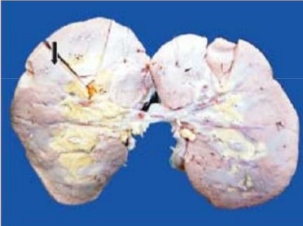
Amyloidosis of kidneys shows small ;pale ; waxy kidneys

Slide 18
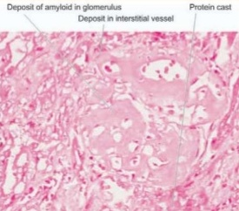
Amyloid deposits are seen in glomerular capillry tuft and in peri tubular connective tissue cause atrophy of tubules of kidney

Slide 19
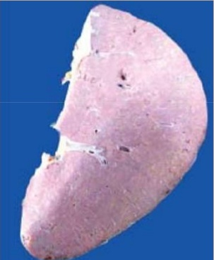
The spleen appear as pale and waxy appearance

Slide 20
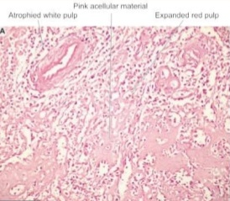
Amyloid material seen in red pulp causing atrophy of white pulp

Slide 21
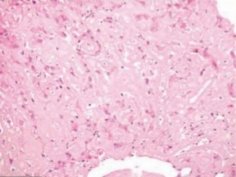
Amyloid deposits cause pressure atrophy of hepatocytes

Slide 22
Pathologic pigments
Pigments are colored substances that are either
exogenous, coming from outside the body , such as carbon or endogenous, synthesized within the body itself.
Endogenous pigments include lipofuscin , melanin , and certain derivatives of hemoglobin.
1-Lipofuscin, or "wear-and-tear pigment," is an insoluble brownish-yellow granular intracellular material that accumulates in a variety of tissues (particularly the heart, liver, and brain) as a function of age or atrophy .

Slide 23
2-Melanin is, brown-black pigment that is synthesized by melanocytes located in the epidermis and acts as a screen against harmful ultraviolet radiation.
Although melanocytes are the only source of melanin, adjacent basal keratinocytes in the skin can accumulate the pigment (e.g., in freckles).
3- Hemosiderin is a hemoglobin-derived granular pigment that is golden yellow to brown and accumulates in tissues when there is a local or After lysis of the erythrocytes at the site of hemorrhage, the red cell debris is phagocytosed by macrophages; the hemoglobin content is then catabolized by lysosomes with accumulation of the heme iron in hemosiderin.

Slide 24
exogenous pigment
The most common exogenous pigment is
1- inhaled pigments :-
A- pneumoconiosis:- asbestos fibers and silica dusts.
B-anthracosis deposition of coal.
2- injected pigments (tattooing ):-
Indian ink and carbon deposit in dermis.

