Slide 1
Patient evaluation, diagnosis and treatment plaaning

Slide 2
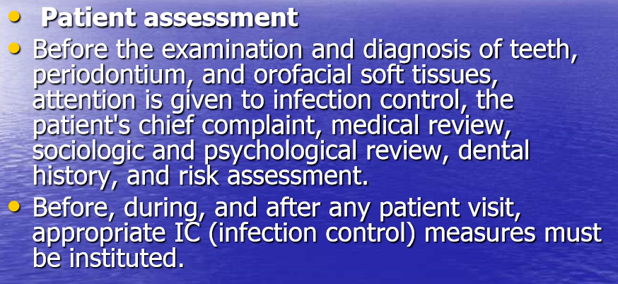

Slide 3
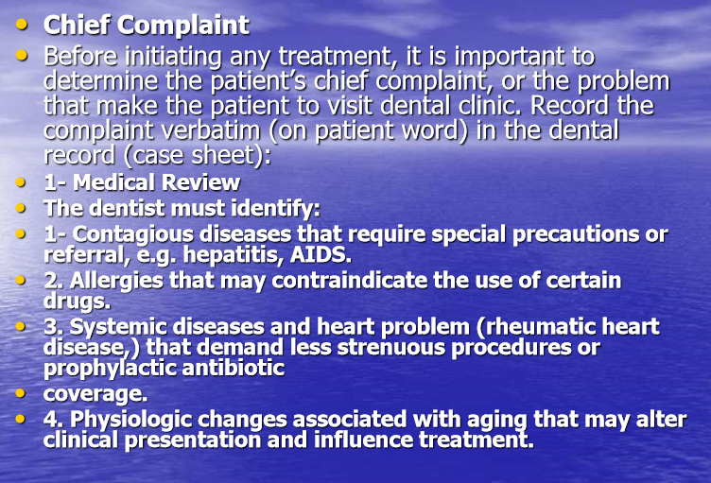

Slide 4
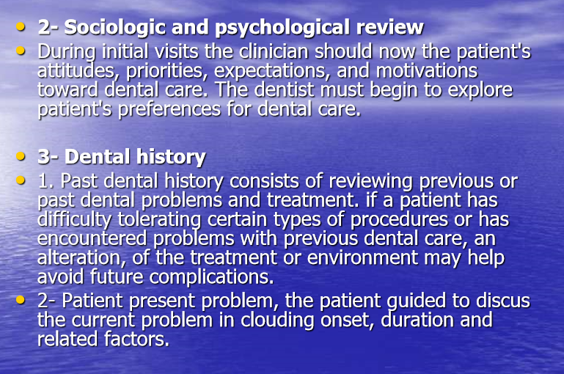

Slide 5
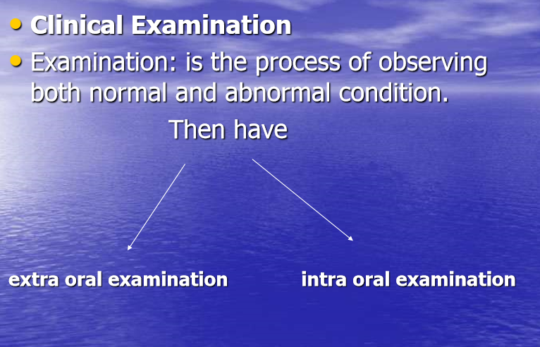

Slide 6
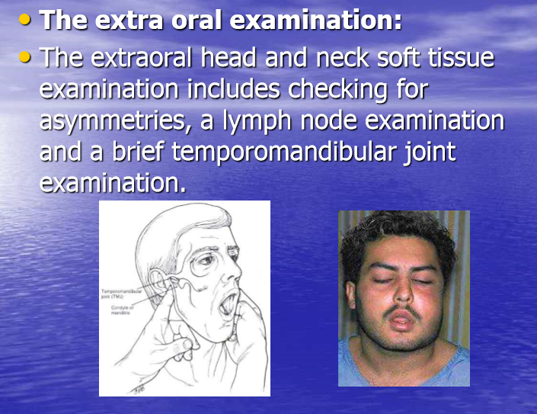

Slide 7
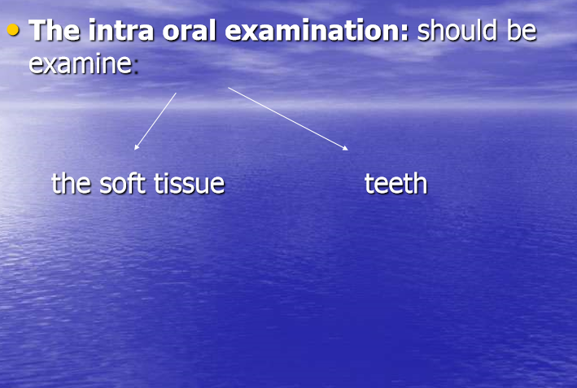

Slide 8
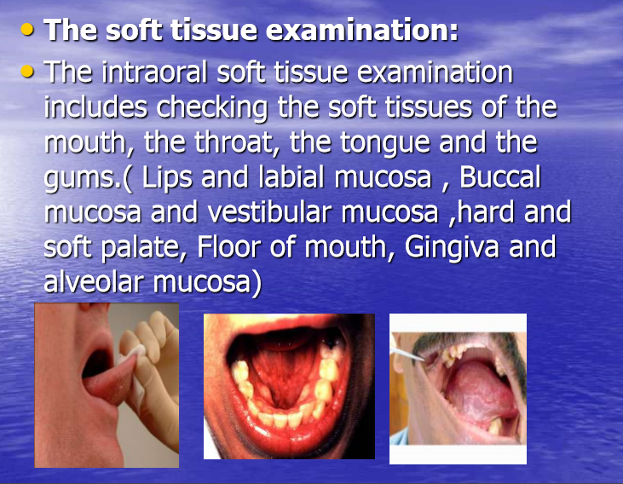

Slide 9
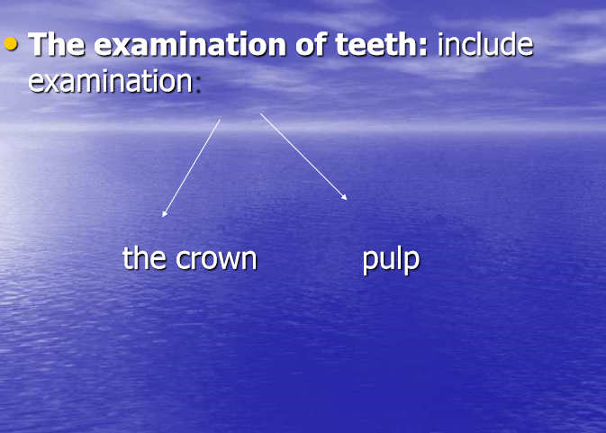

Slide 10
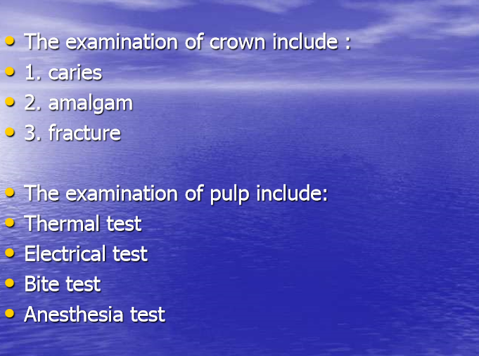

Slide 11
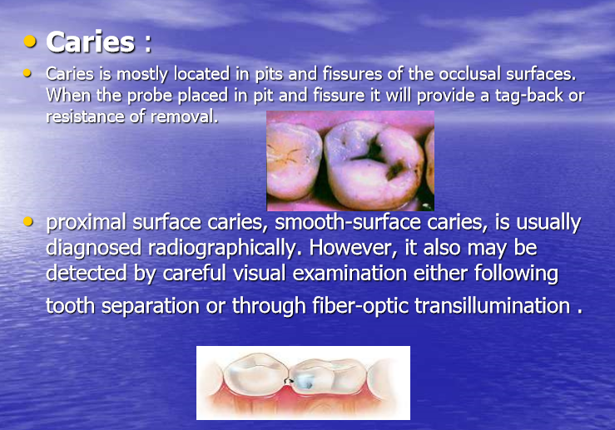

Slide 12
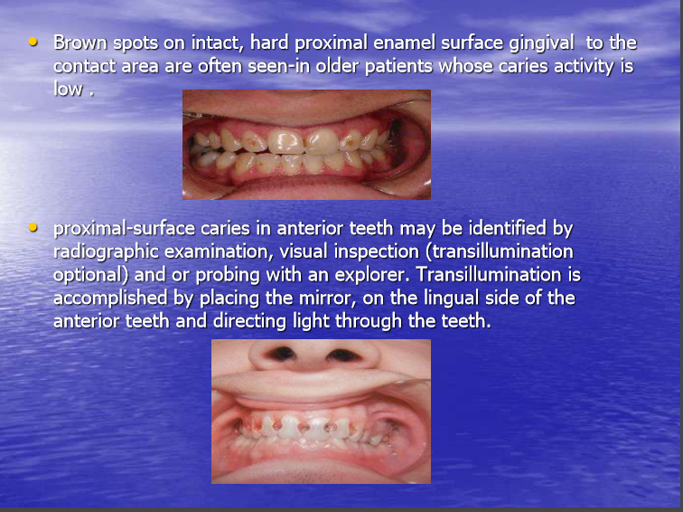

Slide 13
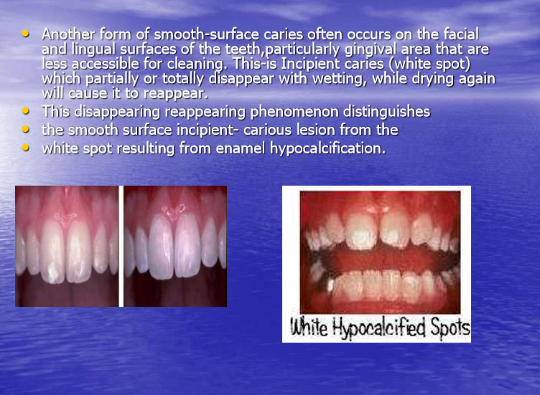

Slide 14
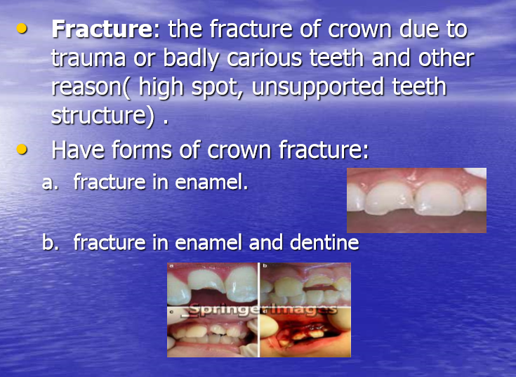

Slide 15
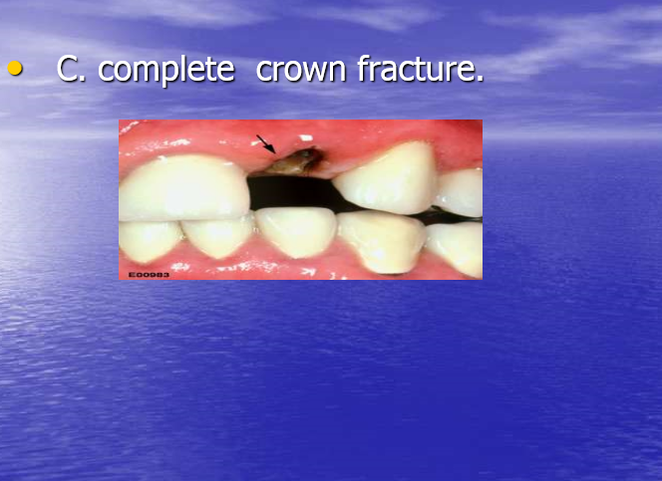

Slide 16
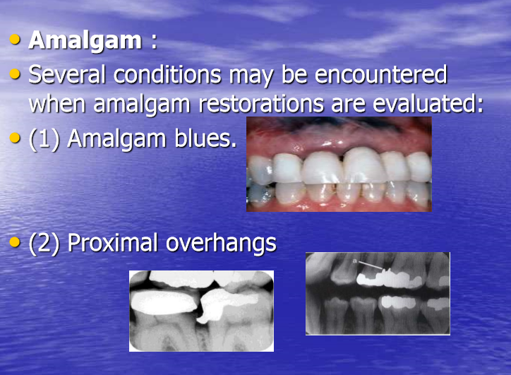

Slide 17
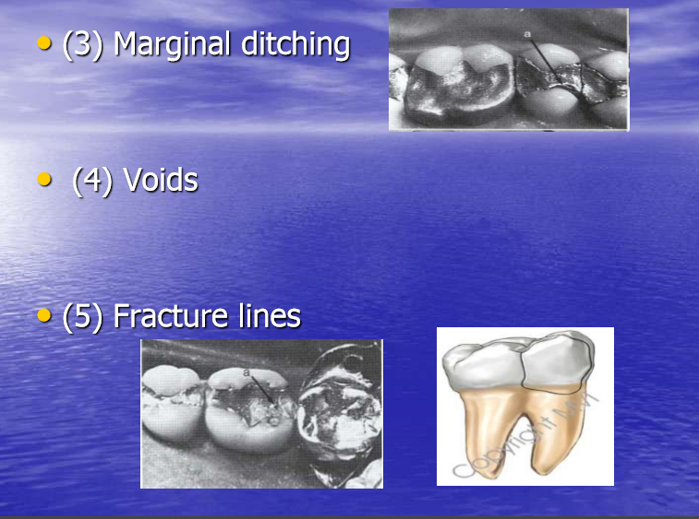

Slide 18
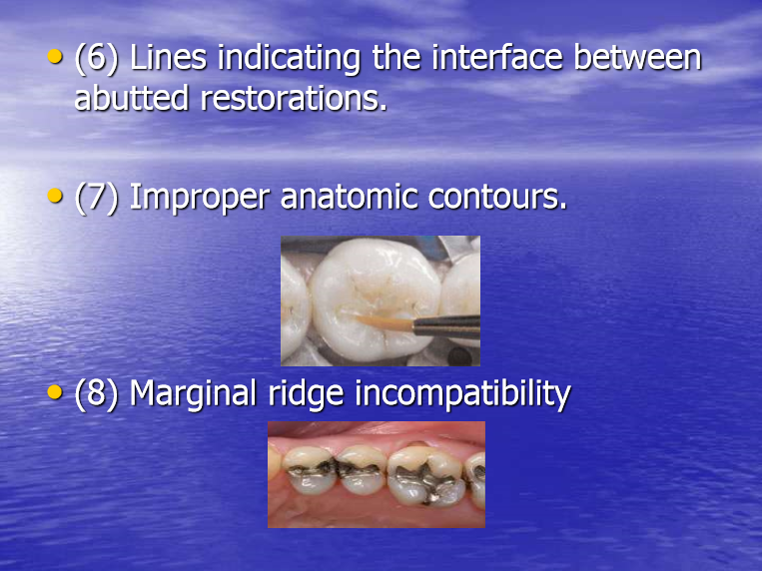

Slide 19
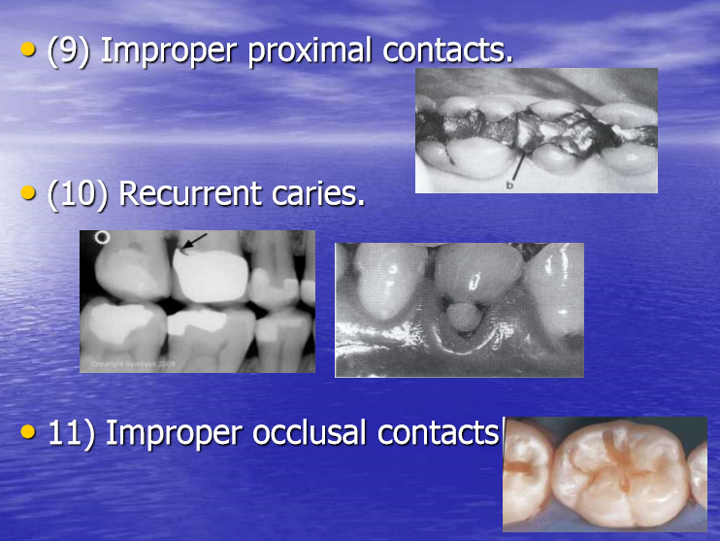

Slide 20
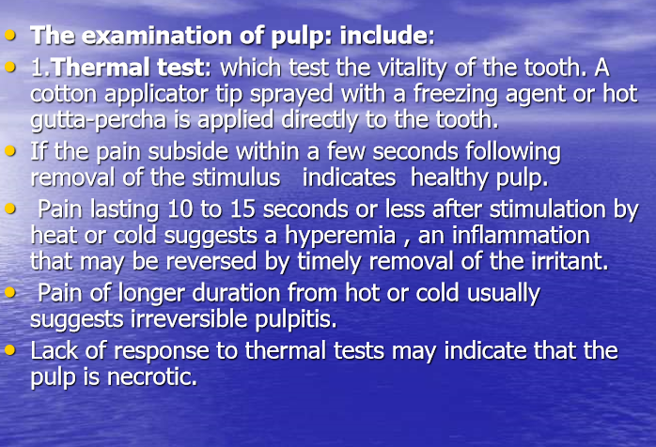

Slide 21
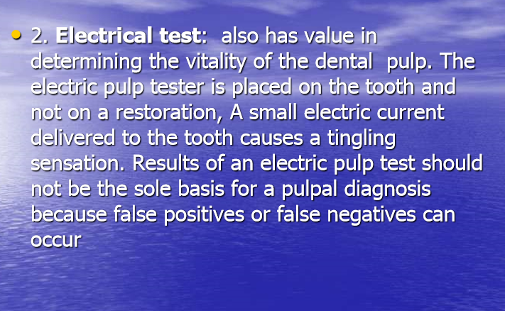

Slide 22
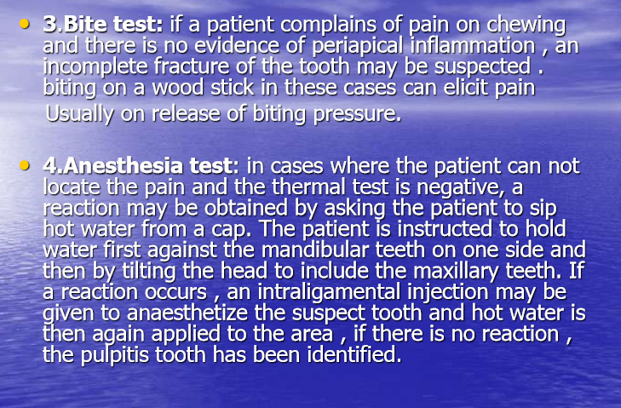

Slide 23
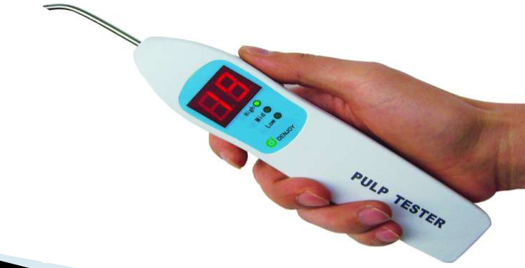

Slide 24
Treatment plan
Dentist lists the problem related to restorative dentistry so treatment plan depend on four factors:
*Amount and form of remaining tooth structure.
*functional need of each tooth.
Esthetic needs of each tooth.
* Final objective of overall treatment plan.

Slide 25
Treatment sequence
The following consideration should be taken:
*severity of disease process (the most symptomatic tooth, tooth with deepest lesion or the most debilitated tooth is restored).
*Esthetic needs.
*effective use of time.
So treatment done in area of most acute need of restoration and complete quadrant by quadrant.

